Slide 1

Software Engineering OOP Tools of the Trade

Slide 2
Topics
Practice Problem
OOP Analysis Review
WindowBuilder
Notes:
First of all, what is a plugin? These are development tools and Most IDEs, such as Eclipse, are extensible through the use of plug-ins.
The first topic of this video aims to provide an explanation of plugins, in general.
The second topic looks at Eclipse’s MarketPlace and how to acquire plugins.
In the last topic, I will demo the plugin windowbuilder, which you will be using in your first assignment for the course.
So, let’s get started.

Slide 3
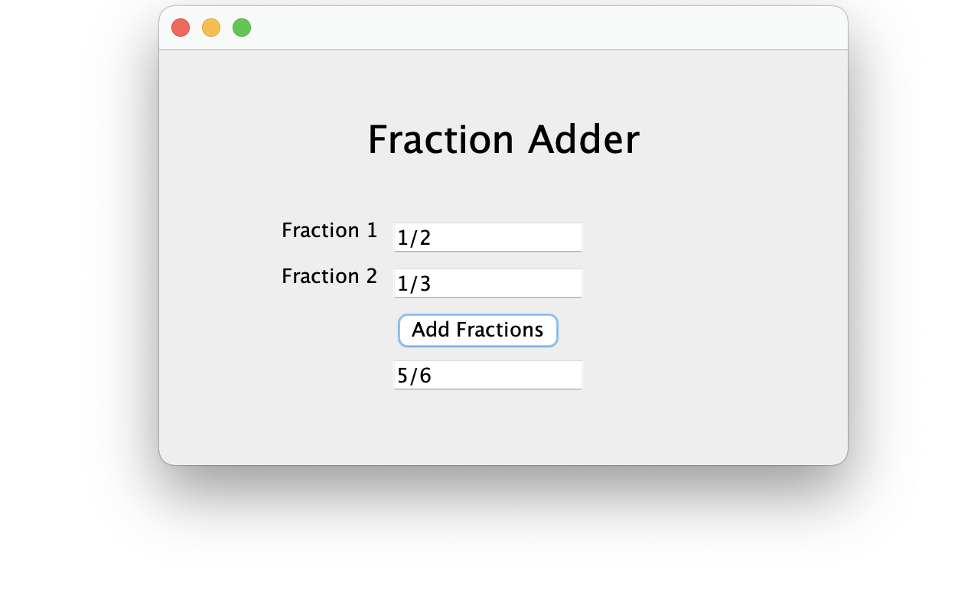
Create a GUI app.

Slide 4
OOP Review
OOP is Object-Oriented Programming.
OOP provides a natural way to divide an application into small reusable pieces, called objects.
A class is a blueprint that defines objects of a certain kind.

Slide 5
Quiz
Name the classes used for this application.

Slide 6
Quiz
Name the classes used for this application.
MyMain
(User interface)
Fraction

Slide 7
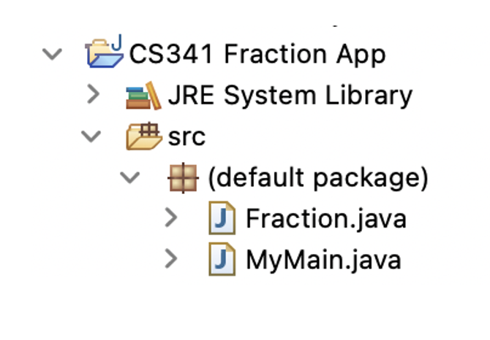
Structure for this App

Slide 8

Design the Fraction Class
Data members
Constructor(s)
Setters & Getters
Additional functionality
Data is private
Implementation is hidden
Notes:
TIP
Data is private
Implementation is hidden

Slide 9
Fraction Class
private Integer num
private Integer den
Data Members
public Fraction(String str)
Constructor
public Integer getDen()
public Integer getNum()
Getters
public String toString()
public void add (Fraction f)
public void reduce()
public Integer getGCD(Integer x, Integer y)
Functionality
Notes:
TIP
Data is private
Implementation is hidden

Slide 10
Creating a launch icon for an application
Running a Java app from command prompt or from IDE is only practical for programmers.
Always create a Desktop icon to launch a Java GUI App.
Use a “runnable JAR” file.

Slide 11
What is a Runnable JAR File
JAR is an acronym that stands for Java Archive.
A JAR is a packaged file that contains all the files that makeup a project. This includes the compressed versions of .class files, audio files, image files or directories.
The runnable jar contains a MANIFEST.MF file, which defines the Main class to be executed when the JAR is run. ... With a runnable JAR, there is a manifest file that will hold that information so you can just type java -jar myRunnable.jar , or simply double click it.
The .class files contain compiled Java code, which is executable by the Java Virtual Machine.

Slide 12
Creating a Runnable JAR File
Step 1:
Implement and test the GUI application.
Step 2:
Export as a Java -> Runnable JAR file.
Right-click the application and choose Export from the drop-down menu.

