Slide 1
PHP – Useful Tips

Slide 2
Topics
PHP arrays
PHP file()
PHP shuffle()
Using a single HTML document to house multiple pages
Connecting JavaScript with PHP

Slide 3
PHP Arrays
Use $ to give an array an identifier name – same as for other variables.
Add the keyword ‘array’ after the equal sign.
$fruit = array (”apple”, ”banana”, “orange”);

Slide 4
PHP file()
file() is used to read a file into an array.
$myfruit = file('fruit.txt');
A URL can be used as a file name.
$myfruit = file('http://www.fruit.com/');

Slide 5
Constructing a single HTML document that contains multiple ”pages”
Multiple “pages” can be loaded together in a single HTML document.
Multiple loads occurs by stacking multiple divs with a data-role of “page”
Each “page” block needs a unique id.
Multiple page loading is useful for logins.

Slide 6
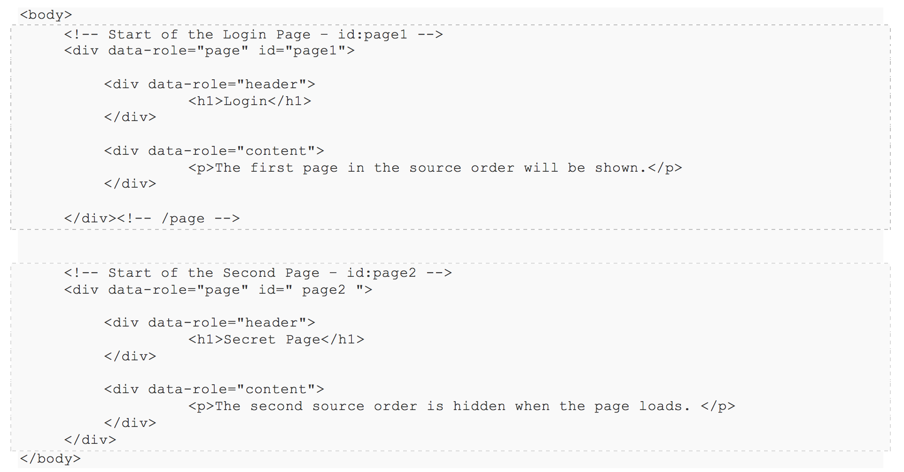
Multiple ”pages”
This documents contains id= “page1” and id=”page2”.
Each page can be displayed separately by JavaScript.
The second page is activated with:
window.location = “#page2”;

Slide 7
Connecting JavaScript with PHP
XMLHttpRequest is used by JavaScript to interact with PHP files on a server.
Data is passed from PHP to JavaScript.
Query strings (parameters) can be passed to the PHP file.
var myXMLRequest = new XMLHttpRequest();
myXMLRequest.onload = displayPHPresults;
myXMLRequest.open("PUT", "code.php?q=" + param, true);
myXMLRequest.send();

Slide 8
Practice with Lab 10

