Slide 1
Essentials of Web Pages

Slide 2
Topics
Static vs. Dynamic Web Pages
Common HTML Tags
Add comments to HTML documents
Validate HTML Web Pages
Video

Slide 3
What is a Static Web Page
A static web page is a web page that doesn’t change each time it is requested.
A static web page is sent directly from the web server to the web browser when the browser requests it.
You can spot a static page by looking at the extension. If it is .html, it is a static web page.

Slide 4
Process for Accessing a Static Web Page
A local computer (a client) requests a web page in a browser.
The web browser builds a request for the web page and sends it to the web server. This request, known as an HTTP request, is formatted using the HyperText Transfer Protocol, which lets the web server know which file is being requested.
When the web server receives the HTTP request, it retrieves the requested file from the disk drive. This file contains the HTML for the requested page. The web server sends the file back to the browser as part of the HTTP response.
Once the browser receives the HTTP response, it translates the HTML into a web page that is displayed in the browser.

Slide 5
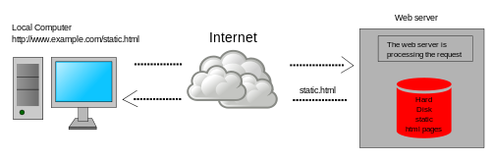
Visual of the Static Web Page Process

Slide 6
Dynamic Web Pages
A dynamic web page is created by a program or script each time it is requested.
When a web server receives a dynamic request, it looks up the extension of the requested file. This could be Java (.jsp), PHP (.php), Python (.py), and so on.
Once the application server has identified the specified script, it processes the request. This often requires collecting data from a database server.
When the application Server finishes processes the dynamic request, it generates the HTML for a web page and returns it to the web server.
The web server returns the HTML to the web browser as part of the HTTP response, where it is displayed

Slide 7
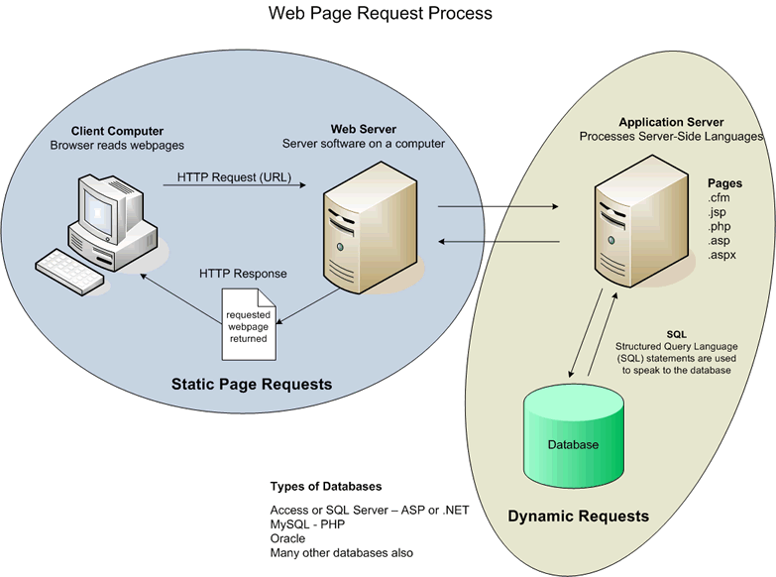
Visual of the Dynamic Web Page Process

Slide 8
Static Web Pages are built at the front end.
Front-end web development involves the construction of HTML, CSS and JavaScript for a website or Web Application so that a user can see and interact with them directly.
Dynamic Web Pages are built at the back end.
Back-end web development consists of a server, an application, and a database.

Slide 9
Common HTML Tags

Slide 10
<p> </p> Enclose paragraphs
<br /> Add a line break
<hr /> Adds a horizontal line
<pre> </pre>
<h1></h1>
<h2> </h2>
<h3> </h3>
<h4></h4>
<h5></h5>
<blockquote>
<i> </i>
<b> </b>
<em> </em> Emphasized - looks similar to italics
<strong> </strong> looks similar to bold
<code> </code>
<sup> </sup> Adds a superscript
<sub> </sub> Adds a subscript
<a href>

Slide 11
<dl> A description List
<dt> A data term
<dd> A data definition
<table>
<tr>
<th>
<td>
<figure></figure>
<img src>
<figcaption> </figcaption> NOTE: Place the image and caption inside figure.
<div> </div>
<ul> </ul>
<ol> </ol>
<li> </li>

Slide 12
Commenting HTML Code
<!-- This is a comment -->

Slide 13
Do’s and Don’ts for Commenting HTML
Use comments to briefly identify segments of your HTML code.
Don’t comment every block of code. Commenting should be placed only where something may not be completely clear.

Slide 14
Why is the Validation of a Web Page Important?
Validation will ensure that each page will be interpreted correctly and consistently across all the various browsers and devices.
Validations provides confirmation to developers that they are conforming to standards and regulations that make a website universally consistent.

Slide 15
Where do I validate a webpage or CSS page?
Validate HTML files at http://validator.w3.org/
CSS files can be validated at http://jigsaw.w3.org/css-validator

Slide 16
Practice

Slide 17
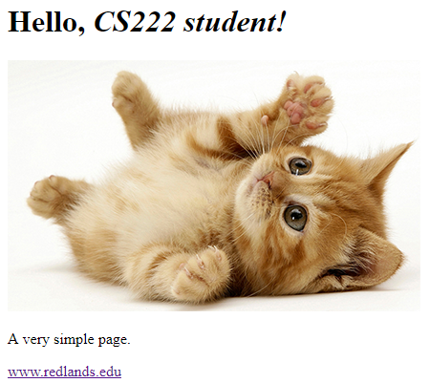
Build the Web Page.
Start by creating a directory for the page.
Add a directory for the image.
Use a text editor to enter the HTML.

Slide 18
<html>
<head>
<title>A Simple Webpage</title>
</head>
<body>
<h1>Hello, <em>CS222 student!</em></h1>
<div>
<img src="./images/kitten.png">
<p>A very simple page.</p>
<a href="http://www.redlands.edu">www.redlands.edu</a>
</div>
</body>
</html>
Source Code

Slide 19
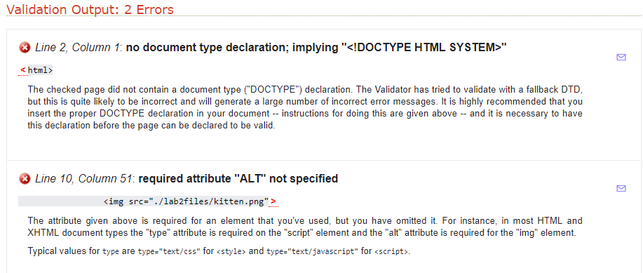

Slide 20
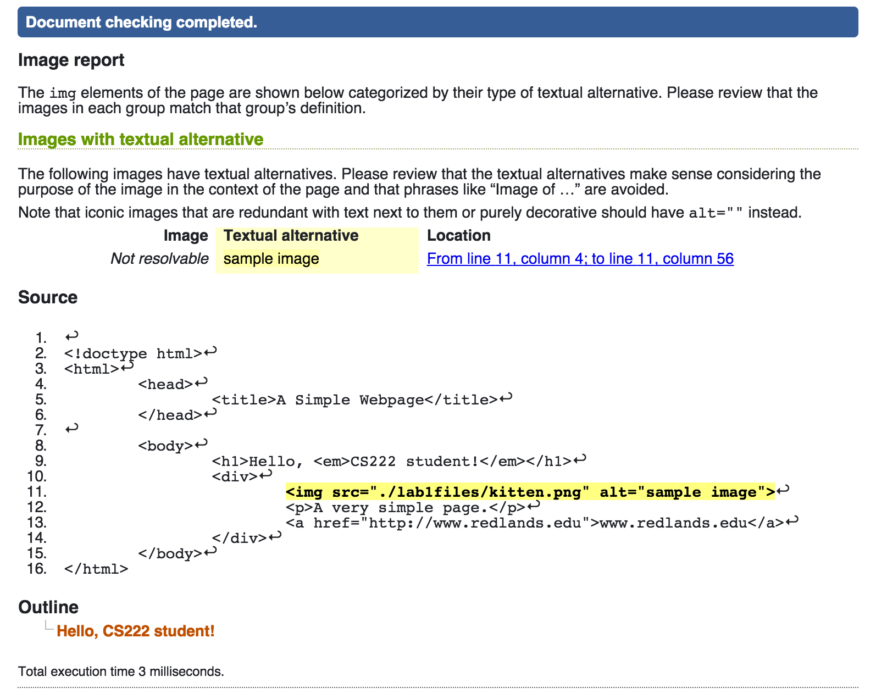
Specify a document type.
Image elements should use a textual alternative.

Slide 21
<!doctype html>
<html>
<head>
<title>A Simple Webpage</title>
</head>
<body>
<h1>Hello, <em>CS222 student!</em></h1>
<div>
<img src="./images/kitten.png" alt="sample image">
<p>A very simple page.</p>
<a href="http://www.redlands.edu">www.redlands.edu</a>
</div>
</body>
</html>
Corrected
Source Code

Slide 22
Video
Before HTML5, there was no standard for showing videos on a web page.
Videos could only be played with a plug-in (such as flash).
With the advent of HTML5, a new tag was added: <video>
<video> specifies a standard way to embed a video in a web page.

Slide 23
The <video> tag
The <video> tag defines a single video or media resource, such as a movie clip or other video streams.
In the following example, a single video is embedded on your page. It will show the basic controls so that a user can play, pause, or otherwise control the video:
<video src="video.webm" controls></video>

Slide 24
Using the <source> tag with <video>
The <source> tag defines multiple media resources for media elements, such as <video> and <audio>
You can specify multiple source files using the <source> tag.
Multiple formats can be used as a fallback in case the user’s browser doesn’t support one of them.
The browser parses the <source> tag, and decides which file to download and play.

Slide 25
Example of <source> and <video>
<video width="320" height="240" controls>
<source src=http://techslides.com/demos/sample-videos/small.webm type=video/webm>
<source src=http://techslides.com/demos/sample-videos/small.ogv type=video/ogg>
<source src=http://techslides.com/demos/sample-videos/small.mp4 type=video/mp4>
<source src=http://techslides.com/demos/sample-videos/small.3gp type=video/3gp>
Your browser does not support the video tag.
</video>

Slide 26
Supported Video formats
Browser | MP4 | WebM | Ogg
Internet Explorer | YES | NO | NO
Chrome | YES | YES | YES
Firefox | YES from Firefox 21 from Firefox 30 for Linux | YES | YES
Safari | YES | NO | NO
Opera | YES From Opera 25 | YES | YES

Slide 27
Additional Video Attributes
autoplay | autoplay | Specifies that the video will start playing as soon as it is ready
controls | controls | Specifies that video controls should be displayed (such as a play/pause button etc).
height | pixels | Sets the height of the video player
loop | loop | Specifies that the video will start over again, every time it is finished
src | URL | Specifies the URL of the video file
width | Pixels | Sets the width of the video player

