Slide 1
PHP and Forms

Slide 2
Topics
How PHP works
WAMP and MAMP
PHP and Forms
POST and Get
Practice

Slide 3
How PHP works
PHP is typically used in combination with a Web server like Apache.
Requests for PHP scripts are received by the Web server
Instructions are then handled by the PHP interpreter.
The results obtained after execution are returned to the Web server, which takes care of transmitting them to the client browser.

Slide 4
What is WAMP or MAMP?
PHP runs on a web server. This means that testing is more time consuming due to upload requirements.
WAMP and MAMP represent local servers with Apache, MySQL, and PHP bundled together.
WAMP – Windows
MAMP - Mac
WAMP and MAMP describe a fully functioning local servers used for developing dynamic Internet PHP web sites.

Slide 5
Place MAMP or WAMP on your computer!

Slide 6
MAMP Notes
MAMP will NOT work if the MAMP folder is not located in the Applications directory.
By default, Apache runs on Port 8888 and MySQL on Port 8889. It’s best not to change the port, but you can.
By default, PHP and HTML Pages should be stored inside the MAMP "htdocs" folder which is located in the MAMP Application directory /Applications/MAMP.

Slide 7
WAMP Notes
A www directory will be automatically created (usually c:\wamp\www)
Create a subdirectory in www and put your PHP files inside.
Click on the “localhost” link in the WampSever menu or open your internet browser and go to the URL : http://localhost

Slide 8
Forms
HTML forms are used to collect user input.
PHP script can easily process user input and performs calculations based on user forms.

Slide 9
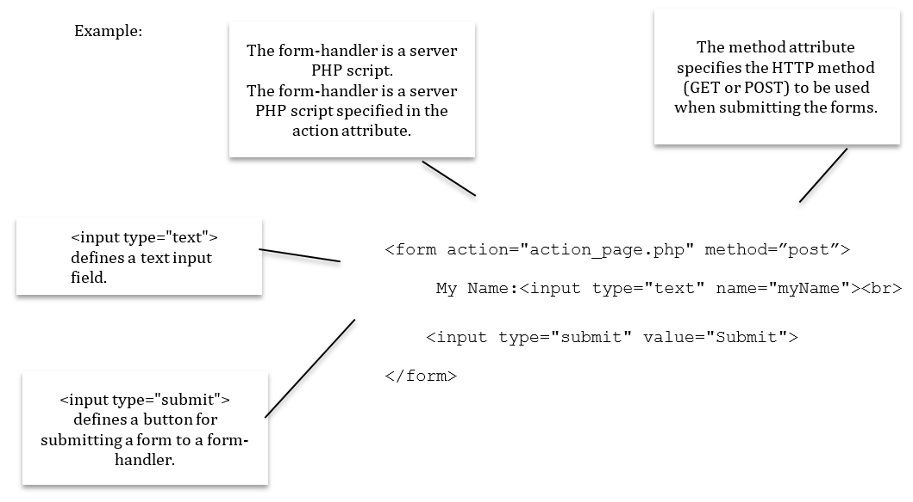

Slide 10
POST and GET
POST and GET are two HTTP request methods.
POST and GET are important to PHP because they are intended to retrieve data.
What are the differences?
GET is the default. It has limitations because it can only send small amounts of parameter data to the server. GET requests are often cached by default by some browsers. This means that data will be visible in the HTTP request address. It’s not secure.
POST is intended for changing the server state. This is the one we will always use. It’s secure, it carries more data, and is flexible (repeating the query is allowed (and often expected) to have side-effects such as creating two messages instead of one.)

Slide 11
Practice with Lab 9

