Slide 1
PHP and JSON
Topics
Review
JSON

Slide 2
Reading a file in PHP
file_get_contents() :Using this function will return the contents of a given file as a single string.
file() : Reads an entire file into an array. Each cell contains a string of text (paragraph).
Writing to a file in PHP
file_put_contents() :Using this function will write the contents of a string to a given file.
<?php $file = ‘players.txt'; $current = file_get_contents($file); $current .= “Bobo\n"; file_put_contents($file, $current); ?>

Slide 3
PHP: array()
array() : used to create an array
Example:
<?php
$my_array = array("Dog","Cat","Horse");
?>

Slide 4
PHP: list()
list(): used to assign a list of variables in one operation.
Example:
<?php
$my_array = array("Dog","Cat","Horse");
list($a, $b, $c) = $my_array;
echo "I have several animals, a $a, a $b and a $c.";
?>
Output:
I have several animals, a Dog, a Cat and a Horse.

Slide 5
PHP: preg_split()
preg_split() is used to split strings into a meaningful regular expression.
A regular expression is a sequence of characters that can be defined by a pattern.
Requires two parameters: the pattern and the input string.

Slide 6
PHP preg_split() Example
Example : Split a four word sentence by commas or space characters: " ", \r, \t, and \n
<?php
$mywords = preg_split("/[\s]/", "Bobo likes cold fries");
?>
The above example will create the following array:
Array
(
[0] => Bobo
[1] => likes
[2] => cold
[3] => fries
)
Explanation :
/ = start or end of pattern string
[ ... ] = grouping of characters
\s = Any whitespace character (space, tab).

Slide 7
JSON

Slide 8
JSON
JSON is a simple way to represent JavaScript object as strings.
JSON stands for JavaScript Object Notation.
A web application and a server communicate easily using the JSON data format.

Slide 9
JSON – How data is stored.
Each object in JSON is represented as a list of property names, called Keynames and their values, in the following format:
(
“keyname1” => “value1”,
“keyname2” => “value2”
)
NOTE: => is an association symbol

Slide 10
JSON Data Structure Requirements
JSON relies on two data structures: Strings and Arrays
Strings are used to store both the Keyname and the value.
Example:
“FirstName” => “Carol”
An array is used to store the list of Keyname/ Value pairs.
Example:
$json = array (
“FirstName" => ”Carol”,
“LastName" => “Baca”,
“IdNumber" => “986345”
);
Keyname
value

Slide 11
How is JSON used?
When a web application interacts with a web service it can obtain secure data using a PHP script.
A PHP script can return this data to JavaScript using a JSON object.
JSON strings are converted into JavaScript objects with JavaScript’s JSON.parse function.

Slide 12
What is XMLHttpRequest
XMLHTTPRequest is an API that provides JavaScript client functionality.
XMLHTTPRequest is used to transfer data between a client and a server.
XMLHTTPRequest enables a web page to update just a part of the page without disrupting what the user is doing.

Slide 13
Example XMLHTTPRequest in JavaScript
Step 1: Create an XMLHttpRequest
var myXMLRequest = new XMLHttpRequest();
Step 2: Register an onload event to assign a handler for when the event is triggered.
This event looks at the request's readyState to see if the transaction is complete
myXMLRequest.onload = createPossibleAnswers;
Step 3: Open the request and send it to the server.
myXMLRequest.open("GET", “myProgram.php", true);
myXMLRequest.send();
NOTES: Parameters of the open() method:
Type of request: GET or POST
The url and data: an address to a file on a server:method:
Async: true (asynchronous) or false (synchronous)
By sending asynchronously, the JavaScript does not have to wait for the server response, but can instead:
(a) Execute other scripts while waiting for server response.
(b) Deal with the response when the response is ready
NOTE: We can pass a variable to the PHP file using a query string.

Slide 14
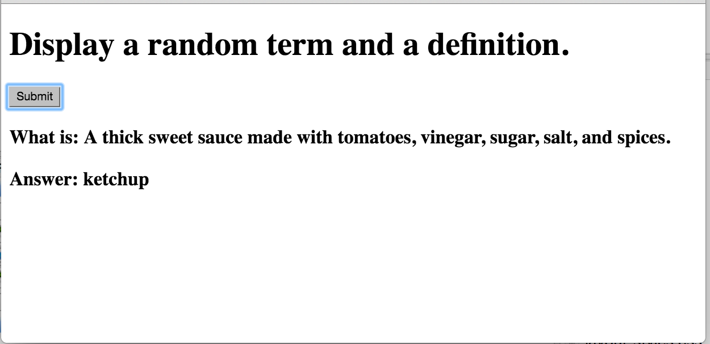
Practice: Create the following web page:
Build a text file containing terms and definitions.
Build the HTML page (no forms). Include a button, id for “defin”, and an id for “word”.
Build the JavaScript file to request a JSON object from a PHP script.
Build the PHP script to open a file, randomly select a word /definition pair, and return it as a JSON object to the JavaScript file.
Id: “word”
Id: “defin”

