Slide 1
MySQL Web Application
Connecting to a MySQL database
Building and Executing a Query
Implement three examples

Slide 2
mysqli class for Connecting to a MySQL Database
To access the data on a MySQL server, a connection to that server must be created.
mysqli is a class that uses a data object to establish that connection.
mysqli is an extension of MySQL and is short for MySQL Improved.
mysqli is a relational database driver used in the PHP programming language to provide an interface with MySQL databases.

Slide 3
Connection Requirements
Parameter
$servername - Specifies the server to connect to.
NOTE: If you pass the NULL value or an empty string "", the server will use the default value: "localhost”
- $username - Specifies the MySQL username to log in with.
NOTE: Default value is the name of the user that owns the server process
- $password - Specifies the password to log in with.
- $database - Specifies the database to be used when performing queries.
- $port - Specifies the port number to attempt to connect to the MySQL server.
NOTE: The default port is 3306

Slide 4
Example
<?php
// TASK 1: CONNECT TO THE SERVER
$mysqli= new mysqli($servername, $username, $password, $database, $port);
// TASK 2: CHECK IF THERE IS AN ERROR CONNECTING.
//Mysqli_connect_errno() WILL RETURN AN ERROR CODE.
if (mysqli_connect_errno()) {
exit('Connect failed: '. mysqli_connect_error());
}
//TASK 3: CLODE THE CONNECTION
$mysqli->close();
?>

Slide 5
PHP Documentation Site Example
<?php
// Connecting to and selecting a MySQL database named sakila
// Hostname: 127.0.0.1
$mysqli = new mysqli('127.0.0.1', $username, $password, ‘sakila’);
// Check if a connect_errno exists, causing a connection attempt to fail.
if ($mysqli->connect_errno) {
// The connection failed. What do you want to do?
// You could contact yourself (email?), log the error, show a nice page, etc.
// You do not want to reveal sensitive information
echo "Sorry, this website is experiencing problems.";
// Something you should not do on a public site, but this example will show you
// anyways, is print out MySQL error related information -- you might log this
echo "Error: Failed to make a MySQL connection, here is why: \n";
echo "Errno: " . $mysqli->connect_errno . "\n";
echo "Error: " . $mysqli->connect_error . "\n";
// In case of an error, exit
exit;
}

Slide 6
Perform an SQL Query
$sql = "SELECT actor_id, first_name, last_name FROM actor WHERE actor_id = $aid";
if (!$result = $mysqli->query($sql)) {
//Respond to a failed query.
echo "Sorry, the website is experiencing problems.";
// get the error information
echo "Error: Our query failed to execute: \n";
echo "Query: " . $sql . "\n";
echo "Errno: " . $mysqli->errno . "\n";
echo "Error: " . $mysqli->error . "\n";
exit;
}

Slide 7
Fetch the result of SQL Query
// Our MySQL connection and query succeeded, but do we have a result?
if ($result->num_rows === 0) {
echo "We could not find a match, sorry about that. Please try again.";
exit;
}
// Fetch the result into an associated array where the array's keys are the
// table's column names
$actor= $result->fetch_assoc();
echo "Sometimes I see " . $actor['first_name'] . " " . $actor['last_name'] . " on TV.";
// Fetch five random rows and output their names to a list.
$sql = "SELECT actor_id, first_name, last_name FROM actor ORDER BY rand() LIMIT 5";
if (!$result = $mysqli->query($sql)) {
echo "Sorry, the website is experiencing problems.";
exit;
}
// Print our 5 random names in a list, and link to each actor
echo "<ul>\n";
while ($actor = $result->fetch_assoc()) {
echo "<li><a href='".$_SERVER['SCRIPT_FILENAME']. "?aid=".$actor['actor_id']."'>\n";
echo $actor['first_name'] . ' ' . $actor['last_name'];
echo "</a></li>\n";
}
echo "</ul>\n";

Slide 8
Close a MySQL Connection
// The PHP script will automatically free the result
// and close the MySQL connection when it exits.
//Perform this task as a precaution.
$result->free();
$mysqli->close();

Slide 9
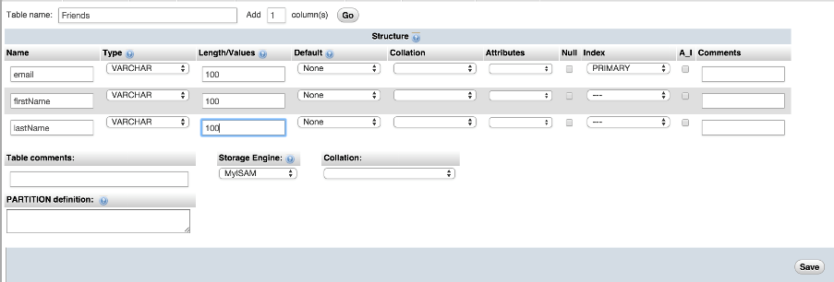
Lab 12: Database

Slide 10
Lab12a: Display all Contact records
<?php
//TASK 1: MAKE A CONNECTION TO THE DATABASE,
// DISPLAY ERROR FOR FAILED CONNECTIONS
//TASK 2: BUILD A STRING CONTAININ A MYSQL INSTRUCTION.
// SELECT ALL RECORDS
//TASK 3: USE THE ESTABLISHED DATABASE CONNECTION TO
// PROCESS THE DATABASE QUERY. STORE THE RESULTS IN A VARIABLE.
// TASK 3: OUTPUT DATA FOR EACH ROW
?>

Slide 11
Lab12b: Construct a Query for all Records with a Specified First name
<?php
//TASK 1: MAKE A CONNECTION TO THE DATABASE
//TASK 2: GET FIRST NAME FROM THE FORM
//TASK 3: CONSTRUCT A QUERY FOR ALL RECORDS WITH A MATCHING FIRST NAME
//TASK 4: DISPLAY ALL RECORDS FROM THE QUERY RESULT
?>

Slide 12
Lab12 c: Build a Table of Results to Send to JavaScript to display in HTML
<?php
//TASK 1: MAKE A CONNECTION TO THE DATABASE,
// DISPLAY ERROR FOR FAILED CONNECTIONS
//TASK 2: BUILD A QUERY STRING
//TASK 3: PROCESS THE DATABASE QUERY. STORE THE RESULTS IN A VARIABLE.
//TASK 4: BUILD A TABLE OF RESULTS IN A STRING
?>

