Slide 1
JavaScript Basics
Topics
Review
Important Methods
Writing Functions
JavaScript Event Handlers
Practice:
Carving out divisions for JavaScript Object Models
Creating an App

Slide 2
Review JavaScript document
document is the object that lets you work with the Document Object Model (DOM) that represents HTML elements of a page.
Example:
document.open() will open/load a document for writing.
document.write() will write to a document that has been loaded.

Slide 3
Review $
$ is a valid JavaScript identifier.
The $ was intended to be used for machine-generated variables (such as $0001).
The $ represents a jQuery Function, and is actually a shorthand alias for jQuery.
$ symbol is not reserved, and may be used as a variable name.)
$ is typically used as a selector (i.e. a function that returns a set of elements found in the DOM).

Slide 4
Review: Building content with JavaScript
<!DOCTYPE html>
<html>
<head>
<meta charset="utf-8">
<title>Practice JavaScript</title>
<script src="js/navigation.js"></script>
</head>
<body>
</body>
</html>
HTML
The JavaScript file is located in the js folder.

Slide 5
Methods
One of the most important methods using in JavaScript is is getElementById().
A second important method is parseInt() and parseFloat(). These are available through the window object.

Slide 6
Accessing Document Objects using JavaScript
getElementById() is used to retrieve the object that represents an HTML element.
getElementById() requires the id for the element as the parameter.
Example:
  var name = document.getElementById(“name”);

Slide 7
Parsing input from the User in JavaScript
parseInt() and parseFloat() are used to convert a string to an integer or a float.
If a string cannot be converted to a numeric value, these methods will return NaN (Not a Number)

Slide 8
JavaScript Functions
JavaScript provides for two kinds of functions:
Function expression:
A variable is assigned the value returned by a function expression. These functions are not given a name, they are often referred to as anonymous functions.
Function declaration:
Function declarations are equivalent to methods in Java.

Slide 9
Function Expression Example 1
The following function expression returns a DOM element:
var $ = function (id) {
return document.getElementById(id);
}
A statement that calls the $ function might be:
var address = $(“email_address”).value;
NOTE: $ has no specific meaning and is used to access anonymous functionality.

Slide 10
Function Expression Example 2
The following function expression returns a DOM element:
var displayYear = function () {
var today = new Date();
alert (“The year is “+today.getFullYear());
}
A statement that calls the $ function might be:
displayYear();

Slide 11
Function Definition Example 1
The following function returns the smallest integer value :
function smallest (x, y) {
return (x < y) ? x: y;
}
A statement that calls the function might be:
var min = smallest(x, y);

Slide 12
JavaScript EventHandlers
An event handler is a function that will execute when an event is triggered.
Technically, an event handler “handles” an event.
To attach an event handler to an event, specify the object and the event that triggers the event handler.
Finally, assign the event handler function to the specific event.

Slide 13
Event Handler Example
Consider the following HTML button:
<input type="button"
class="btn"
id="computeBtn"
value="Compute It">
An event listener can be assigned as follows:
window.onload = function() {
var computeBtn = document.getElementById("computeBtn");
computeBtn.onclick = computeValue();
}

Slide 14
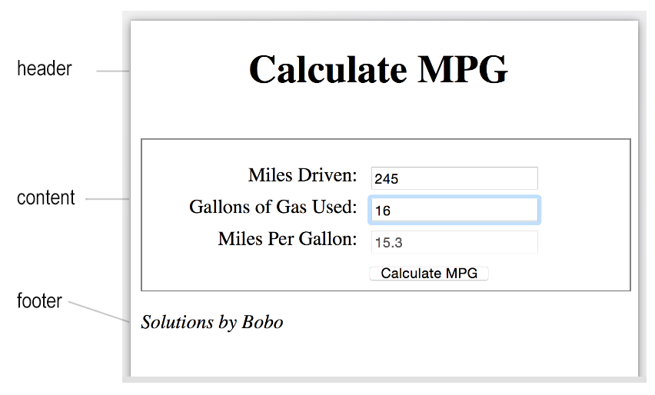
Practice: Miles Per Gallon Web App
Examine the mockup and carve out divisions. Focus will be on JavaScript, not CSS.

Slide 15
Practice: Miles Per Gallon Web App HTML
<!DOCTYPE html>
<html lang="en" dir="ltr">
<head>
<meta charset="utf-8">
<title>Web App</title>
<link rel="stylesheet" href="http://code.jquery.com/mobile/1.4.5/jquery.mobile-1.4.5.min.css" />
<script src="http://code.jquery.com/jquery-1.11.1.min.js"></script>
<script src="http://code.jquery.com/mobile/1.4.5/jquery.mobile-1.4.5.min.js"></script>
<link rel="stylesheet" href="css/main.css"><script src="compute_mpg.js"></script>
</head>
<body>
</body>
</html>
You may use jquery
CSS for web app format.
Body elements will be added on the next slide.

Slide 16
Practice: Miles Per Gallon Web App HTML continued
<body>
<div data-role="page">
<!--HEADER OF THE PAGE -->
<div data-role="header">
<h1> Calculate MPG</h1>
</div>
<!--CONTENT PORTION OF THE PAGE -->
<div data-role="content">
<label for="milesdriven" class="mlabel">Miles Driven:</label>
<input type="text" id="milesdriven" class="mfield"><br>
<label for="ngallons">Gallons of Gas Used:</label>
<input type="text" id="ngallons"><br>
<label for="milespergallon">Miles Per Gallon:</label>
<input type="text" id="milespergallon" disabled><br>
<label>&nbsp;</label>
<input type="button" class="btn" id="calculate" value="Calculate MPG"><br>
</div>
<!--FOOTER OF THE PAGE -->
<div data-role="footer">
<p><i>Solutions by Bobo<i></p>
</div>
</body>
</html>

Slide 17
Practice: Miles Per Gallon Web App CSS
h1 {
padding: 0 2.75em .5em;
}
.content {
width: 100%;
padding-top: 20px;
border: 1px solid gray;
}
label {
float: left;
width: 11em;
text-align: right;
}
input {
margin-left: 1em;
margin-bottom: .5em;
}

Slide 18
Solution: Miles Per Gallon Web App JavaScript
window.onload = function() {
// REGISTER AN ON CLICK EVENT FOR THE CALULATE BUTTON
var calculateBtn = document.getElementById("calculate");
calculateBtn.onclick = processMPG;
// PLACE THE FOCUS ON THE MILES DRIVEN FIELD
var milesDrivenField = document.getElementById("milesdriven");
milesDrivenField.focus();
}
var processMPG = function() {
// TASK 1: COLLECT THE INPUT FOR MILES DRIVEN
// TASK 2: COLLECT THE INPUT FOR GALLONS USED
// TASK 3: VALIDATE THE INPUT
// TASK 4: COMPUTE AND DISPLAY MILES PER GALLON
}
}

Slide 19
Modify the JavaScript
* Include an alias function for returning an element Id
var $ = function (id) {
return document.getElementById(id);
}

Slide 20
Event Handler Options
Option 1: In a JavaScript file, attach an onclick() listener to the DOM element:
window.onload = function() {
var myBtn = document.getElementById(buttonIdName);
myBtn.onclick = eventHandlerName;
}
Option 2: Attach a listener directly in HTML
<button onclick="eventHandlerName();">
Compute ;
</button>

