Slide 1
JavaScript Basics
Topics
Overview
Syntactic Characteristics
JavaScript - Practice
Functions in JavaScript - Practice

Slide 2
Overview
JavaScript is used to create interactive content.
The objective behind the development of JavaScript is client-side development.
JavaScript was originally developed by Netscape in the mid 1990s. It was originally called ActionScript.
JavaScript is the main tool for create interactive content on the Internet.

Slide 3
JavaScript Client-Side Essentials
Browsers convert HTML into a JavaScript object called the Document Object Model (DOM).
JavaScript can be used to programmatic content to HTML.
Create placeholders in HTML and use JavaScript to replace the placeholders with real data using replace() and append().

Slide 4
JavaScript Variables
Before a variable can be used, it must be declared.
Variables are declared with the var keyword.
var x;
var y;

Slide 5
JavaScript is an untyped language
The datatype of a variable is not required when it is defined.
The datatype of a variable can change during the execution of a program.
A variable can store the following data types:
Numbers
Strings
Boolean
JavaScript also defines two trivial data types:
null
undefined
JavaScript supports a composite data type known as object.

Slide 6
JavaScript: Dynamically Typed
JavaScript is dynamically typed.
Declared variables are not bound to any one type.
A variable in JavaScript can contain any type of data.
Example:
var x;
x = "25";
x = 25;

Slide 7
JavaScript: Strings
JavaScript requires Strings to be surrounded by quotes.
There are three types of quotes.
Name them.

Slide 8
JavaScript: Strings
Three types of quotes:
Double – Treated the same as Single
Single – Treated the same as Double
Backticks : allow us to embed variables and expressions into a String. Research this?

Slide 9
JavaScript document
document is the object that lets you work with the Document Object Model (DOM) that represents HTML elements of a page.
document.open() will open/load a document for writing.
document.write() will write to a document that has been loaded.
Note: document.open() is not required if you’re using the html page for writing.

Slide 10
Practice 1
Show the output displayed for the following:
var i = 25;
var j = "25";
var k = 2 + "5";
var l = "2" + "5";
document.write(i == j);
document.write(j == k);
document.write(i == k);
document.write(k == l);

Slide 11
Practice 1
Solution
var i = 25;
var j = "25";
var k = 2 + "5";
var l = "2" + "5";
document.write(i == j); true
document.write(j == k); true
document.write(i == k); true
document.write(k == l); true

Slide 12
Practice 2
Locate errors:
var words = 'These french fries are cold.";
var isBad = "false";
var $fun = "Bobo went for swim."

Slide 13
Practice 2 Solution
Delimit strings with two double quotes or two single quotes. Don’t mix them.
var words = 'These french fries are cold.";
var isBad = "false";
var $fun = "Bobo went for swim."
Don’t put double quotes around a reserved word .
It’s okay to use $ to begin a variable.
Missing semicolon.

Slide 14
Practice 1: Building content with JavaScript
Write the HTML, and JavaScript to produce the webpage shown below.
Note:
The body tag should be empty
Use JavaScript to compute the date and time information
Format date and time exactly as shown in the image
See the next slide for the HTML
The year is 2018
It is Tuesday: Day 30 of January in the year 2018
The time is 10:05am

Slide 15
Practice 1: Building content with JavaScript
<!DOCTYPE html>
<html>
<head>
<meta charset="utf-8">
<title>Practice JavaScript</title>
<script src="js/navigation.js"></script>
</head>
<body>
</body>
</html>
HTML
The JavaScript file is located in the js folder.

Slide 16
Practice 1 navigation.js
// TASK 1: GET THE COMPREHENSIVE DATE INFO
var date = new Date();
// TASK 2: USE date TO COMPUTE TIME INFORMATION
// TASK 3: USE date TO COMPUTE DAY, WEEKDAY, ETC.
// TIP: Use a switch statement for specific values
// TASK 4: OUTPUT CONTENT TO THE WEBPAGE.

Slide 17
Accessing Document Objects using JavaScript
getElementById() is used to retrieve the object that represents an HTML element.
getElementById() requires the id for the element as the parameter.
Example:
var name = document.getElementById(“name”);

Slide 18
Parsing input from the User in JavaScript
parseInt() and parseFloat() are used to they a string to an integer or a float.
If a string cannot be converted to a numeric value, these methods will return NaN (Not a Number)

Slide 19
JavaScript Functions
JavaScript provides for two kinds of functions:
Function expression:
A variable is assigned the value returned by a function expression. These functions are not given a name, they are often referred to as anonymous functions.
Function declaration:
Function declarations are equivalent to methods in Java.

Slide 20
Function Expression Example 1
The following function expression returns a DOM element:
var $ = function (id) {
return document.getElementById(id);
}
A statement that calls the $ function might be:
var address = $(“email_address”).value;
NOTE: $ has no specific meaning and is used to access anonymous functionality.

Slide 21
Function Expression Example 2
The following function expression returns a DOM element:
var displayYear = function () {
var today = new Date();
alert (“The year is “+today.getFullYear());
}
A statement that calls the $ function might be:
displayYear();

Slide 22
Function Definition Example 1
The following function returns the smallest integer value :
Function smallest (x, y) {
return (x < y) ? x: y;
}
A statement that calls the function might be:
var min = smallest(x, y);

Slide 23
JavaScript EventHandlers
An event handler is a function that will execute when an event is triggered.
Technically, an event handler “handles” an event.
To attach an event handler to an event, specify the object and the event that triggers the event handler.
Finally, assign the event handler function to the specific event.

Slide 24
Event Handler Example
Consider the following HTML button:
<input type="button"
class="btn"
id="computeBtn"
value="Compute It">
An event listener can be assigned as follows:
window.onload = function() {
var computeBtn = document.getElementById("computeBtn");
computeBtn.onclick = computeValue();
}

Slide 25
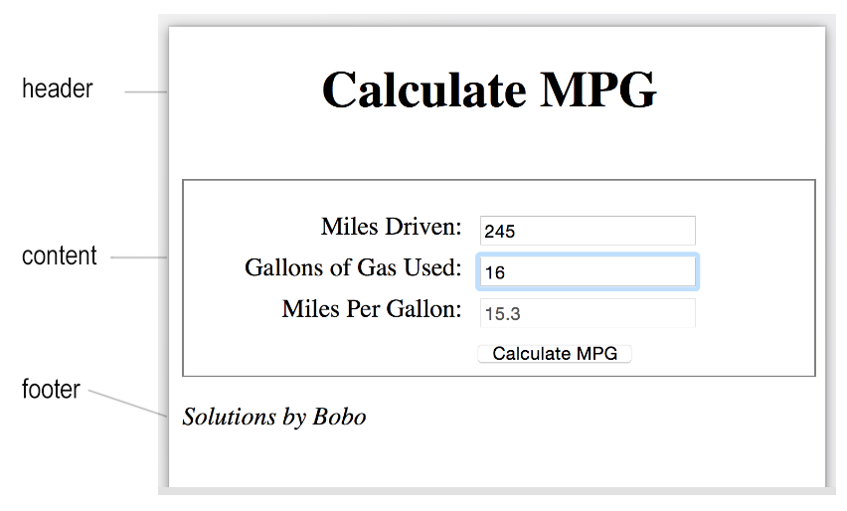
Practice: Miles Per Gallon Web App
Examine the mockup and carve out divisions. Focus will be on JavaScript, not CSS.

Slide 26
Practice: Miles Per Gallon Web App HTML
<body>
<div>
<div class=”header">
<h1>Calculate MPG</h1>
</div>
<div class="content">
<label for="milesdriven" class="mlabel">Miles Driven:</label>
<input type="text" id="milesdriven" class="mfield"><br>
<label for="ngallons">Gallons of Gas Used:</label>
<input type="text" id="ngallons"><br>
<label for="milespergallon">Miles Per Gallon:</label>
<input type="text" id="milespergallon" disabled><br>
<label>&nbsp;</label>
<input type="button" class="btn" id="calculate" value="Calculate MPG"><br>
</div>
<div class=”footer">
<p><i>Solutions by Bobo<i></p>
</div>
</div>
</body>

Slide 27
Practice: Miles Per Gallon Web App CSS
h1 {
padding: 0 2.75em .5em;
}
.content {
width: 100%;
padding-top: 20px;
border: 1px solid gray;
}
label {
float: left;
width: 11em;
text-align: right;
}
input {
margin-left: 1em;
margin-bottom: .5em;
}

Slide 28
Solution: Miles Per Gallon Web App JavaScript
window.onload = function() {
// REGISTER AN ON CLICK EVENT FOR THE CALULATE BUTTON
var calculateBtn = document.getElementById("calculate");
calculateBtn.onclick = processMPG;
// PLACE THE FOCUS ON THE MILES DRIVEN FIELD
var milesDrivenField = document.getElementById("milesdriven");
milesDrivenField.focus();
}
var processMPG = function() {
// TASK 1: COLLECT THE INPUT FOR MILES DRIVEN
// TASK 2: COLLECT THE INPUT FOR GALLONS USED
// TASK 3: VALIDATE THE INPUT
// TASK 4: COMPUTE AND DISPLAY MILES PER GALLON
}
}

Slide 29
Modify the JavaScript * Include an alias function for returning an element Id
var $ = function (id) {
return document.getElementById(id);
}

Slide 30
Event Handler Options
Option 1: In a JavaScript file, attach an onclick() listener to the DOM element:
window.onload = function() {
var myBtn = document.getElementById(buttonIdName);
myBtn.onclick = eventHandlerName;
}
Option 2: Attach a listener directly in HTML
<button onclick="eventHandlerName();">
Compute ;
</button>

