Slide 1
CSS – Cascading Style Sheet
DOM – Document Object Model

Slide 2
Topics
CSS Selectors
Rely on subdivisions in web pages.
Introduction to DOM. Examine the relationship between DOM, HTML, and CSS.
Practice by exploring DOM Structure in Chrome Dev Tools
MockUp Practice:
  Analyze digital design mockups.
  Break down the design into page elements
  Implement page elements in HTML and CSS.

Slide 3
CSS Selectors
Selectors are style rules that can be applied to specific HTML tags.
Categories of Selectors:
  Default Selector : Will be applied to all specified tags.
  Explicit Selectors : Used to apply a rule from an explicit class selector.
  Static class Selectors: A static class Selector can be used to classify a generic HTML tag.
  ID Selectors: Used to select a specific style.

Slide 4
CSS Example 1
<!DOCTYPE html>
<html>
<head>
<title>CS222 Lab 1c</title>
<link rel="stylesheet" type="text/css" href="./css/style1.css">
</head>
<body>
<div id="content">
<h1>Hello Everyone!</h1>
<h1>Hello Everyone </h1>
<h1>Very Sorry</h1>
<h1>My Sister's Birthday</h1>
<h1> My Sister's Birthday is Fun</h1>
</div>
</body>
</html>
Specify a style sheet.
Located css files in a directory.
Subdivisions are useful when creating responsive design.

Slide 5
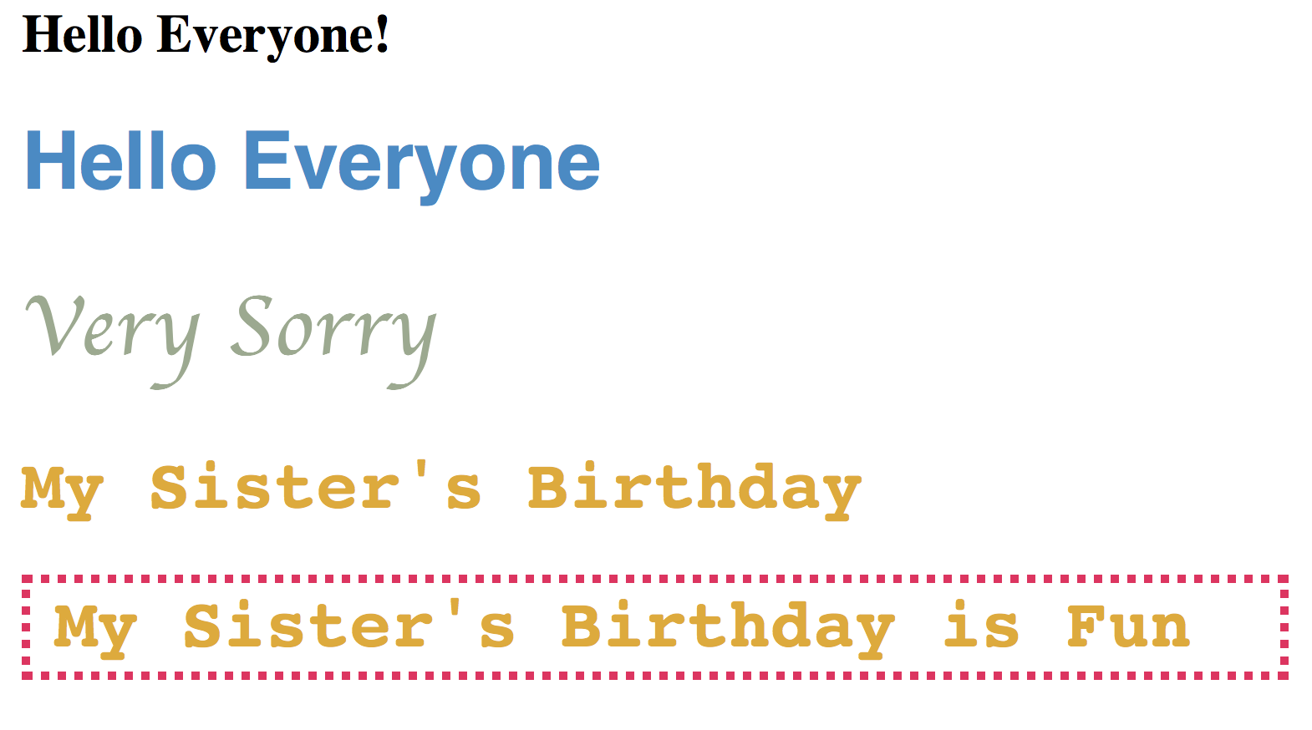
CSS Example 2 : Create the following headings.
Default h1 Selector
Use Explicit h1 class
Use Explicit h1 class
Use a static class
Add ID selector style

Slide 6
CSS Example 2: HTML
<!DOCTYPE html>
<html>
<head>
<title>CS222 Lab 1c</title>
<link rel="stylesheet" type="text/css" href="./css/style1.css">
</head>
<body>
<div id="content">
<h1>Hello Everyone!</h1>
<h1 class="greeting">Hello Everyone </h1>
<h1 class="condolences">Very Sorry</h1>
<h1 class="birthday">My Sister's Birthday</h1>
<h1 class="birthday" id="fun"> My Sister's Birthday is Fun</h1>
</div>
</body>
</html>
Calls Default Selector
Calls Explicit Selector
Can be used to call a static class (generic)
Calls Selector by ID

Slide 7

CSS Default Selector
In the example below, the h1 selector is used to apply a style to all <h1> tags.
  h1 {
  margin: 30px;
  }
Format for attribute/value pair

Slide 8

CSS Explicit Class Selector
A class Selector can be used to classify a specific HTML tag.
Subclasses of the H1 tag: greeting class and a condolences class.
  h1.greeting {
color: #4889C5;
font-size: 48px;
font-family: Helvetica;
  }
  h1.condolences {
color: #9CA98F;
font-size: 52px;
font-family:cursive;
  }
<h1 class="greeting">Hello Everyone </h1>
<h1 class="condolences">Very Sorry</h1>

Slide 9

CSS Static Class Selector
A static class Selector can be used to classify a generic HTML tag. In this case, the static class birthday is applied to the HTML element..
  .greeting {
color: # DEAB2F;
font-size: 48px;
font-family: monospace;
  }
<h1 class="birthday">My Sister’s Birthday </h1>

Slide 10

CSS ID Class Selector
An ID Selector can be used to identify a specific style. In this case, the style identified by “fun” is applied to the HTML element. You can apply multiple styles to an HTML element.
  #fun {
padding-left: 15px;
padding-bottom: 5px;
border: 5px #DE325E dotted;
}
<h1 class="birthday" id=”fun”>My Sister’s Birthday is fun </h1>

Slide 11
DOM
HTML
CSS

Slide 12
DOM
The Document Object Model (DOM) is a programming interface (API) for HTML, XML and SVG documents.
DOM defines the logical structure of documents and the way a document is accessed and manipulated.
The HTML you write is parsed by the browser and turned into the DOM.
Each HTML5 document is represented structurally as a tree.

Slide 13

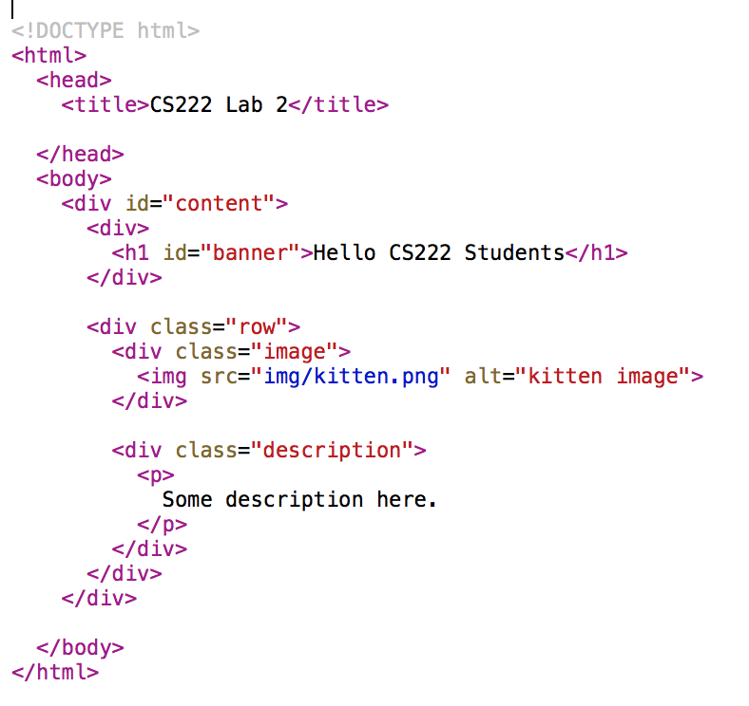
HTML File Example
NOTE: <div> is used to structure the page.

Slide 14
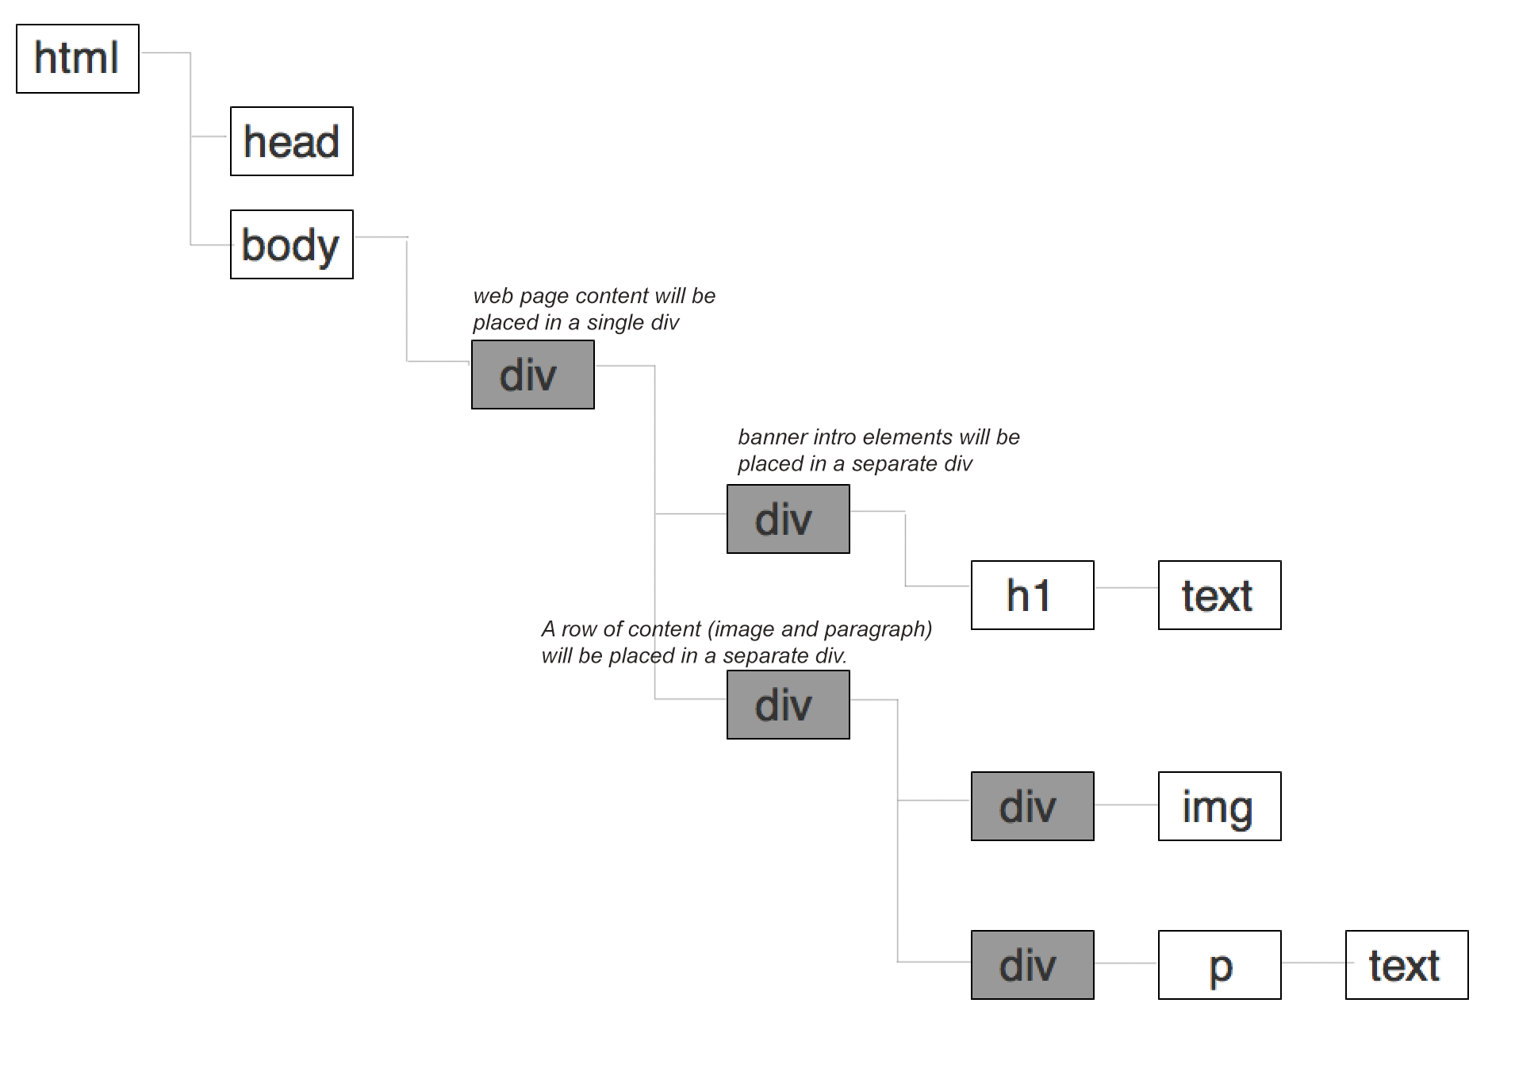
DOM Example

Slide 15
Facts about DOM
Uses a tree-like structure to represent the document.
The structure can be accessed from programs so that document elements can be altered.
The DOM provides a representation of the document as a structured group of nodes and objects that have properties and methods.
DOM works with Javascript by allowing nodes to employ event handlers.
Though accessed using JavaScript, the DOM itself is not a part of the JavaScript language.

Slide 16
Explore Wikipedia’s DOM Structure
Use Chrome’s Developer Tools to examine how HTML classifies page content.
DOM is shown in Elements.
Tasks:
  Mouse over the lines or elements in the structure.
  Notice that parts of the page become highlighted.
  Explore element sub-structures.
  Draw the structure. Restrict your attention to the entry form located at the bottom portion of the page.
  Try making changes within Styles. For example, alter the background color.
  Change the color of the language labels to a bright green.
  Try changing the logo to another image.
  Alter spacing for text.

