Slide 1
CS222 Web Programming Course Outline
Week 1:
Set up development environment and learn how to work with FTP, our web host, and basic UNIX. We will explore HTML.
Weeks 2 – 4:
Learn how to analyze a Web page design mockup and translate it into HTML and CSS. We will develop a CSS framework, which will help us make websites faster and easier. Along the way, we’ll learn about responsive design, which is a principle that will help you reach users on any device that they're using to pull-up your website. In addition, we’ll briefly explore Twitter’s Bootstrap framework for building a static website.
Weeks 5 – 9:
Starting in week 5, we will look to JavaScript as a way to provide programming capability at the client ends of a Web page.
Weeks 10-14:
Finally, we will explore server-side development. This will include constructing MySQL databases on the server and using the scripting language PHP to handle data access, including processing forms, database files, and cookies.

Slide 2
Task for today: Acquire the Development Tools
Text Editor: Atom, Sublime, Notepad++, or Aptana.
Google Chrome. We will rely on Chrome’s Developer Tools
FTP Software, such as FileZilla or sFTP Client.
We will also rely on Unix and FTP from the command line.
Web Host: GoDaddy Do NOT use free hosting.
These tools must be setup/activated before class on Thursday.

Slide 3
Topics for Today:
What is a Web Application?
Networks and the Internet
What is Packet Switching? How does it differ from Circuit Switching?
TCP/IP
Telnet Experiment

Slide 4
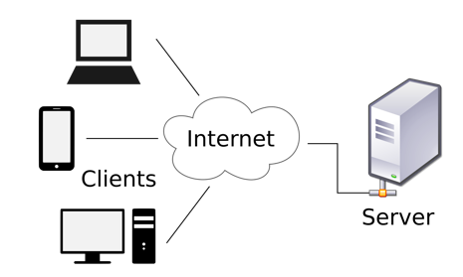
Components of a Web Application
Clients
Web Server
Network connecting clients to the web server

Slide 5
Definition of web application components
The clients are the computers and devices that access the web application. A client device can be anything that can access a network. There is tremendous diversity in the client of devices.
A web server holds the files that make up a web application.
For example, TrishCornez.com is where students can go to access class assignments and labs for courses they are taking from me.
The name trishcornez.com is the address of the webpage, or more commonly known as the URL. This address points to files located on a server that is running 24/7.
A network connects the clients to the web server. Access to the network is often gained through a web browser, such as Chrome.

Slide 6
Networks and the Internet
The Internet is a network that consists of many networks.
Network Hardware Components:
Modem
Router
The router is wired to the modem and the modem is connected to an Internet Service Provider (ISP) by fiber, DSL, or coaxial cable.

Slide 7
Modem
A modem is designed to encode and decode data so that it can pass to and from the Internet.
It facilitates a connection to the Internet by transmitting and receiving data over telephone lines.

Slide 8
Router
A router shares your Internet connection among multiple devices.
The router is connected to the Internet through the modem.
The router uses a single public IP address on the Internet.
Servers on the Internet can communicate with your router, and the router routes that traffic to the appropriate devices on your network.
There is an Ethernet port on the back of the router that allows us to directly connect to the router for faster Internet access.
­
The router is wired to the modem and the modem is connected to an Internet Service Provider (ISP) by fiber, DSL, or coaxial cable.

Slide 9
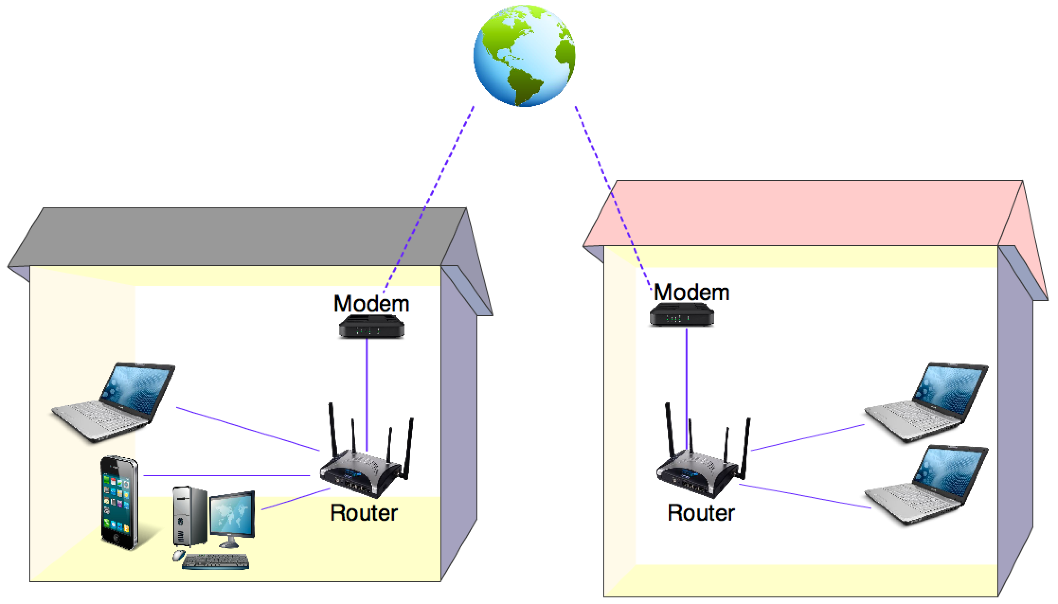
Basic Connection to the Internet
Major Hardware Components
Modem: Designed to encode and decode
data so that it can pass to and from
the Internet.
Router: Shares an Internet
connection among
multiple devices.

Slide 10
Internet Network
The Internet is a network of networks
It has structure, but there is no centralized element.
There is no centralized authority
Different types of networks can communicate with each other.

Slide 11
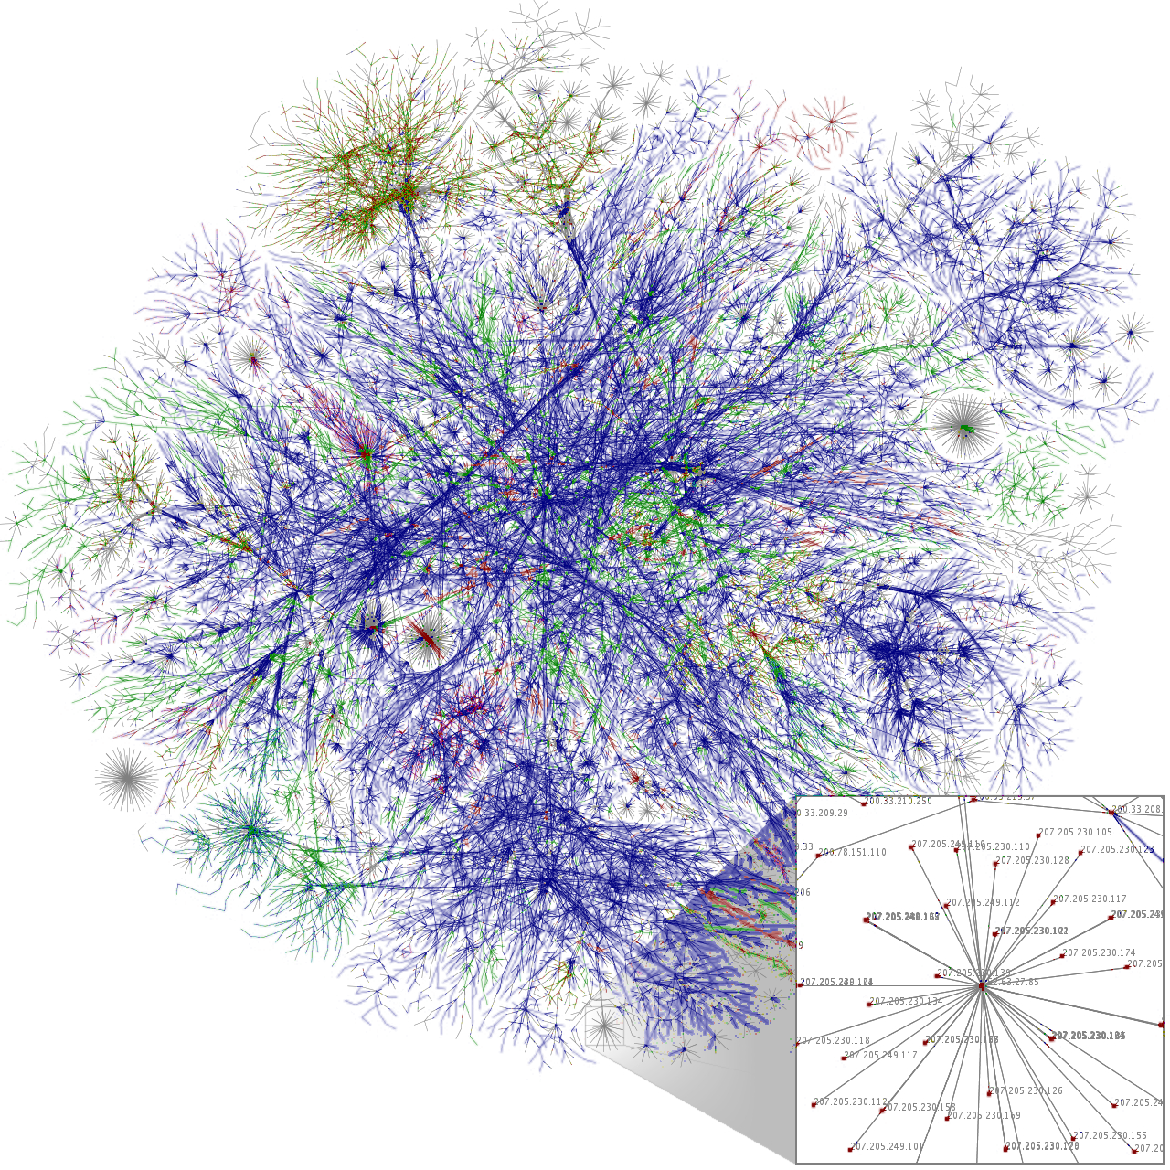

Slide 12
The Internet architecture
An Internet service provider (ISP) owns a network that is connected to the Internet.
At the top of the Internet hierarchy sits the global ISPs who provide service to regional ISPs, mobile networks, corporations, government, and academic institutions.
The regional ISPs provide Internet service to end users, small business, mobile, and institutions. Together the global ISPs, regional ISPs, maintain the links to the Internet, which are usually constructed with a mesh topology (any to any connections).
A DNS Server (Domain Name System) contains a database of network addresses to other networks. It translates a domain name and host name into the corresponding numeric address. The numeric address is the Internet Protocol address, or IP address. We will do an experiment shortly to better understand this.

Slide 13
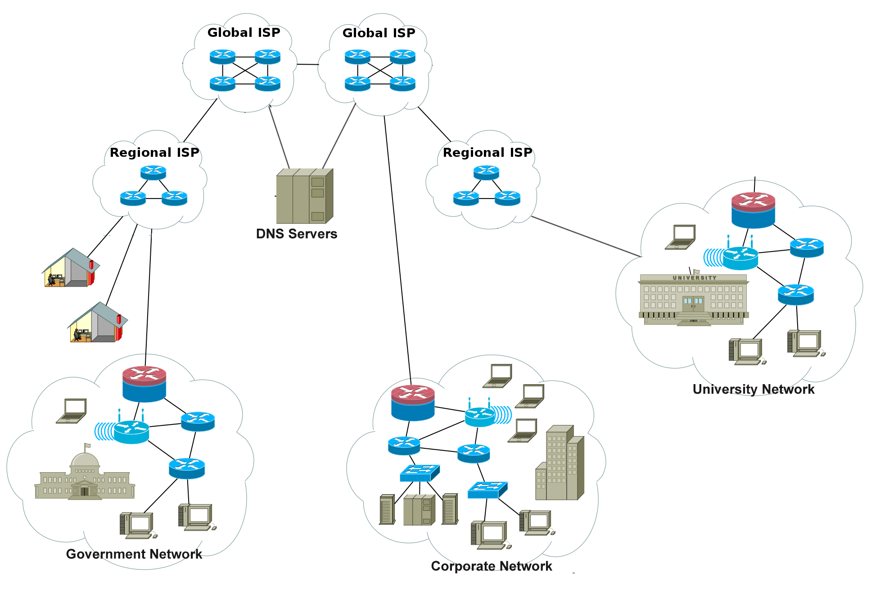
Internet Architecture
An Internet Service Provider (ISP) owns a network that is connected to the Internet.
Global ISPs provide service to regional ISPs, mobile networks, corporations, governments, and academic institutions.
Regional ISPs provide Internet service to end users, small businesses, academic institutions, etc.
DNS Server (Domain Name System) contains a database of network addresses to other networks.

Slide 14
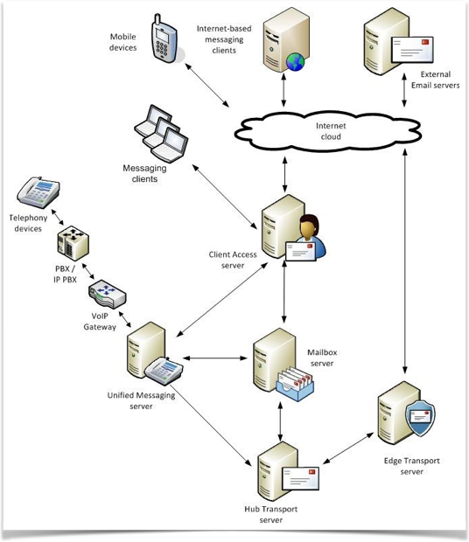
How Data Travels
Across the Internet
Packet Switching

Slide 15
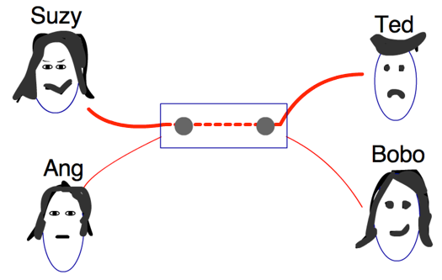
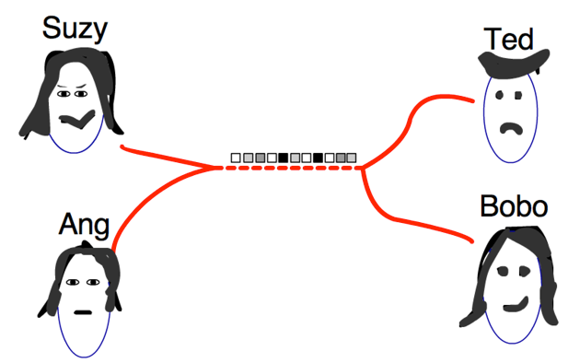
Packet Switching was a Revolutionary Concept
Data is broken up into small packets.
Multiple people can use the same wire.
Circuit Switching
Packet Switching

Slide 16
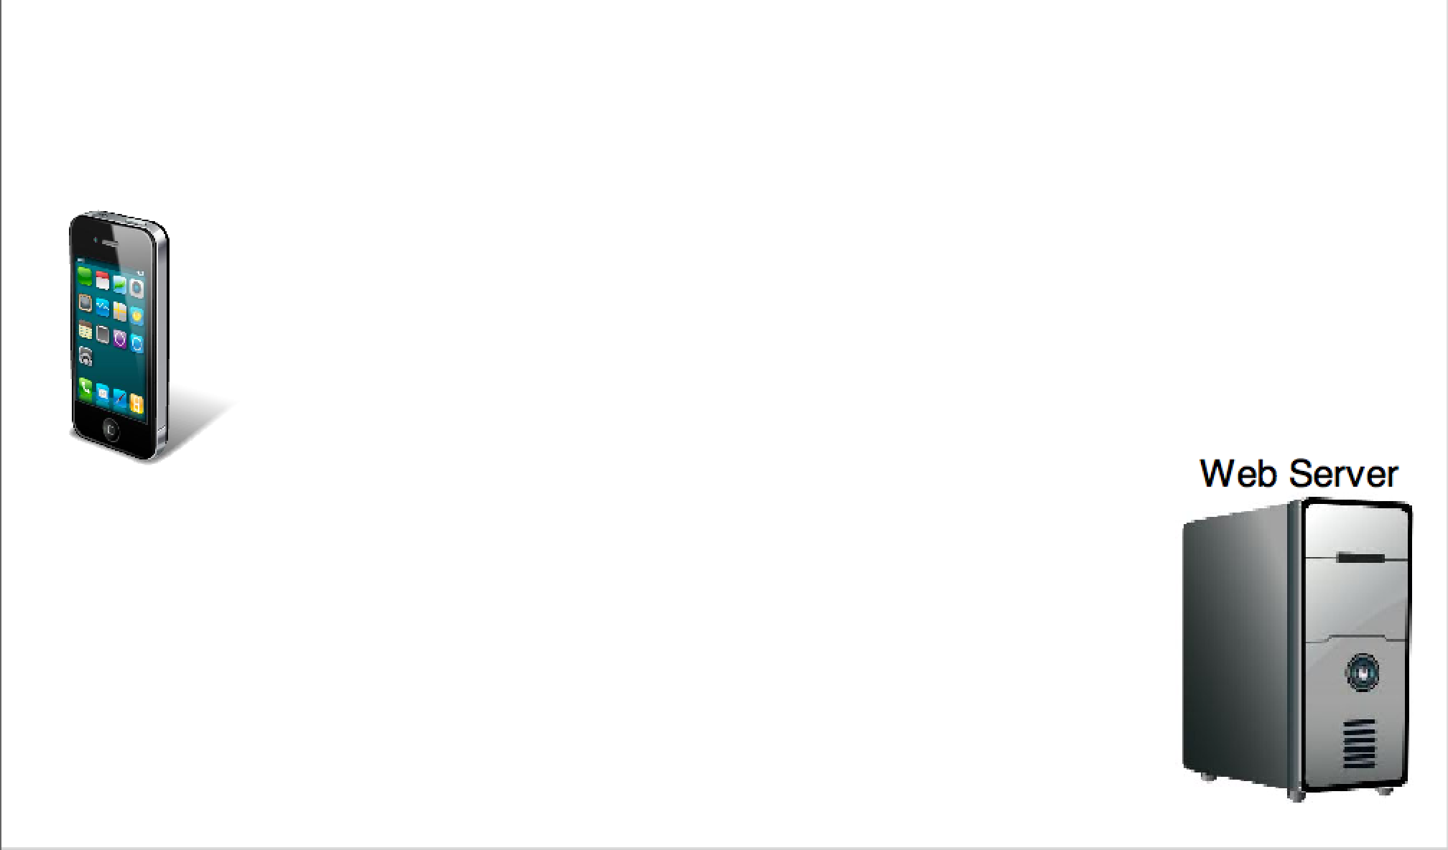
Packet Switching and TCP/IP Example
TCP - Transmission Control Protocol IP - Internet Protocol
  Imagine an Android user wants to view a web page that is hosted on a Web Server.
  How is this webpage sent to the device from the Web Server?
Packet Switching

Slide 17
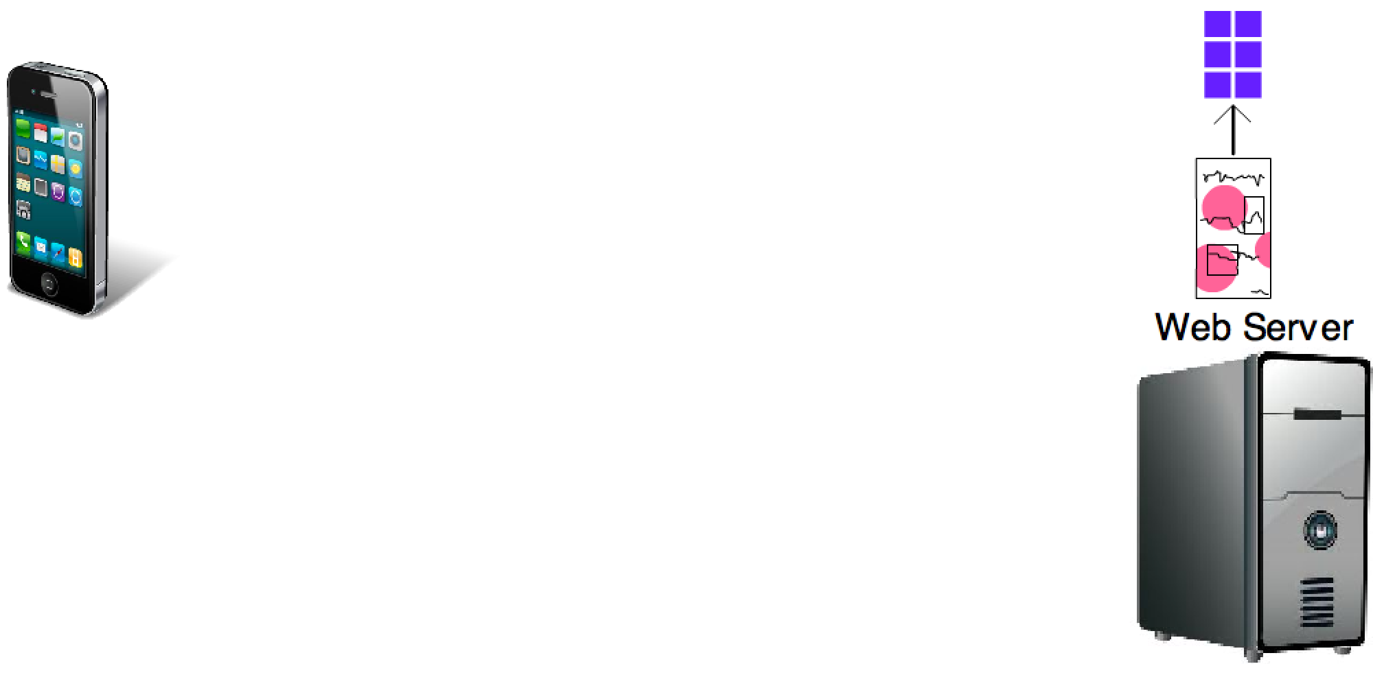
Packet Switching and TCP/IP Example
Step 1:
  Using TCP protocol the webpage is
  broken up into multiple small fixed size packets.
  Each packet contains a final destination.

Slide 18
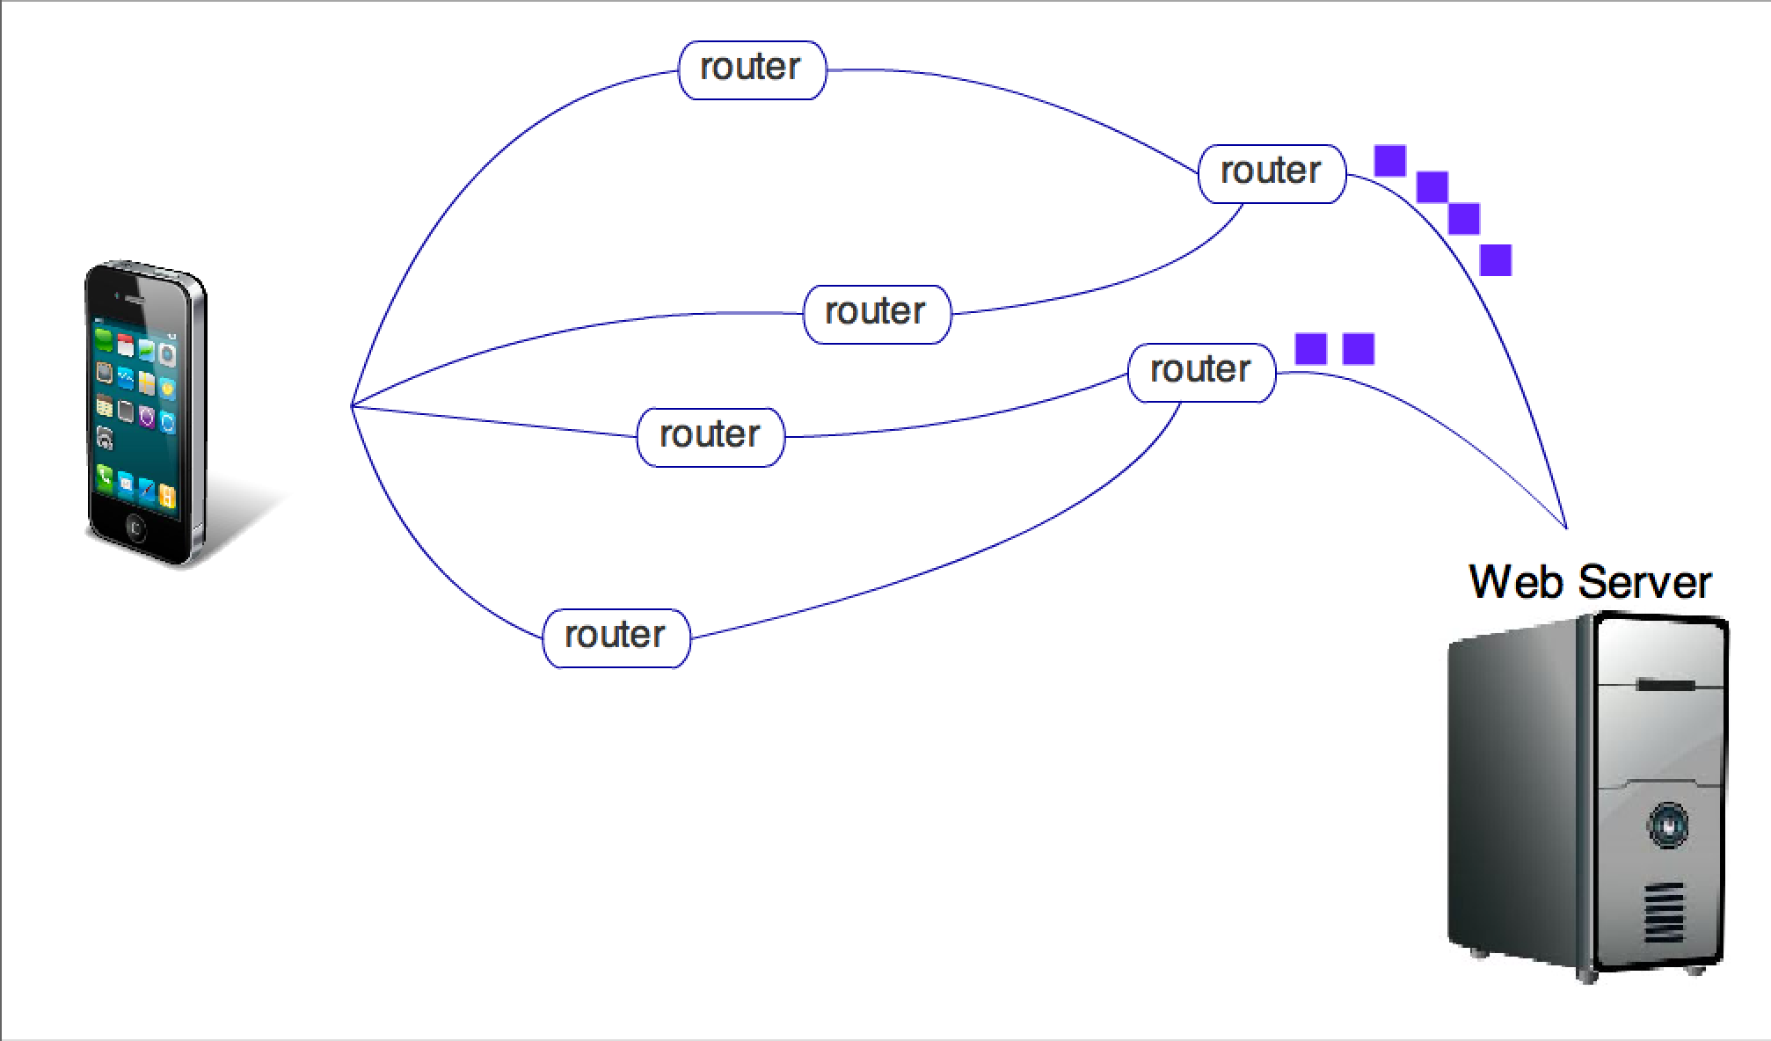
Packet Switching and TCP/IP Example
Step 2:
  Multiple routers live within the core of the Internet itself.
  A router determines where to send each packet.
  Packets travel from router to router according to the IP protocol.

Slide 19
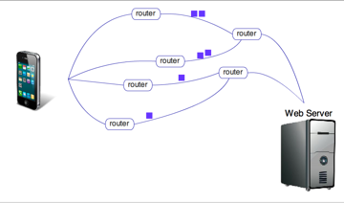
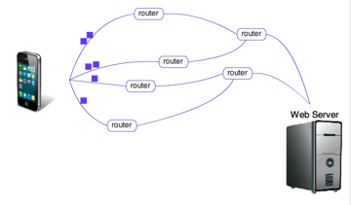
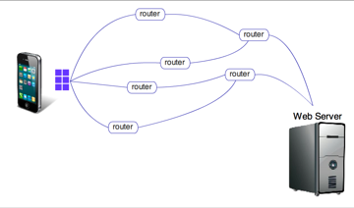
Packet Switching and TCP/IP Example
Step 3:
  Each packet is routed according to the best Internet traffic report.
  All packets for this request have the same final destination, the IP address.

Slide 20
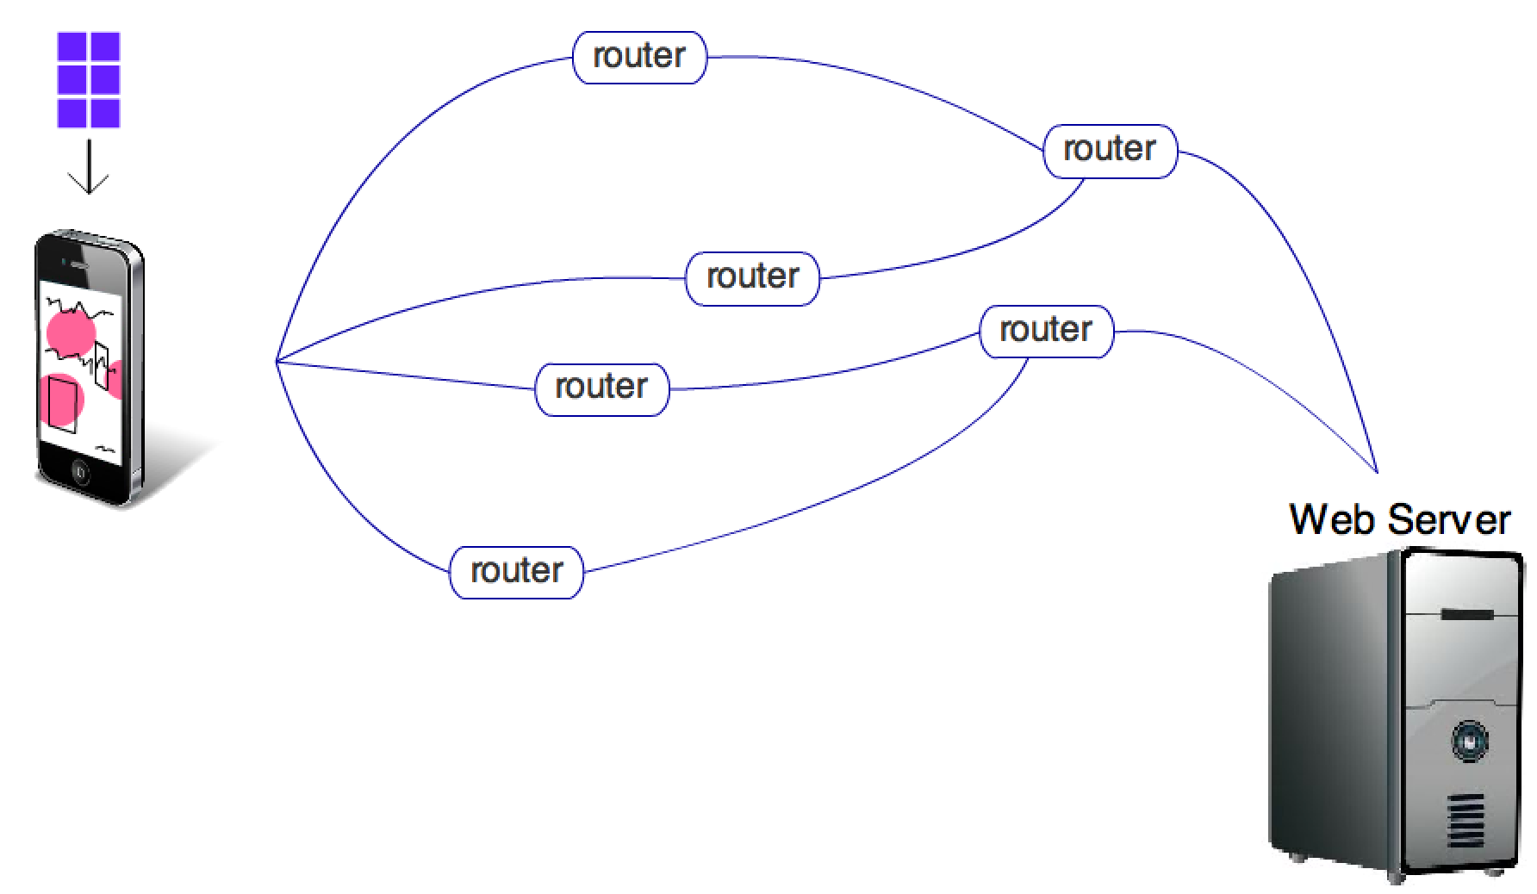
Packet Switching and TCP/IP Example
Step 4:
  TCP is run again when the packets arrive at their final destination.
  TCP reassembles the small packets into the original whole webpage.

Slide 21
Difference between URL and IP
In order to find what you want on the internet, you need to have a pointer of where to find it.
URLs (Uniform Resource Locators) and IP addresses are identifiers used for this purpose.
The main difference between URL and IP address is what they point to.
An IP address basically points to a computer, whether it is the physical hardware or a virtual one as in the case of shared hosting.
A typical URL contains the protocol to be used (i.e. HTTP, FTP), the domain name or IP address, the path, and optional fragment identifier. It is obvious to see that an IP address can be part of a URL, although it is more common to see a domain name instead of an IP address.

Slide 22
IP Experiment
The IP address of a packet is used to determine direction and a final destination.
The IP address is a unique 32-bit number, written as four 8-bit numbers separated by periods.
Users typically use domain names, but IP numbers work just as well.
Task 1:
  Use telnet in terminal mode to connect with University of Redlands. This will reveal its IP address.
Task 2:
  Load Chrome and connect to University of Redlands using the IP address. TIP: type the string “http://“ followed by the IP number and then a forward slash.

