Slide 1
TOPICS
Chrome Dev Tools
Process for Building a Static Website
Introduction to CSS

Slide 2
Introduction to Chrome’s Developer Tools
Chrome provides a set of Developer Tools for developing and debugging web pages. Developer Tools is also referred to as DevTools.
DevTools support layout design, code optimization, and JavaScript development.
Dev Tools provides the structure of a given page as the browser interprets it.

Slide 3
Experiment: Load Wikipedia in Chrome
Access Dev Tools in Chrome
Select Elements. Code elements in the structure will appear.
This structure is how HTML classifies page content. It tells the browser which part is text and which is an image, etc.
Mouse over the lines or elements in the structure.
Notice that parts of the page get highlighted. Click on triangles to the left of a line.
Use the triangles to expand elements deeper and deeper into the tree-like structure.

Slide 4
Questions
Inspect the main graphic element that is the Wikipedia logo. Identify its graphic format.
What is the width of the graphic logo?
What is the text alternative to the graphic?

Slide 5
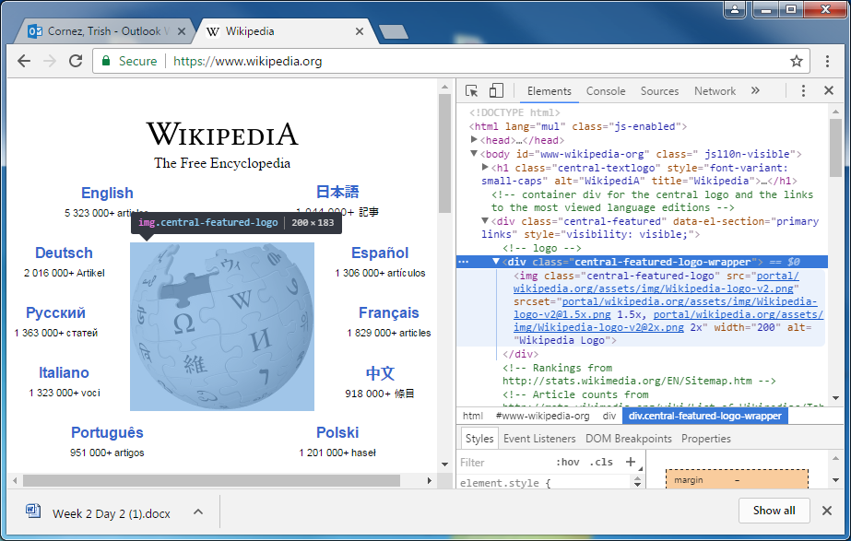

Slide 6
What is the process for building a static website?
Examine and analyze the website mockup.
Determine the structure elements.
Determine the visual design elements.
Code the visual design elements into a CSS file. CSS stands for Cascading Style Sheets.
Code the structure elements into HTML and apply the design elements
Add JavaScript for interactive components.

Slide 7
Overview of Static Webpage Components
HTML5 is used to specify the structure of a web page.
CSS is used to add design attributes or formatting to the document.
Example: HTML Tags, such as <table>, <ul>, <p> specify the sections of a document.
Designing a style for the structure means adding color, font size, responsive placement, etc.

Slide 8
Introduction to CSS
Several CSS files can be referenced in HTML.
The simplest way to build a website is to use a singleCSS style sheet. Often there are many of them and all of them will be used to find the final style to be applied to a page element.
CSS contains a collection of style rules. The most specific rule is applied to a given element.
The word cascading means that we move down the list of style rules until a rule is found that best describes the elements. That rule gets applied.

Slide 9
HTML Divisions and CSS
The <div>..</div> is an additional pair of tags that is important to HTML5 documents.
The <div> tag defines a generic division or a section in an HTML5 document.
Unlike tags such as <h1>, <table>, the <div> tag does not have any associated semantic.
One of the most frequent uses of the <div> tag is for grouping a block of HTML5 elements to format with CSS.

Slide 10
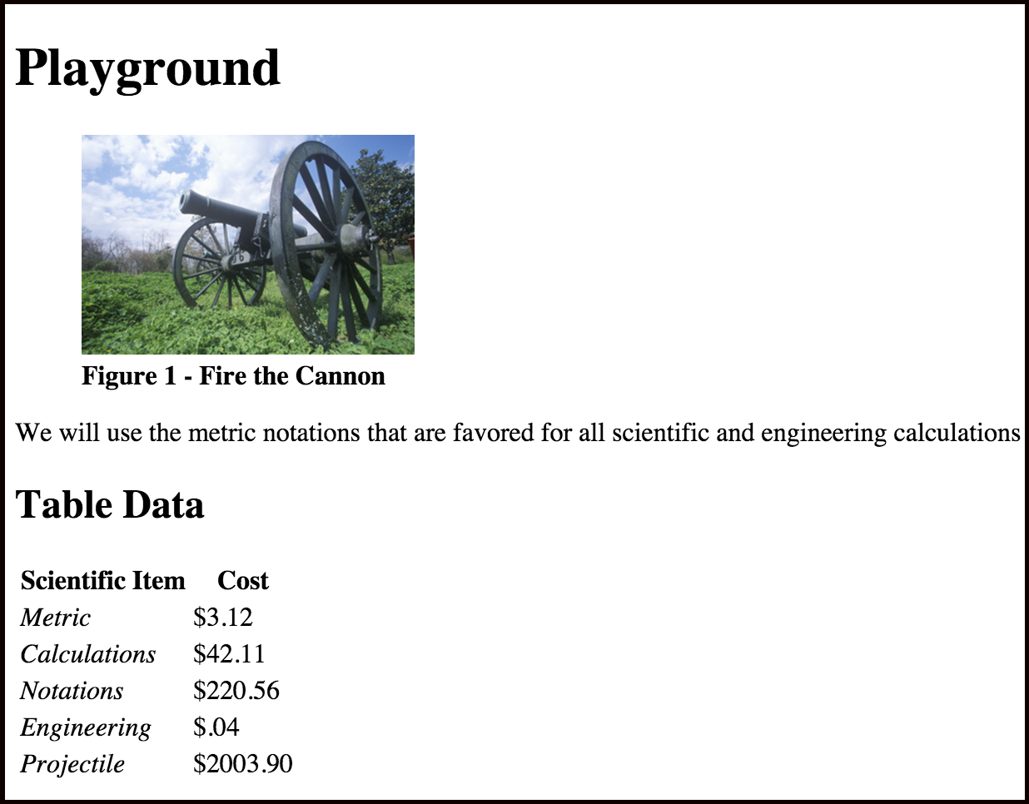
Practice 1 Examine the mockup. Build the html page. See Lab 2. Use the tags for: <h1> <h2> <figure> <p> <table>

Slide 11
<!DOCTYPE html>
<html>
<head>
<title>Lab Example</title>
<link rel="stylesheet" href="css/mystyle.css">
</head>
<body>
<div>
</div>
</body>
</html>
There is a single division in this static webpage.
All content will be placed within <div> and </div>.

Slide 12
<h1>Playground</h1>
<figure>
<img src="media/play.png" alt="A play image" width="200">
<figcaption><strong>Figure 1 - Fire the Cannon</strong></figcaption>
</figure>
<p>
We will use the metric notations that are favored for
all scientific and engineering calculations
</p>

Slide 13
<h2>Table Data</h2>
<table>
<tr>
<th>Scientific Item</th>
<th>Cost</th>
</tr>
<tr>
<td><em>Metric</em></td>
<td>$3.12</td>
</tr>
<tr>
<td><em>Calculations</em></td>
<td>$42.11</td>
</tr>
<tr>
<td><em>Notations</em></td>
<td>$220.56</td>
</tr>
<tr>
<td><em>Engineering</em></td>
<td>$.04</td>
</tr>
<tr>
<td><em>Projectile</em></td>
<td>$2003.90</td>
</tr>
</table>

Slide 14
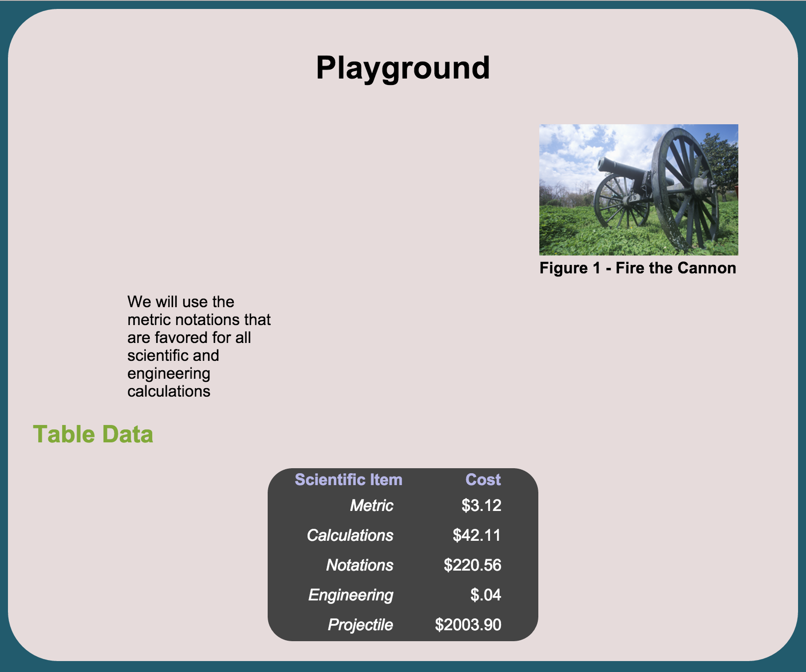
Practice 2 Examine the mockup. Identify the CSS rules that will be applied.

Slide 15
Practice 2 Rules will be applied to the following: body div h1 h2 table

Slide 16
CSS Guidelines
In the HTML document, the <link> tag is used to define the relationship between an HTML5 document and an external resource.
The CSS file contains the display styles for specific tags.
The formatting instructions are enclosed in a pair of curly brackets { } after the name of the tag.
Each formatting instruction is ended with a semicolon.
A format instruction consists of the attribute : value pair.

Slide 17
Body Style Rule
body specifies two style attributes:
background-color
font for the body.
body {
background-color: #225B6D;
font-family: Arial;
}

Slide 18
div Style Rule
The entire content of the web page is enclosed in the <div> tags.
The style rules for the div element are as follows:
background color
padding attribute
border radius (which gives it a rounded rectangle appearance).
div {
background-color: #E6DBDB;
border-radius: 50px;
padding: 20px;
}

Slide 19
Practice 2: Additional Style Rules
Center the title
Right-align the figure
Set the margin of the paragraph and alter the width
Change the color of the h2 title and add a little space
Center the table, add a background color, set the text color.
The th and td tags are nested inside the table and tr tags. Alter these tags independent of each other.

Slide 20
h1 {
text-align: center;
}
figure {
float: right;
}
Center the title
Right-align the figure

Slide 21
p {
clear: both;
margin-left: 100px;
width:150px;
}
h2 {
color: #81A939;
margin-left: 5px;
}
Set the margin of the paragraph and alter the width
Change the color of the h2 title and add a little space

Slide 22
table {
background-color: #444444;
color: white;
border-radius: 25px;
margin-left:auto;
margin-right:auto;
}
Center the table, add a background color, set the text color.

Slide 23
table tr th {
padding-left: 25px;
padding-right: 25px;
text-align: center;
color: #B6B6E6;
}
table tr td {
padding: 5px;
padding-right: 35px;
text-align: right;
}
The th and td tags are nested inside the table and tr tags.
Alter these tags independent of each other.

