Slide 1
Drawing Graphics in JavaScript

Slide 2
Topics
<canvas> element
The canvas context
The canvas coordinate system
Basic Usage:
Drawing Rectangles
Drawing paths
strokeStyle() and fillStyle

Slide 3
<canvas> element
Used to draw graphics on web pages via JavaScript.
Added in HTML5
<canvas> was originally introduced by Apple for the OS X Dashboard and Safari.
<canvas> element has only two attributes: width and height.

Slide 4
The canvas context
The <canvas> element creates a fixed-size drawing surface.
Other contexts may exist that provide different types of rendering, such OpenGL.
To display something, a script first needs to access the canvas context.
<body>
<canvas id=“drawingBoard”
width=“500”
height=“600”>
</canvas>
</body>
var canvas = document.getElementById('drawingBoard');
var canvasContext = canvas.getContext('2d');
HTML
JavaScript

Slide 5
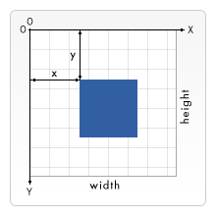
Canvas Coordinate System
The 0,0 coordinate is positioned in the top left corner.

Slide 6
Drawing Rectangles
<canvas> only supports rectangles and lines
Non-rectangular shapes must be created using lines
functions that draw rectangles on a canvas:
fillRect(x, y, width, height) Draws a filled rectangle.
strokeRect(x, y, width, height) Draws a rectangular outline.
clearRect(x, y, width, height) Clears a rectangular area

Slide 7

Drawing Paths
A path is a collection of line segments.
moveTo(), lineTo(), and arc() are used to create line segments.
Example:
canvasContext.beginPath();
canvasContext.moveTo(25, 25);
canvasContext.lineTo(105, 25);
canvasContext.lineTo(25, 105);
canvasContext.fill();
canvasContext.closePath();

Slide 8
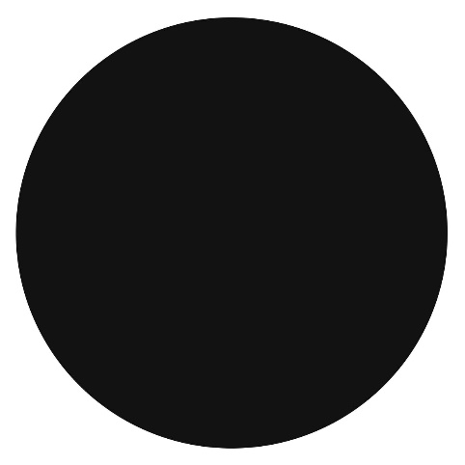
Drawing Paths Example 2
var startPt = 0;
var endPt = 2 * Math.PI;
canvasContext.beginPath();
canvasContext.arc(25, 25, beginPt, endPt);
canvasContext.fill();
canvasContext.closePath();

Slide 9
fillStyle() and strokeStyle()
fillStyle = color Sets the style used when filling shapes.
strokeStyle = color Sets the style for shapes' outlines.
By default, the stroke and fill color are set to black (#000000).
A newly set strokeStyle and/or fillStyle property becomes the default for all shapes.
Example:
canvasContext.fillStyle = “blue”;
canvasContext.strokeStyle = “#034AAD”;

Slide 10
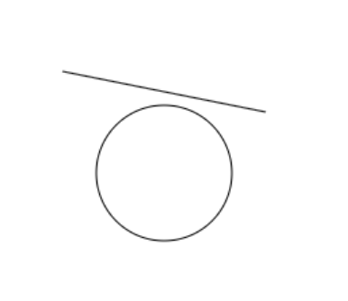
Exercise 1: Write the HTML and JavaScript to produce the image shown below.

Slide 11
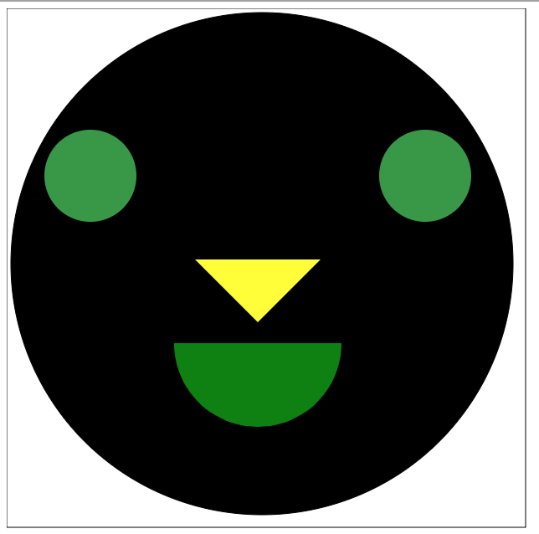
Exercise 2: Write the HTML and JavaScript to produce the image shown below.

