Slide 1
CSS and Box Model

Slide 2
Topics
Quick Tips and CSS style priorities
Divisions – The Design Process
Box sizing
Practice - MockUp Implementation

Slide 3
CSS Tips
To center an element, other than text, use the margin attributes.
image {
margin-left: auto;
margin-left: auto;
}
Float can be used for alignment, but it is unpredictable because it is highly responsive to the size of a screen.
image {
float:right;
}
Use clear to ensure that nothing else appears to the left/right of an element.
table {
clear: both;
margin-left: 100px;
width: 150px;
}

Slide 4
CSS Style Priorities
It matters where you define the rules and in what order they are applied.
Styles can be defined in different places.
A higher-priority rule will overwrite a previous definition.

Slide 5
Priority Rule 1: Inline Style Rule
Example:
<li>
<a href= "http://www.Redlands.edu" style="color: #90a184;"
title="About Us">About Us
</a>
</li>
NOTE: This style should usually be avoided.

Slide 6
Priority Rule 2: Style Rule Embedded in HTML
Example:
<head>
<title>A Simple Webpage</title>
<style>
table, th, td {
border: 1px solid black;
}
</style>
</head>
NOTE: Use only for very small projects.

Slide 7
Priority Rule 3: Stylesheet in a separate CSS file
IDEAL

Slide 8
Priority Rule 4: Style Used by a Browser
Different browsers have slightly different styles.
Browsers use default stylesheets to determine how to display HTML elements.
Because these rules differ sometimes between browsers, there are efforts to promote consistency in styles across browsers.

Slide 9
Final Statement on Priority Rules
If an object has multiple, overlapping CSS rules defined for it, the one with the higher priority will take effect.

Slide 10
Divisions in a Design
A webpage is a collection of objects.
When designing, objects should be placed in divisions.
div represents a division class.
div is used to divide a page into objects, box model elements.
Goal:
Position elements so that they can be easily rearranged if we decide to give users a different experience.

Slide 11

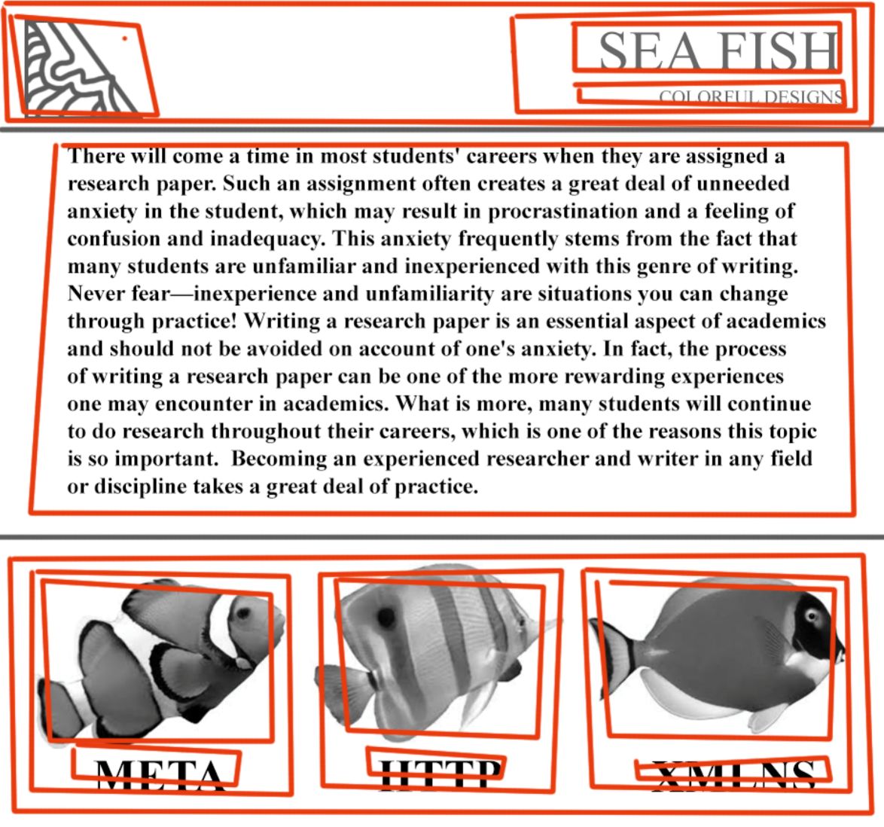
Carve a webpage mockup into box elements

Slide 12
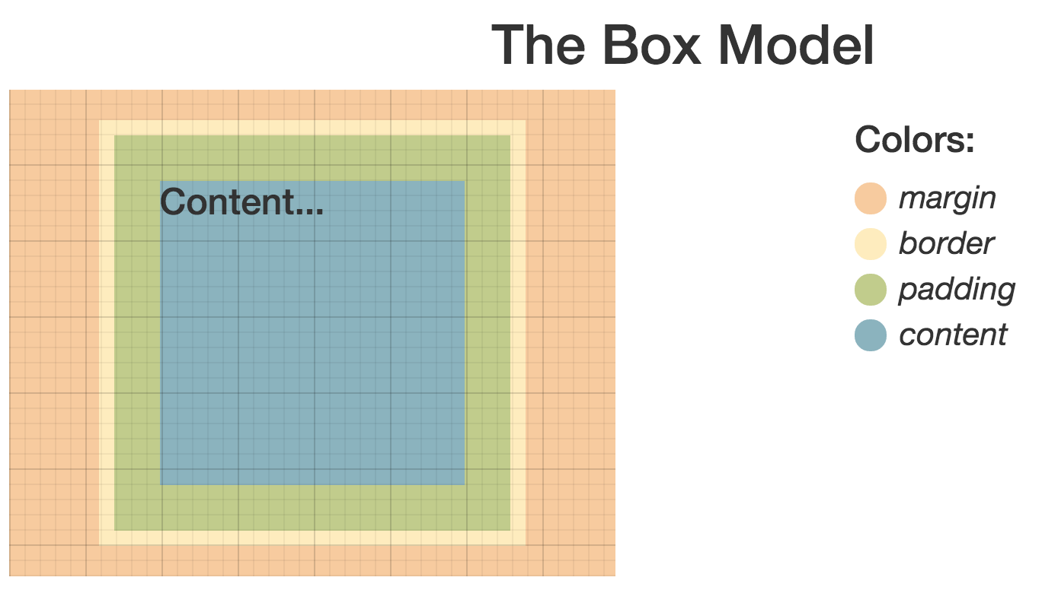
Every object on a web page is modeled as a box

Slide 13
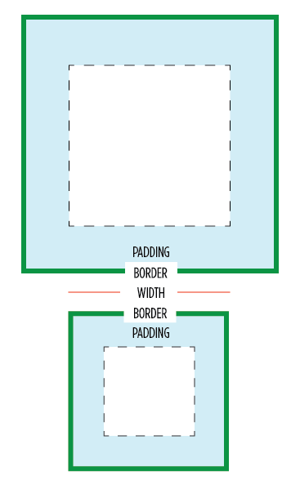
Box Model size
width + padding + border
=
actual visible/rendered width of an element's box
height + padding + border
=
actual visible/rendered height of an element's box

Slide 14
Box Sizing
The box-sizing property can make CSS layouts more intuitive.
The box-sizing property has a common value called border-box.
Every current browser supports box-sizing: border-box;
If you need to support older versions of Safari (< 5.1), Chrome (< 10), and Firefox (< 29), you should include the prefixes -webkit and -moz:
* {
-webkit-box-sizing: border-box;
-moz-box-sizing: border-box;
box-sizing: border-box;
}

Slide 15
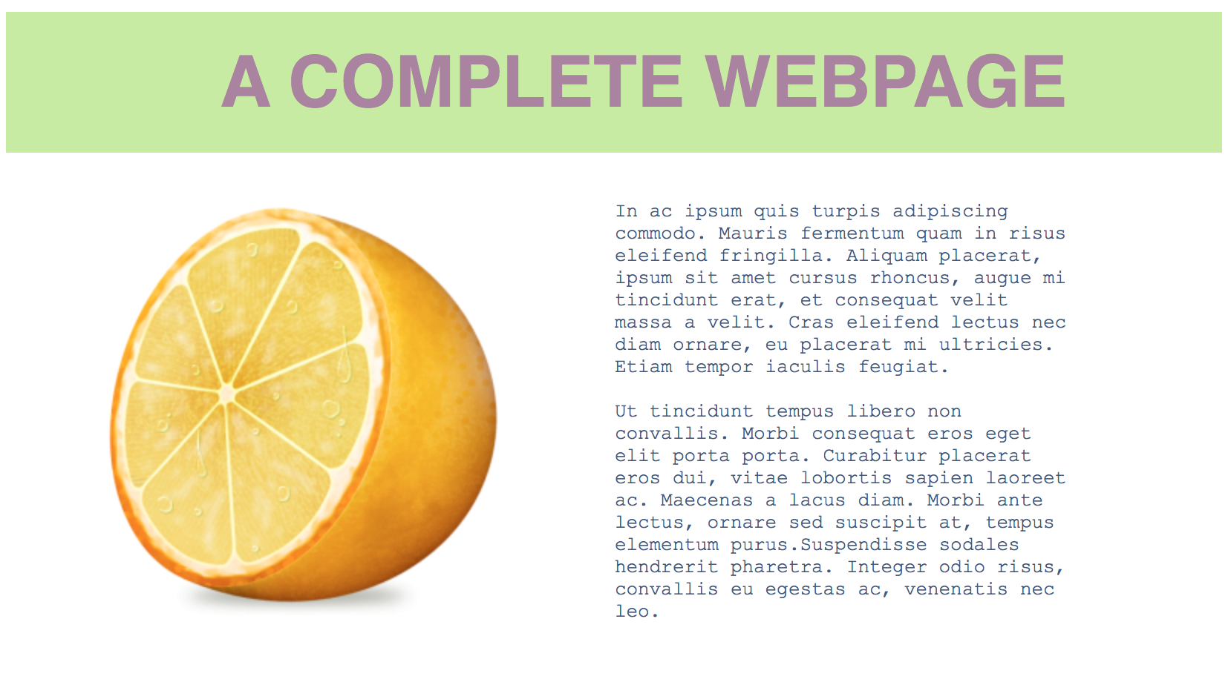
Lab 4 Exercise 1 How is this webpage carved up?

