Slide 1
Data Structures
TreeSet
TreeMap
HashMap

Slide 2
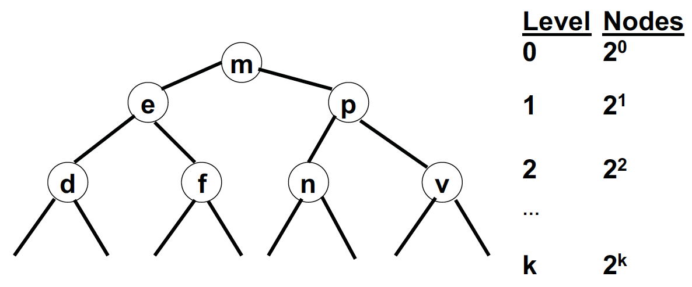
Review of Binary Trees
All nodes to the left are smaller than the parent.
All nodes to the right are larger than the parent.
Each node is unique. No duplicates.
A balanced binary tree has 2^{(k+1)}-1 nodes.
The maximum number of comparisons required to locate a given node is k.

Slide 3
Why are Binary Search Trees (BST) Important?
Binary search trees are used to store large amounts of data
They have a high capacity – Approximately 2^{k}.
They have fast search access (k comparisons).
Basic tree operations (insert, find, delete) are fairly simple to implement.
TIPS:
  It is important to keep the tree balanced, so that all branches are comparable length. This may require sophistication.
  Java has a Tree implementation.

Slide 4
Java Tree API
A Tree is a non-linear data structure.
The Tree data structure is useful on occasions where linear representation is not a good option.
Java provides two in-built classes, TreeSet and TreeMap, in Collection Framework.

Slide 5
Java TreeSet and TreeMap
TreeSet represents a collection of distinct elements.
TreeMap represents a collection of elements as a key - value pair. Each key maps to one value only; that means it disallows duplicate keys. A value with a distinct key may be duplicated, however.
What is the difference?
  TreeSet stores single objects
  TreeMaps requires the storage of two objects: Key and Value

Slide 6
Exercise 1:
Use the TreeSet to Construct a Binary Search Tree
Instantiate an empty binary search tree object named bst.
Insert the following nodes: “b”, “q”, “t”, “d”, “a”
  The first node, “b”, will be the root.
  Draw the tree by hand and perform an inOrder, postOrder, and preOrder traversal.
Display each node in bst.
TIP:
  Use the toArray() method to create an array holding all the nodes.
  Question: What type of traversal was used in toArray()?

Slide 7
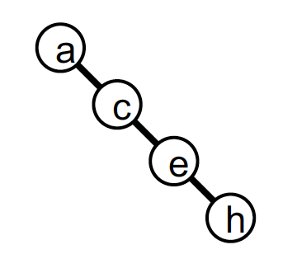
Java Tree Implementation
Trees are efficient if they are balanced.
  A balanced tree of depth 20 can hold about 2²⁰ nodes.
  If the tree were unbalanced, in the worst case it would require k levels to hold k nodes and k steps to locate, insert, and delete a node
TIP:
  To prevent unbalanced, Java uses a binary tree known as a red-black tree.
  Red-black trees automatically rebalance themselves if one branch becomes deeper than a sibling.

Slide 8
Exercise 2 Part I:
Build FullName class implemented as a Comparable
Comparable is an interface that imposes an ordering on objects of the class that implements it. This ordering is a natural ordering.
The class's compareTo() method is referred to as its natural comparison method. This method will compare this object with a specified object for order and will return one of -1, 0, or 1.
  -1: this object was less than the specified object.
  0 : this object was equal to the specified object.
  1: this object was greater than the specified object.

Slide 9
public class FullName implements Comparable<FullName> {
private final String firstName;
private final String lastName;
public FullName(String f, String l) {
firstName = f;
lastName = l;
}
public String getFirstName() { return firstName; }
public String getLastName() { return lastName; }
public int compareTo(FullName fn) {
// Complete the compareTo() method. Order by last name, then first name.
// NOTE: String has a compareTo() method
}
public String toString() {
// Complete the toString() method. Return first name, a space, and last name.
}
}

Slide 10
Exercise 2 Part II:
Create a TreeSet object to store a tree of names
FullName f1 = new FullName("Manuel", ”Nader");
FullName f2 = new FullName("Kacey", ”Que");
FullName f3 = new FullName("Jason", "Red");
FullName f4 = new FullName("Bobo", ”Baca");
TreeSet<FullName> names = new TreeSet<FullName>();
names.add(f1);
names.add(f2);
names.add(f3);
names.add(f4);

Slide 11
Exercise 2 Part III:
Display the tree of names.
for (FullName f : names)
System.out.println(f);
Question: What order of traversal was used in accessing names?

Slide 12
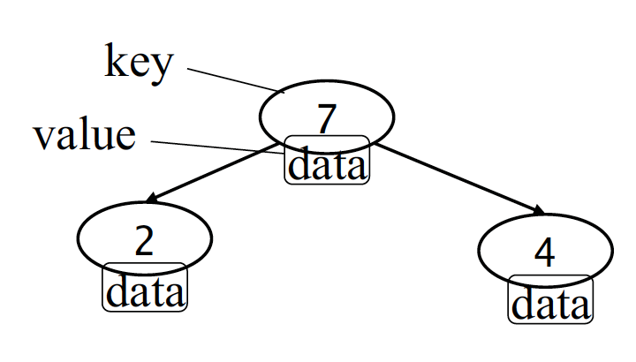
TreeMap
Each node in a TreeMap contains a key and a value.
A “key” is an ordered value, i.e. a key can be compared with another object of the same type.
A node in an ordered TreeMap consists of an ordered key and a value.
All the keys in a TreeMap should be of the samne type.

Slide 13
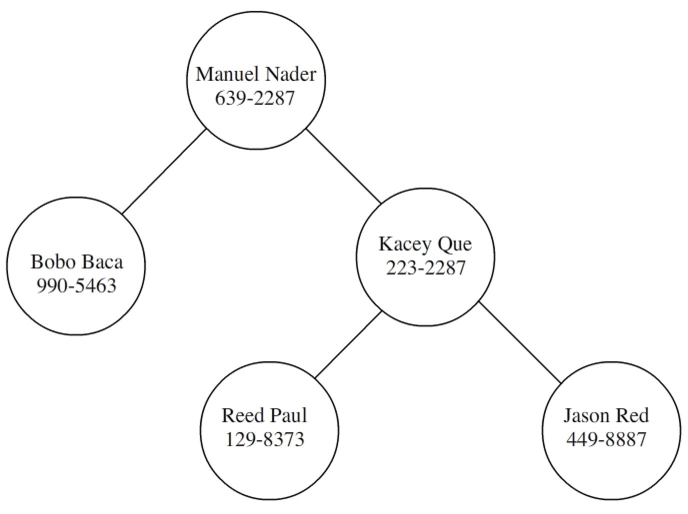
Exercise 3 Part I:
Create a phonebook (TreeMap) with the following entries.
Indicate the in-order traversal.
What is the key in the code below?
What is the value in the code below?
TreeMap<FullName,String> phones= new TreeMap<FullName,String>();
FullName f1 = new FullName("Manuel", ”Nader");
phones.put(f1, "639-2287");

Slide 14
Exercise 3 Part II:
Answers to questions
In the phones TreeMap, what is the node key?
FullName is the key.
In the phones TreeMap, what is the value?
String (phone number) is the value.

Slide 15
Exercise 3 Part III:
Create a TreeMap object to store a tree of names
Use a loop to display a JOptionPane that asks for a full name in the format: “firstName lastName”.
Create a lookup method that searches for and displays the phone number for the input name.
TIPS:
Use the String method split() to parse the name.
  -split() takes the delimiter as its argument and returns an array of Strings.
Use the TreeMap<FullName, String> method get() to return the phone number of the entered person.
  -get() will return the value if the key is found and a null if the key cannot be found.

Slide 16
Exercise 3 Part III
Code Guide
while (true) {
String text= JOptionPane.showInputDialog("Enter full name");
if (text.isEmpty()) break;
// TASK 1: Parse the full name (firstName lastName)
// TASK 2: Use get() with FullName key to retrieve phone number value.
// TASK 3:Print the phone number or "Subscriber unknown" if get() returns a null
}

Slide 17
Can we do better than a TreeMap for Data Structure Efficiency?
Possibly.
What about a HashMap?

Slide 18
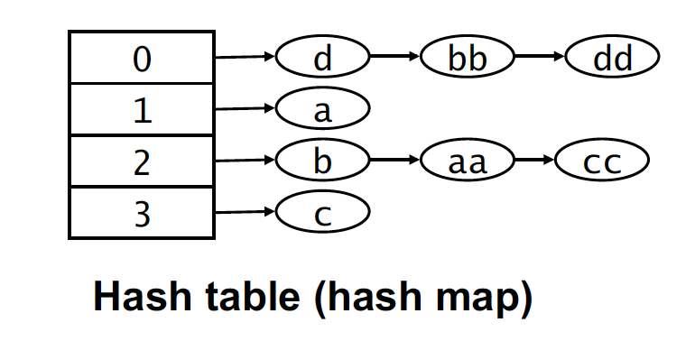
Hashing Illustration
Keys = {a, b, c, d, aa, cc, dd}
Hash Function: (sum of chars) % 4
Hashing maps each Object to an index in an array of Node references.
The array contains the “first reference to a linked list of Objects.
We traverse the list to add or find Objects that hash to that value.
We keep the lists short, so hash efficiency is close to array index lookup.

Slide 19
A Closer look at HashMap
HashMap holds keys and values, similar to TreeMap
HashMap is similar to a filing cabinet, in which each folder has a tab (hash code) and contains a small number of objects (list)
HashMap can provide a quick lookup time. This time depends on having a good hashCode() method and is statistical.
Elements in a HashMap are NOT ordered by anything useful. Storage order is by hash code.

Slide 20
Java Map API
1. Instantiate a HashMap:
Map<String, String> map = new HashMap<String, String>();
2. Store a key/value pair in the map:
map.put(key, value);
3. Retrieve a stored value for a key, or null if that key is not present in the map map.get(key) .
map.get(key)
4. Determine if a key is in the map:
map.containsKey(key)
5. Remove the key/value pair, if the key is present.
map.remove(key)

Slide 21
Exercise 4: Use HashMap to Construct the phone book
TASK 1:
Add an equals() method to the FullName class.
The equals method implements an equivalence relation between (non null) object references.
The Object class already provides an implementation of the equals method.
Add an Override.
@Override
public boolean equals(Object obj) {
}

Slide 22
Solution : equals()
@Override
public boolean equals(Object obj) {
boolean equalObjects = false;
//NOTE: getClass() returns the runtime class of a given Object.
if (obj != null && this.getClass() == obj.getClass()) {
FullName fnObj = (FullName) obj;
equalObjects =
firstName.equals(fnObj.getFirstName()) &&
lastName.equals(fnObj.getLastName());
}
return equalObjects;
}

Slide 23
Exercise 4: Use HashMap to Construct the phone book
TASK 2:
Add a hashCode() method to the FullName class.
  Use the pattern from a previous slide : Hash Function: (sum of chars) % 4

Slide 24
hashCode()
@Override
public int hashCode() {
return (firstName.length() + lastName.length()) % 4;
}

Slide 25
Exercise 4: Use HashMap to Construct the phone book
TASK 3:
Search for a phone number using a HashMap

Slide 26
Final Points
The TreeSet and TreeMap classes are the most obvious implementation of binary tree data structure in the Java API Library.
For the high-level users, the rules of data organization do not make any difference in its usages.
The tree structure is slightly more complicated and inefficient than its non-tree or linear counterparts, like HashMap, due to the numerous rules to maintain the norms of a balanced tree structure.
Unless a specific need arises, its HashMap should be used more often than trees.

