Slide 1
Sorting Algorithms
Sorting is one of the most common tasks in computer science.
Example:
Applications that present data objects or information, based on relevancy from a search.
Relevancy is first quantified by an algorithm and then sorted.

Slide 2
Common Sort Algorithms
Selection Sort Method
Insertion Sort Method
Bubble Sort Method (Research on your own.)
Quicksort Method

Slide 3
Selection Sort Method
This is the simplest of all sorting algorithms.
The idea behind a Selection sort is to sort a list in passes and group the objects into sorted and unsorted parts.
Example:
To sort integers in increasing order, the sorted part will occur in the front and the back will be the unsorted elements.
Repeated task is to find the smallest element in the unsorted part of the list and swap it into its appropriate place in the sorted part.
Eventually, the unsorted section will no longer exist.

Slide 4
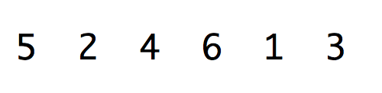
Selection Sort Demonstration
Given a list of 6 unsorted items.
The entire list is currently the unsorted list.
6 cells will require 5 passes.
After each pass, the smallest element in the unsorted part of the list is selected and swapped into its appropriate place in the sorted part.
After sorting the first five cells, the last cell will automatically be sorted, too.

Slide 5
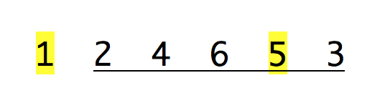
Selection Sort: Pass 1
Pass 1: The smallest value is selected from the unsorted section ( index range 0-5) and swapped with the first index.
After Pass 1:
Sorted Section.
Unsorted Section.

Slide 6
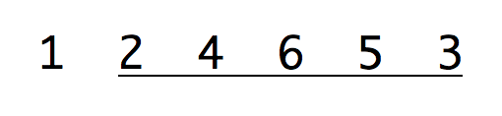
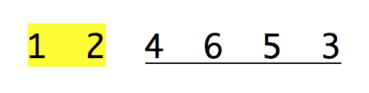
Selection Sort: Pass 2
Pass 2: The smallest value is selected from the unsorted section ( index range 1-5). No swap is required.
After Pass 2:
Sorted Section.
Unsorted Section.

Slide 7

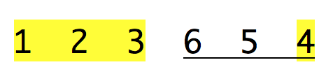
Selection Sort: Pass 3
Pass 3: The smallest value is selected from the unsorted section ( index range 2-5) and swapped with the first index.
After Pass 3:
Sorted Section.
Unsorted Section.

Slide 8

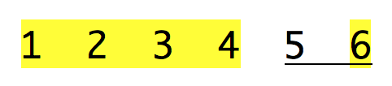
Selection Sort: Pass 4
Pass 4: The smallest value is selected from the unsorted section ( index range 3-5) and swapped with the first index.
After Pass 4:
Sorted Section.
Unsorted Section.

Slide 9

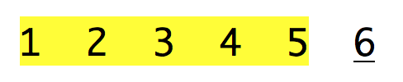
Selection Sort: Pass 5
Pass 5: The smallest value is selected from the unsorted section ( index range 4-5) and swapped with the first index.
After Pass 5:
The list is sorted.

Slide 10
Code the Selection Sort
public static void selectionSort(int[] arr){
for (int pass = 0; pass < arr.length - 1; pass++) {
//TASK 1: LOCATE THE SMALLEST ELEMENT
// WITHIN THE UNSORTED SECTION OF THE LIST
//TASK 2: SWAP THE SMALLEST ELEMENT
// INTO THE APPROPRIATE SPOT.
}
}

Slide 11
Insertion Sort Method
Insertion sort operates similar to the Selection Sort in that an unsorted and sorted section of the list is maintained.
The goal is to examine adjacent cells. An element in the unsorted section is then inserted into the correct position in sorted section.
This process is applied repeatedly until the list is sorted.
In insertion sort, sorting is carried out in passes.
After the nth pass, the first n+1 positions in the list will be sorted and the rest of the list will be unsorted.

Slide 12

Insertion Sort Demonstration
Given a list of 6 unsorted items.
The entire list is currently the unsorted list.
6 cells will require 5 passes.

Slide 13


Insertion Sort: Pass 1
Pass 1: search for unsorted adjacent elements from cells 0 to 1. Only one comparison is made.
After Pass 1:
Sorted Section.
Unsorted Section.

Slide 14
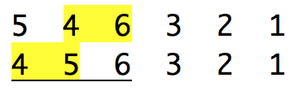
Insertion Sort: Pass 2
Pass 2: search for unsorted adjacent elements from cells 0 to 2. Two comparisons are made.
After Pass 2:
Sorted Section.
Unsorted Section.

Slide 15
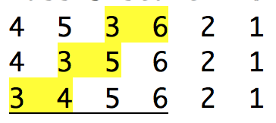
Insertion Sort: Pass 3
Pass 3: search for unsorted adjacent elements from cells 0 to 3. Three comparisons are made.
After Pass 3:
Sorted Section.
Unsorted Section.

Slide 16
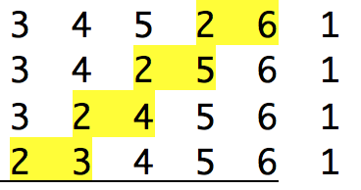
Insertion Sort: Pass 4
Pass 4: search for unsorted adjacent elements from cells 0 to 4. Four comparisons are made.
After Pass 4:
Sorted Section.
Unsorted Section.

Slide 17
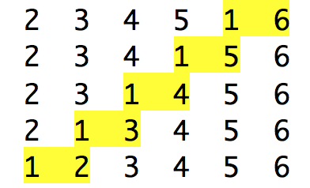
Insertion Sort: Pass 5
Pass 5: search for unsorted adjacent elements from cells 0 to 5. Five comparisons are made.
After Pass 5:
List is Sorted.

Slide 18
Code the Insertion Sort

Slide 19
Analyze the Algorithms Selection Sort Insertion Sort

Slide 20
Selection Sort Findings
Selection sort has an average case time complexity of O(n2).
Due to this, insertion sort is also not suitable for sorting large lists.

Slide 21
Insertion Sort Findings
Insertion Sort has a best case when the list is already sorted. In this case insertion sort has a linear running time Θ(n).
The simplest worst case is a list sorted in reverse order.
In this case, every iteration of the inner loop will scan and shift the entire sorted subsection of the array before inserting the next element.
This gives insertion sort a quadratic running time O(n2).

Slide 22
Selection vs Insertion Sort
The average case for both Selection Sort and Insertion Sort is quadratic.
Both these methods are impractical for sorting large arrays.
Insertion sort is one of the fastest algorithms for sorting very small arrays. The exact threshold must be determined experimentally and depends on the machine, but is commonly around ten.

Slide 23
Quick Sort
Quicksort is based on the strategy of divide and conquer.
The goal is to partition the array into sub-arrays.
Each partition is repeatedly carved up and sorted in sections until the entire list is sorted.

