Slide 1
MVC Basics
Model-View-Controller
Program Design

Slide 2
Model-View-Controller
software design pattern
M: model
V: view ( we will ignore this component)
C: controller

Slide 3
Model-View-Controller
Model objects are used to encapsulate the data. Models are organized around classes.
    Example: A game of Blackjack will have at least two Models: Card and Deck
View objects are visual interface objects (View Objects). These objects refer to the graphical user interface. We won’t be using these.
A Controller act as an intermediary between the interface and the Model objects.
    Example: Blackjack game engine

Slide 4
Practice
Build a Quiz App

Slide 5
Quiz Application Requirements
Who will be using this app?
  The user can practice a subject by taking a quiz containing a series of questions.
Basic Requirements
A quiz will have many questions.
A quiz may be taken as many times.
Each time the user takes the quiz, the questions will be shuffled.
Once the user has read and answered a single question, they receive a response of correct or incorrect and a score.

Slide 6
Quiz App Design
This is a console app.
Model: Quiz applications rely on a set of questions. Questions will be modeled using a Question class.
Controller: A QuizEngine class will control the game play of the app.

Slide 7
QuizApp Design
QuizApp
main()
The QuizApp has
an engine to control
a quiz.
QuizEngine
Controls the quiz
A quiz has
a list of
questions
Qestion

Slide 8
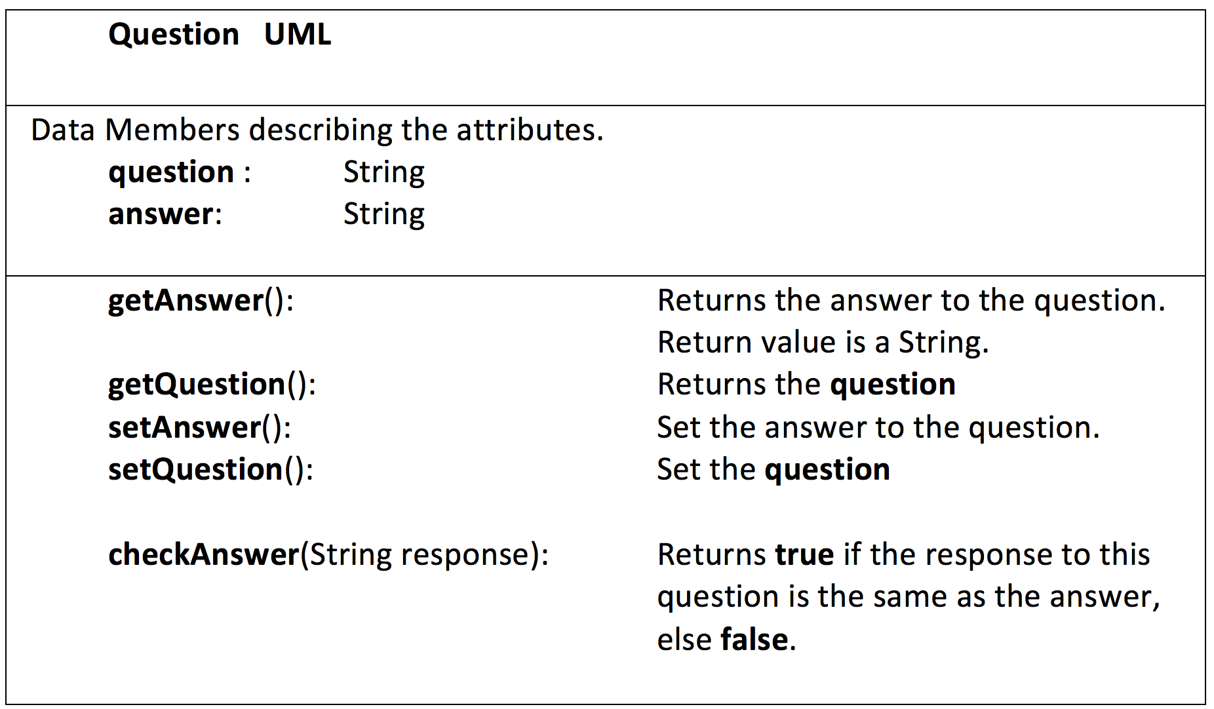

Slide 9
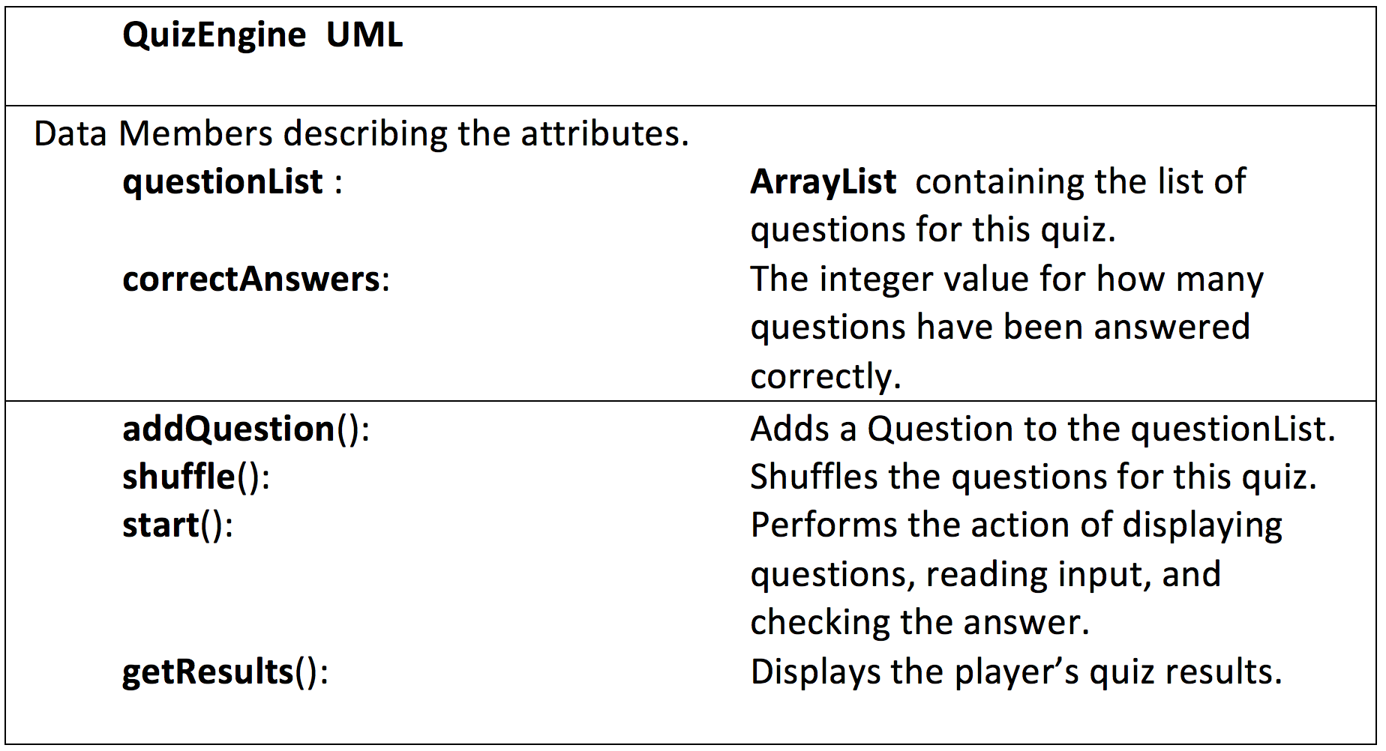

Slide 10
Quiz Questions
Normally quiz data, such as the questions and answers, are stored as external text files.
We will simplify this by populating our quiz directly from our code file.

Slide 11
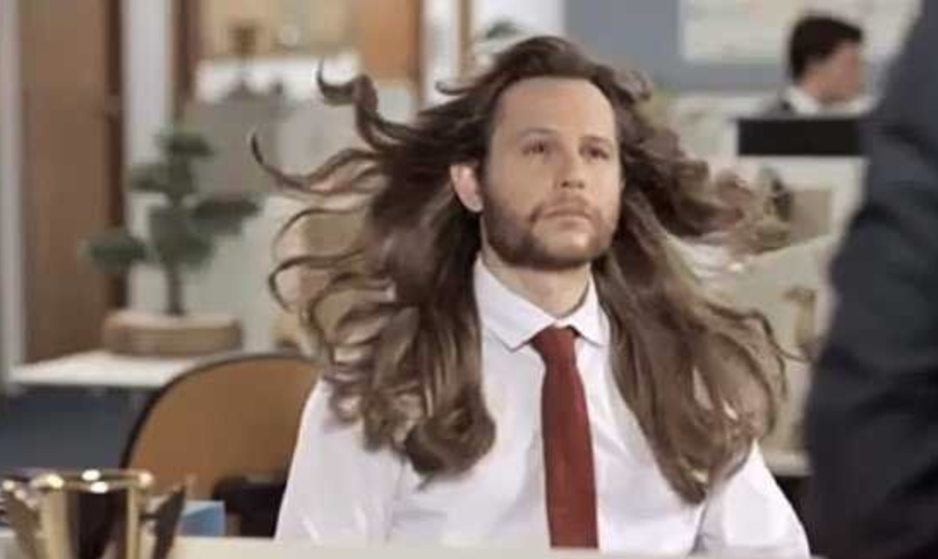
Question 1
What country gave us the word “Shampoo”?

Slide 12
Question 1:
What country gave us the word “Shampoo”?
Answer :
India

Slide 13
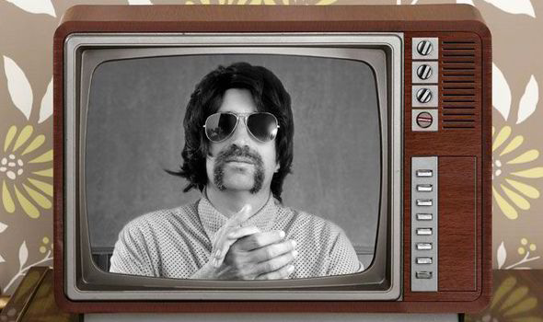
Question 2
How many people living in the UK watched TV on black and white screens in 2018?

Slide 14
Question 2:
How many people living in the UK watched TV on black and white screens in 2018?
Answer :
1000

Slide 15
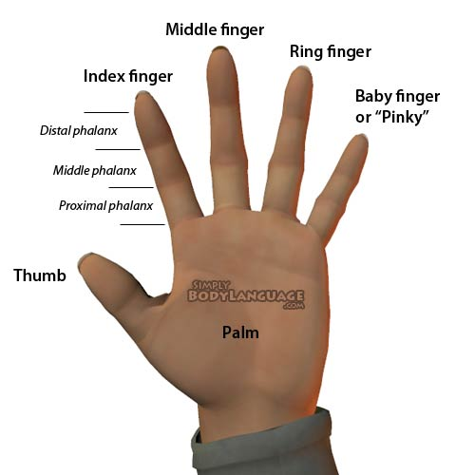
Question 3
Which fingernail grows the fastest?

Slide 16
Question 3:
Which fingernail grows the fastest?
Answer :
Middle finger

Slide 17
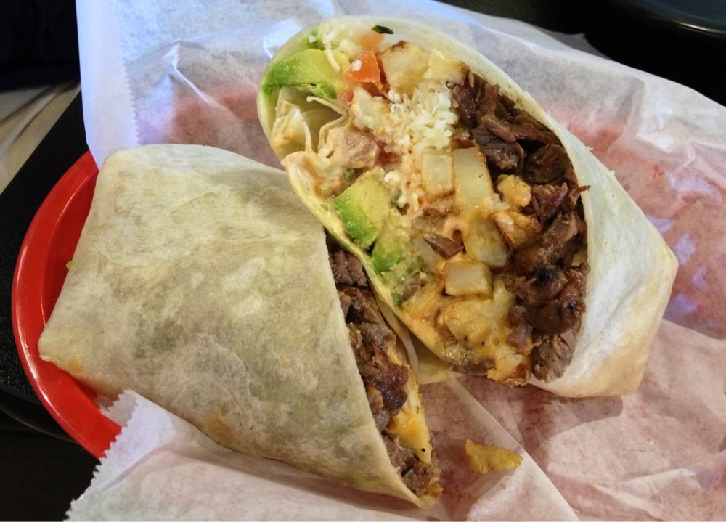
Question 4
Who makes the best burrito in Redlands?

Slide 18
Question 4:
Who makes the best burrito in Redlands?
Answer :
Cuco’s

Slide 19
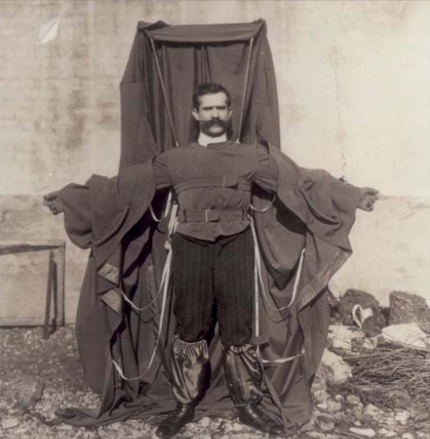
Question 5
The first wing-suit flight occurred in 1912 by a young tailor who built the suit himself and jumped off the Eiffel Tower.
What was this man’s nationality?

Slide 20
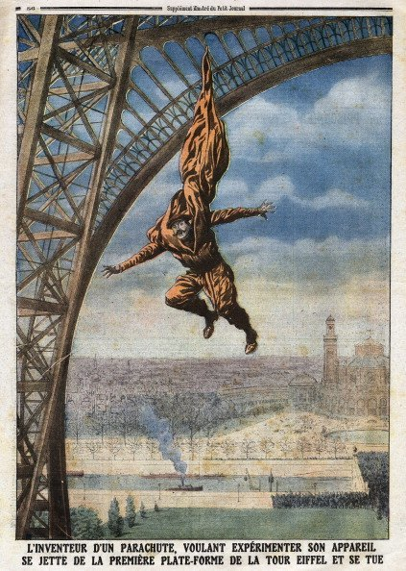
Question 5:
Franz Reichelt jumped off the Eiffel Tower in 1912 wearing the flight suit that he invented.
What was his nationality?
Answer :
French (Austrian born)

Slide 21
import java.util.Scanner;
public class QuizApp {
public static void main(String[] args) {
// TASK 1: CREATE THE QUESTIONS TO BE USED IN THIS QUIZ.
// TASK 2: CREATE A QUIZ ENGINE OBJECT AND POPULATE IT WITH THE QUESTIONS.
// TASK 3:
// (A) ALLOW THE USER TO TAKE THE QUIZ AS MANY TIMES AS THEY WANT.
// (B) SHUFFLE THE QUESTIONS
// (C) START THE QUIZ
// (D) DISPLAY THE RESULTS OF THE QUIZ
}
}

