Slide 1
Linked Lists

Slide 2
Topics
Understanding Linked Lists
Pros and cons of Linked Lists.
Using the Java LinkedList Class.
Implementing a LinkedList Class.
  Adding Linked Nodes
  Deleting Linked Nodes

Slide 3
Understanding Linked Lists
What is a linked list and how is it similar to an array or an ArrayList?
  A Linked List is an ordered collection of elements.
  An array and an ArrayList are also ordered collection of elements.
How is a Linked List different from an array or an ArrayList?
  The difference between a Linked List and an array or ArrayList is efficiency.
  A linked list allows efficient addition and removal of elements in the middle of a sequence.

Slide 4
In-depth look at Efficiency of Ordered Elements
To understand the inefficiency of an array of ArrayList, imagine a program that maintains a sequence of users.
If a user wants to be removed from the list, a gap is created when an element is deleted.
Once a gap appears, it needs to be closed up.
Conversely, when a user needs to be added in the middle of an ordered sequence, all the users following the new user must be moved to the end of the ordered list.

Slide 5
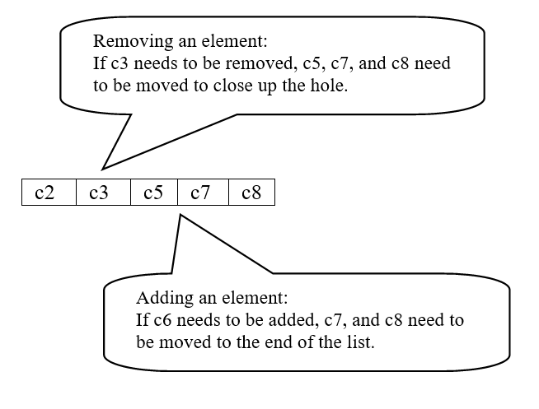
Gaps created when Deleting and Adding
Elements in an Array or ArrayList
Moving a large number of elements in an Array or ArrayList can involve a substantial amount of processing time.

Slide 6
What is a Linked List?
A linked list uses a sequence of nodes to create an ordered list.
A node is an object that stores an element and references to the neighboring nodes in the sequence.
Example : c2 through c8 are nodes in a Linked List

Slide 7
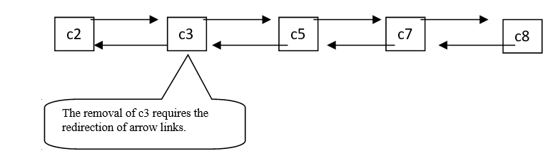
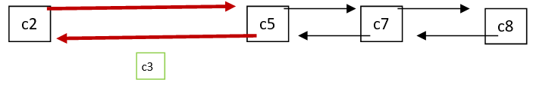
Benefit of a Linked List
Linked Lists allow speedy insertion and removal.
Before:
After:

Slide 8
Cons of a Linked List
Accessing elements in a Linked List
can be slow because it is sequential.
Example:
Accessing c5 requires that we visit c2, c3, then c5.
Or, in reverse we visit c8, c7, and then c5.

Slide 9
Using the Java LinkedList Class
Creating a basic Linked List can be done by using the LinkedList class provided by the Java Library.
This class is part of the java.util package.
Creating a Linked List requires a class.
Example:
LinkedList<Integer> list = new LinkedList<Integer>();

Slide 10
LinkedList Class Methods
addLast()
addFirst()
getFirst()
getLast()
removeFirst()

Slide 11
LinkedList Class Inherited Methods
The LinkedList class also inherits the methods of the collection interface.
      size()
      add()
      toString()
      contains()

Slide 12
Traversing a LinkedList
You may use the for each loop structure with any collection.
Example
    for (Integer c:list)
      System.out.println(c);

Slide 13
Iterators for Visiting an element in a LinkedList
Provide an iterator for visiting list elements.
Example
ListIterator<Integer> itr = list.listIterator();
____________________________________________________
You can use methods of the Iterator and ListIterator Interfaces
    next()
    previous()
    hasNext()
    hasPrevious()
    set()
    add()
    remove()

Slide 14
Tips for LinkedLists
Draw before and after diagrams showing relevant references.
Use before and after diagrams to show elements that need to be altered.
Be sure that no links are left undefined at the conclusion of your code.
Dangling nodes will become garbage and collected by the garbage collector.
Verify that your algorithm works correctly for an empty list and for a list with only one node.

Slide 15

Practice – Create the Linked List Below
Additional Tasks:
Create an iterator and position it after the third number in the list. Insert the number 4 at this position.
Remove the number 5 from the list. You will need to reposition the iterator.
Display the new contents of the linked list.

Slide 16
Implementing a LinkedList Class
Create your own LinkedList Class.
LinkedList will rely on a Node Class containing a generic object data.
This first LinkedList will be a single linked list.
A pointer will be used to point to the next node.
No pointers will be used to point to a previous node.
Member methods will include addNode() and deleteNode()

