Slide 1
Introduction to Java Swing
Graphical User Interface

Slide 2
Two Types of Applications
Console Applications:
Input from keyboard using java.util.Scanner
Output is usually displayed to a console window using System.out.print().
Not practical for real-world
GUI Applications
Graphical User Interface
Very practical for real-world

Slide 3
What is Java Swing?
Java Swing is a framework for developing Java GUI Apps.
Graphical functionality is provided by the library. There is no need to write your own.
Note:
Java 7: Uses Swing (current applications still use it.)
Java 8+: JavaFX

Slide 4
Topics
Swing Components
  JFrame
  JComponent
  JPanel
  User Interface (UI) components: buttons, text fields, labels, etc.
Action Events
Building a Fractal drawing application.

Slide 5
Swing Components
Swing is a toolkit that Sun Microsystems created to enable large-scale java applications.
Swing provides a wide array of visual and interactive components.
All Swing component names begin with "J"

Slide 6
JFrame
The graphical window for an application.
JFrame provides a top-level window with a title, border.
JFrame is a container component.
User Interface components can be easily added to a JFrame.

Slide 7
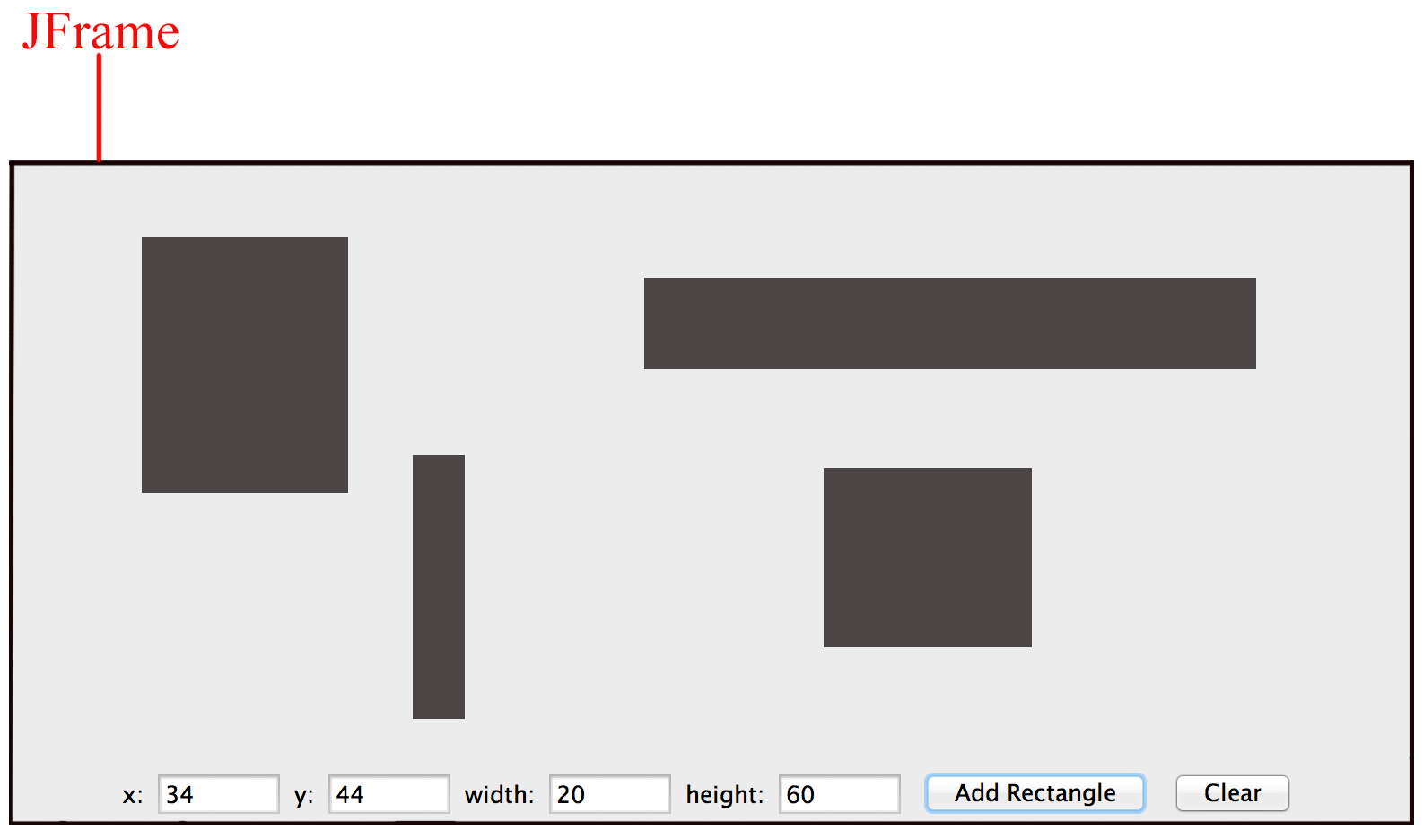
JFrame Example
The application window shown below is a JFrame.
Buttons, text input fields, and a graphic component have been added to the JFrame.

Slide 8
JComponent
This is a container class.
jComponent also provides functionality for painting and drawing.

Slide 9
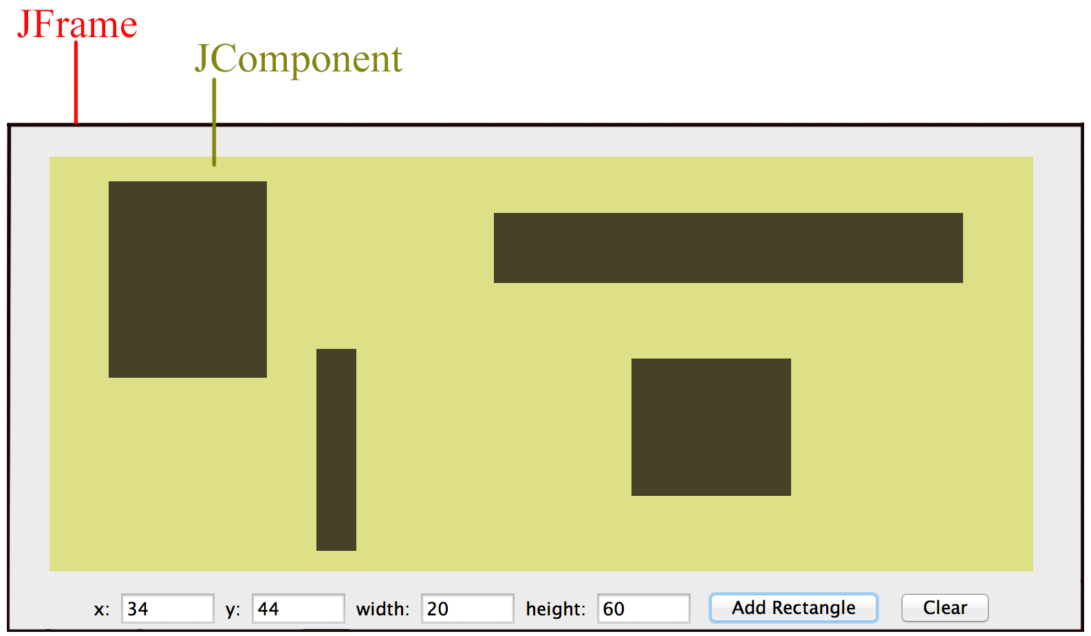
Jcomponent Example:
.
A JComponent element was added to the Jframe.
Rectangles were drawn on the JComponent.

Slide 10
Common UI Components
JButton : This is a typical button. Buttons can react to an action event.
JTextField: This is a standard input text box for the input of a single line of text. A JTextField can react to input events.
JLabel: Used to label a nearby action component. Labels do not react to action events or input events.

Slide 11
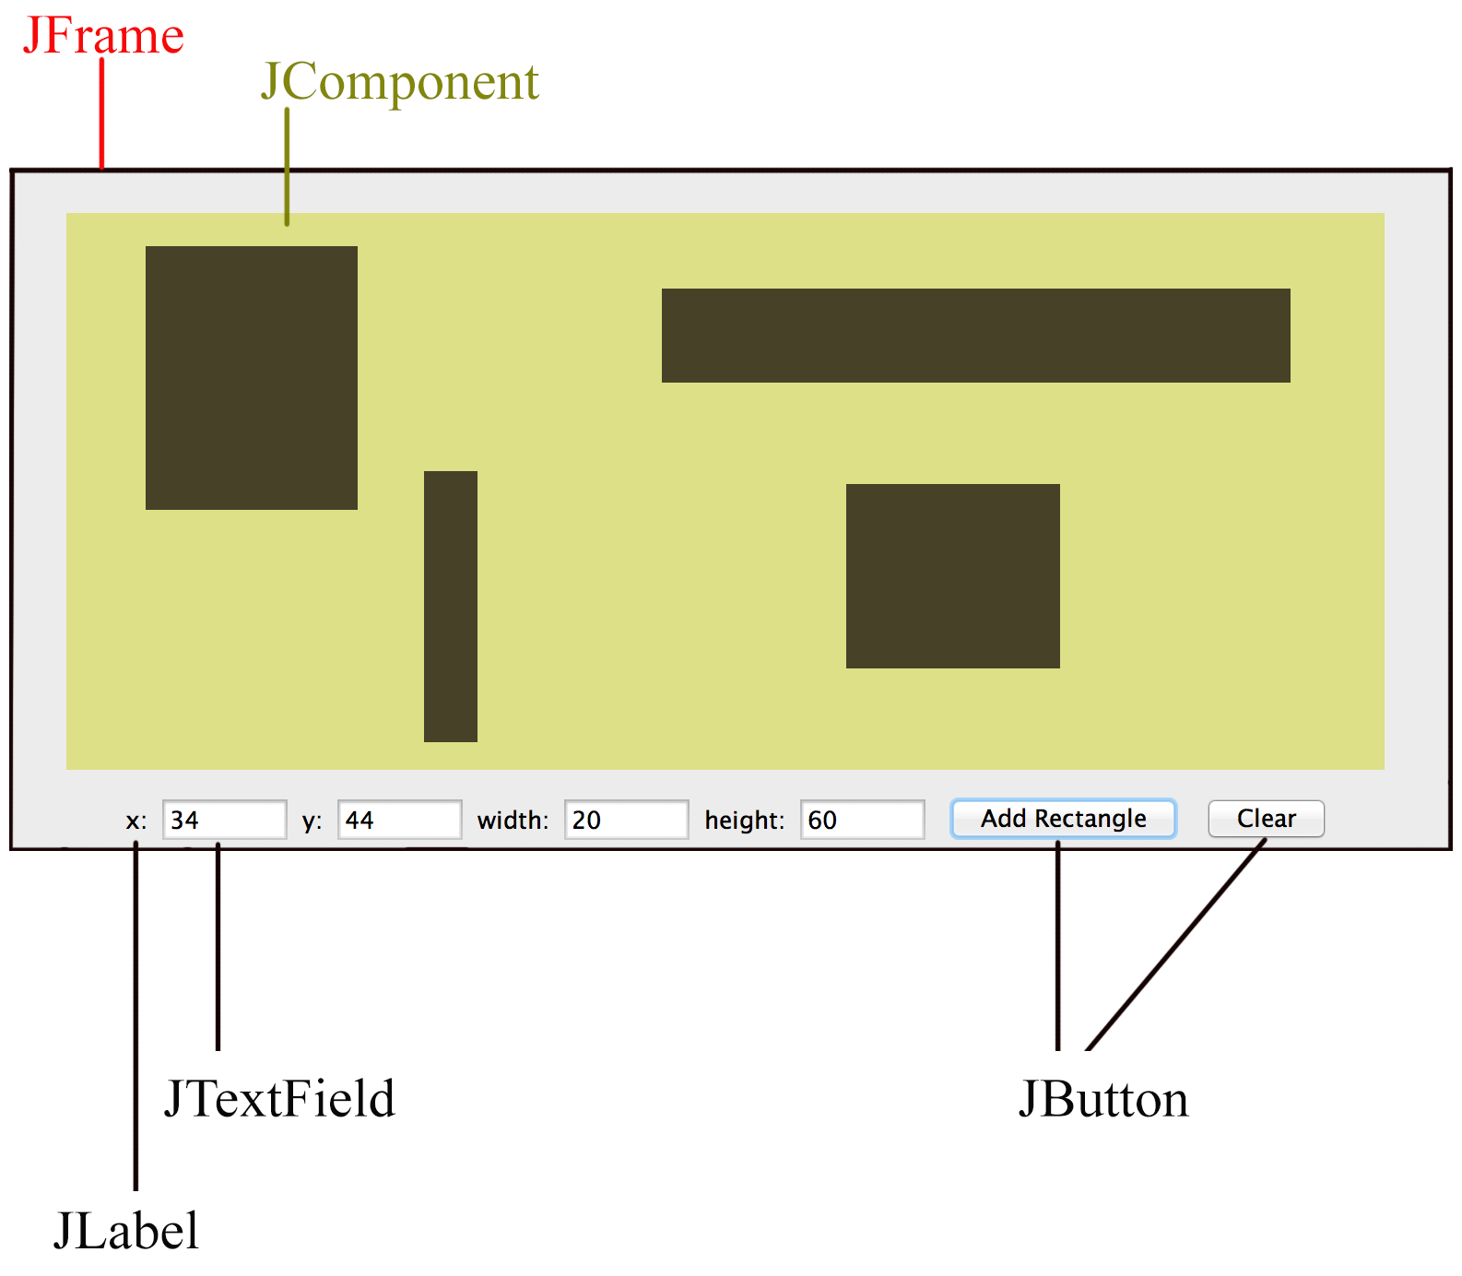

Slide 12
ActionEvent Handling
UIComponents, such as a Jbutton, fire off ActionEvents to indicate some kind of action has occurred.
For example, a JButton fires off an ActionEvent whenever the user presses it.
To respond to an ActionEvent, an action listener must be attached to the UI component.
An event listener is triggered when an action event occurs.
action event can be registered to many UI components.

Slide 13
Handling Events
Clicking a button on the interface is an example of an event. When an event occurs, there are three objects that must be involved:
The object causing the event, the event source, such as a button.
An object representing the event, the ActionEvent.
The object that listens for and then handles a triggered event, the ActionListener.

Slide 14
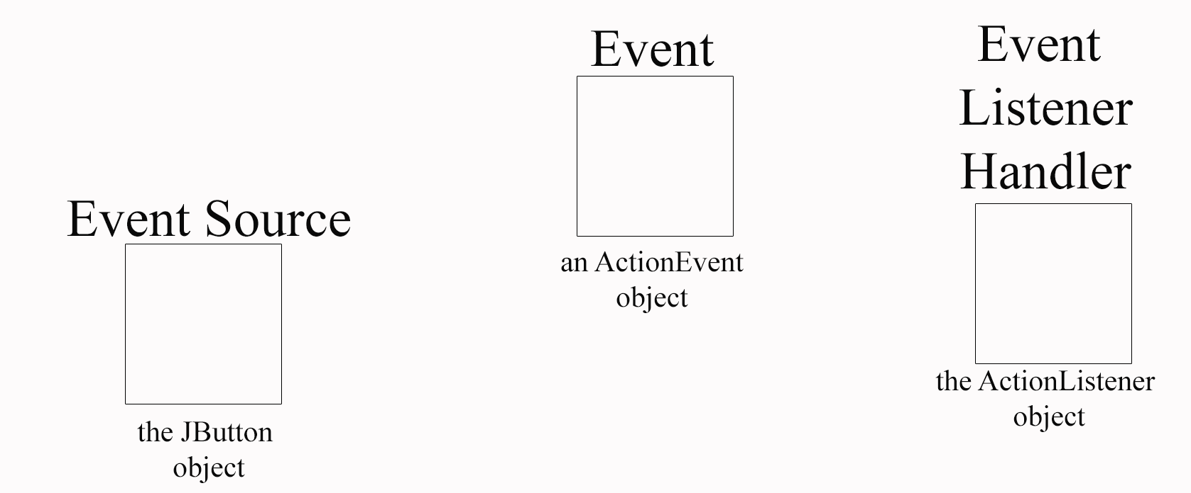
The ActionListener object provides a method called actionPerformed that accepts an ActionEvent argument.

Slide 15
Example:
A button is created.
An ActionListener is instantiated and registered to the button.
When a button click event occurs, the actionPerformed () method will respond.
private void createButton() {
button = new JButton("Create Rectangles");
ActionListener listener = new AddMyListener();
button.addActionListener(listener);
}
class AddMyListener implements ActionListener {
public void actionPerformed(ActionEvent event) {
//DRAW ON ADRAWING COMPONENT
DrawComponent.createRectangle();
}
}

Slide 16
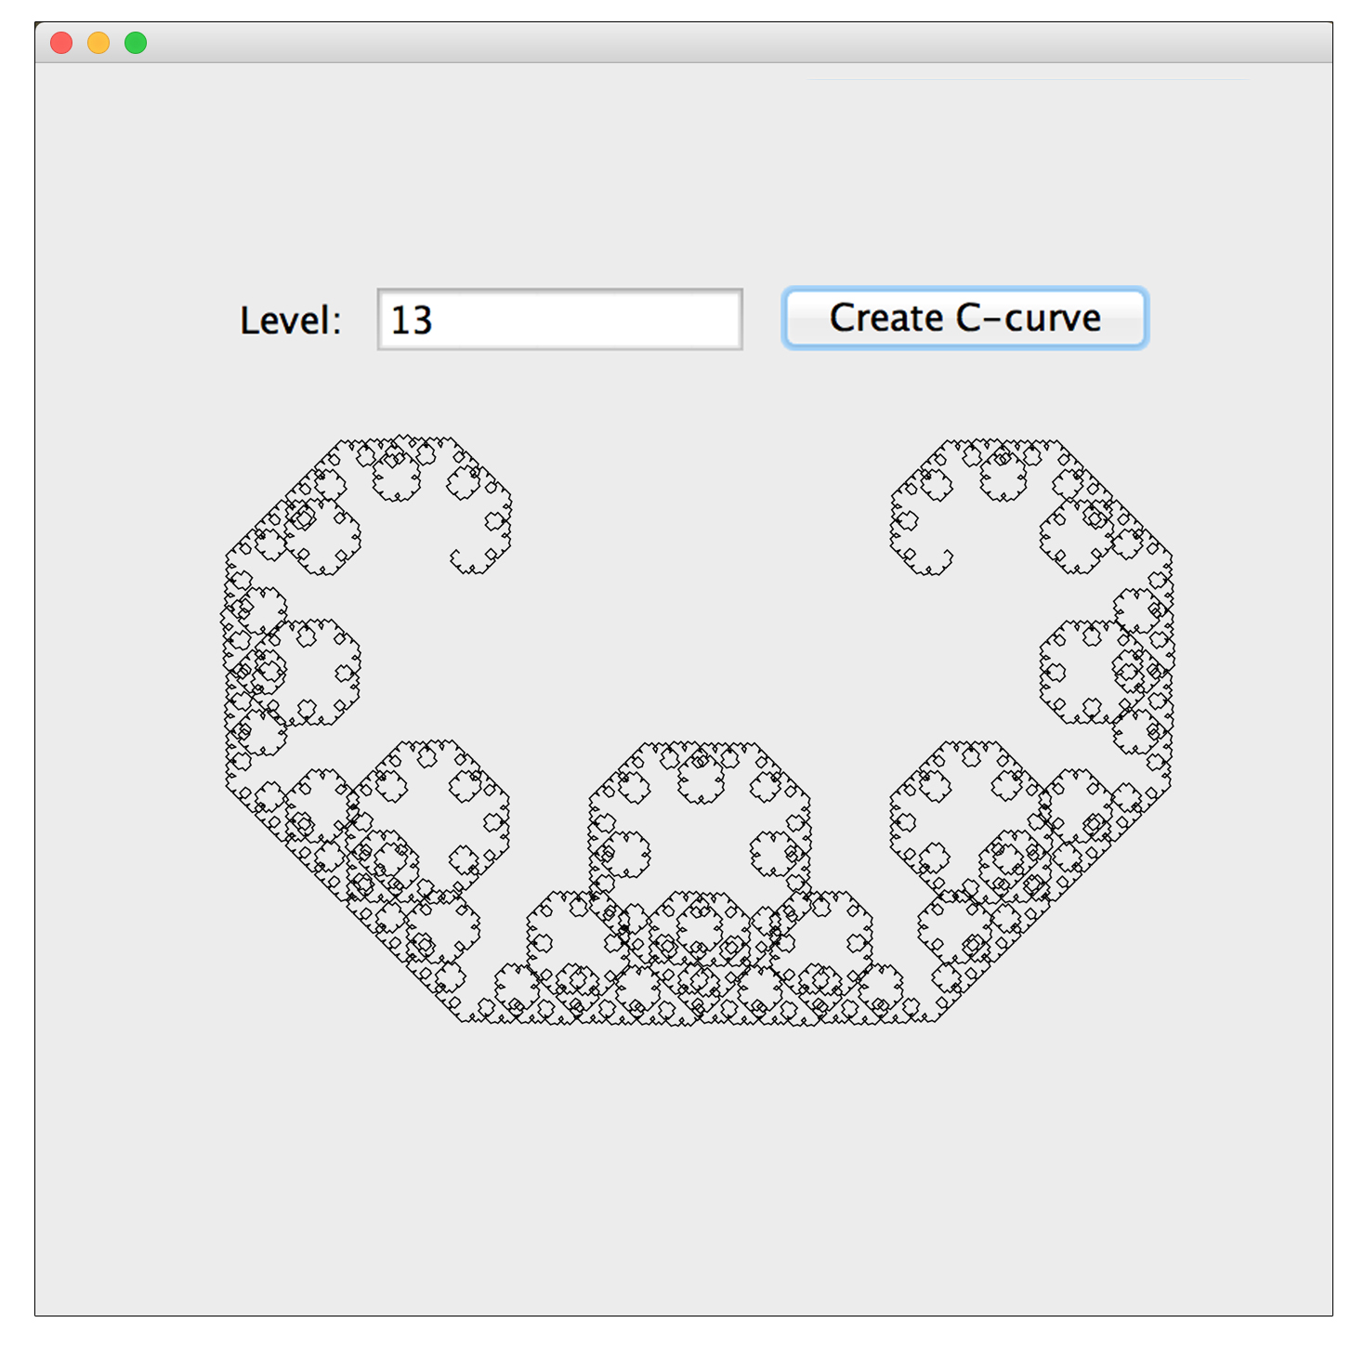
Build the Fractal Generator
App

Slide 17
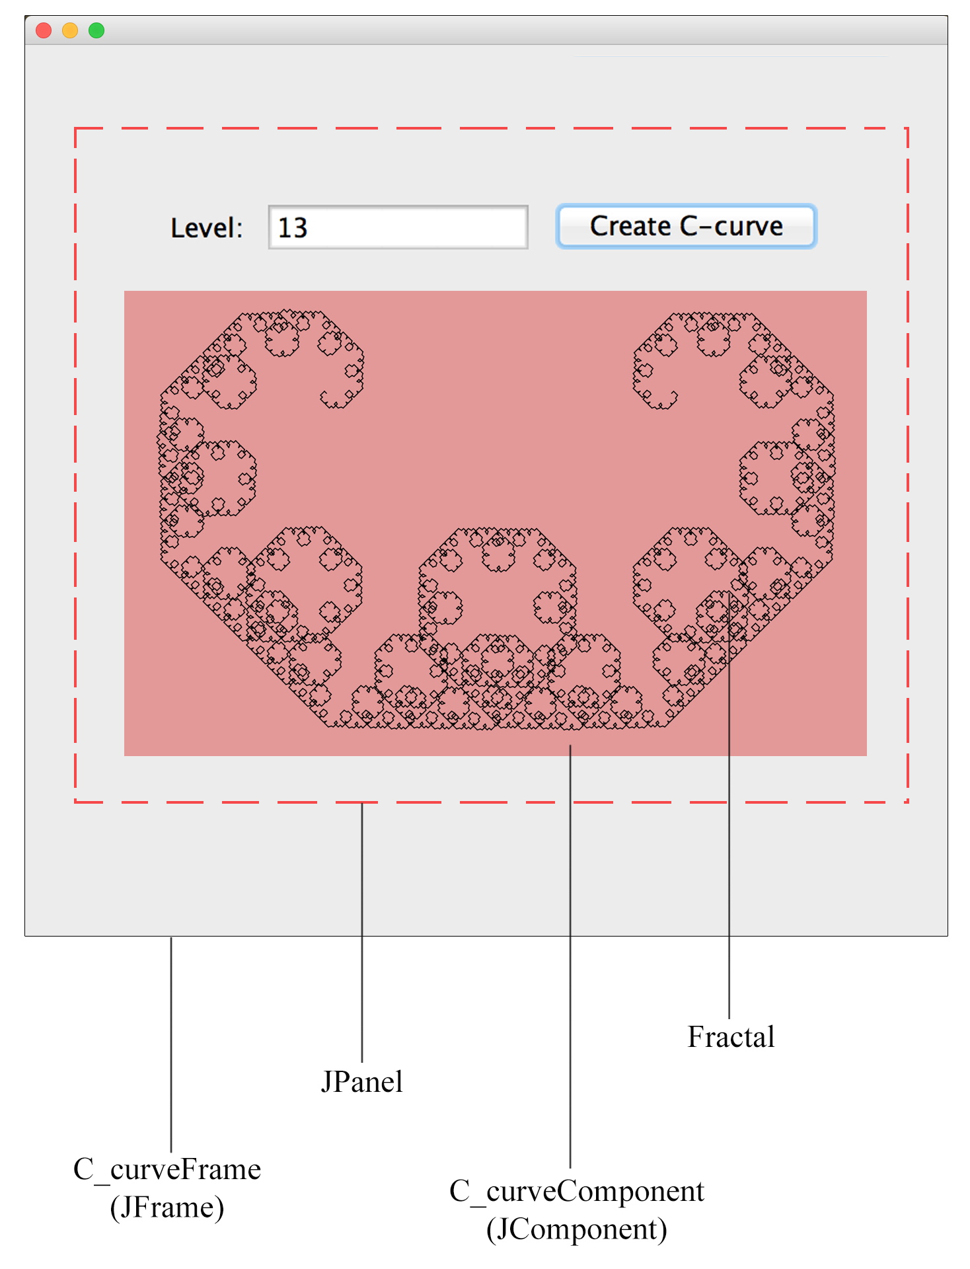

Slide 18
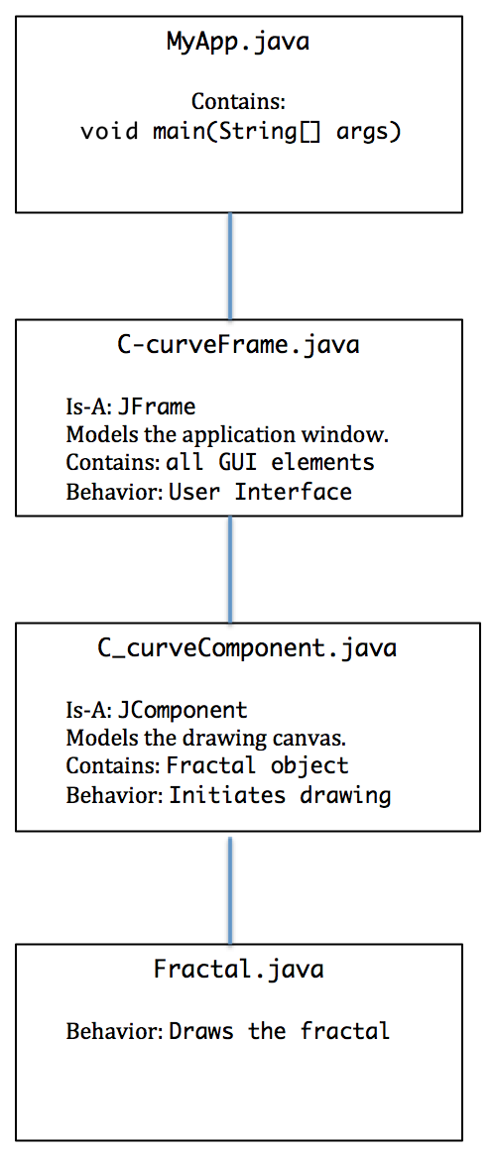
App
Structure Design uses a
MVC
Architecture

Slide 19
Build the App from the Bottom Up!
Fractal.java
C_curveComponent
C-curveFrame
MyApp

Slide 20
import java.awt.Graphics;
public class Fractal {
public void drawCCurve(Graphics g, int x1, int y1, int x2, int y2, int level) {
//PRIMITIVE STATE: DRAWS A STRAIGHT LINE FROM X1,Y1 TO X2,Y2
if (level == 1){
g.drawLine(x1, y1, x2, y2);
}
//RECURSIVE ELEMENT: TWO LINES WILL BE PRODUCED FOR EVERY SINGLE LINE
else {
int xn = (x1 + x2) / 2 + (y1 - y2) / 2;
int yn = (x2 - x1) / 2 + (y1 + y2) / 2;
drawCCurve(g, x1, y1, xn, yn, level - 1);
drawCCurve(g, xn, yn, x2, y2, level - 1);
}
}
}
Fractal.java

Slide 21
public class C_curveComponent extends JComponent {
private Fractal fractal;
private int level;
private int x1, y1, x2, y2;
public C_curveComponent() {
level = 2;
fractal = new Fractal();
}
public void setXY(int _x1, int _y1, int _x2, int _y2) {
x1 = _x1; y1 = _y1; x2 = _x2; y2 = _y2;
}
public void setLevel(int _level){
level = _level;
}
public void createCcurve() {
repaint();
}
public void paintComponent(Graphics g) {
fractal.drawCCurve(g, x1, y1, x2, y2, level);
}
}
C-curveComponent.java

Slide 22
public class C_curveFrame extends JFrame {
private JPanel panel;
private JLabel levelLabel;
private JTextField levelField;
private JButton button;
private C_curveComponent cCurveDrawComponent;
public C_curveFrame() {
// TASK : BUILD THE PANEL ELEMENTS
this.setSize(700, 700); //WINDOW SIZE
panel = new JPanel();
levelLabel = new JLabel("Level: ");
levelField = new JTextField(10); //FIELD WIDTH OF 10
levelField.setText("" + 2); //INITIALIZE THE TEXT FIELD TO 2
button = new JButton("Create C-curve");
panel.add(levelLabel);
panel.add(levelField);
panel.add(button);
cCurveDrawComponent = new C_curveComponent();
cCurveDrawComponent.setPreferredSize(new Dimension(700,700));
cCurveDrawComponent.setLevel(2); //2 is the default level
panel.add(cCurveDrawComponent);
C-curveFrame.java

Slide 23
C-curveFrame.java
// TASK : ADD THE COMPLETED PANEL TO THE FRAME WINDOW
this.add(panel);
// TASK : REGISTER AN ACTION LISTENER FOR THE BUTTON
ActionListener listener = new AddMyListener();
button.addActionListener(listener);
}

Slide 24
class AddMyListener implements ActionListener {
public void actionPerformed(ActionEvent event) {
//TASK 1: GET THE FRACTAL LEVEL INPUT BY THE USER
int level = Integer.parseInt(levelField.getText());
cCurveDrawComponent.setLevel(level);
//TASK 2: COMPUTE THE STARTING AND ENDING XY COORDINATES
int frame_width = 700;
int frame_height = 700;
int x1 = frame_width / 4;
int y1 = frame_height / 3;
int x2 = frame_width - x1;
int y2 = y1;
//TASK 3: SET THE XY START AND END FOR THE DRAWING COMPONENT
cCurveDrawComponent.setXY(x1, y1, x2, y2);
//TASK 4: CREATE THE CURVE ON THE DRAWING COMPONENT
cCurveDrawComponent.createCcurve();
}
}
}
C-curveFrame.java

Slide 25
MyApp.java
import javax.swing.JFrame;
public class MyApp {
public static void main(String[] args) {
JFrame frame = new C_curveFrame();
frame.setDefaultCloseOperation(JFrame.EXIT_ON_CLOSE);
frame.setVisible(true);
}
}

