Slide 1
Topics
Review
Interface Classes

Slide 2
Review
Abstract classes define the common
attributes of a general class.

Slide 3
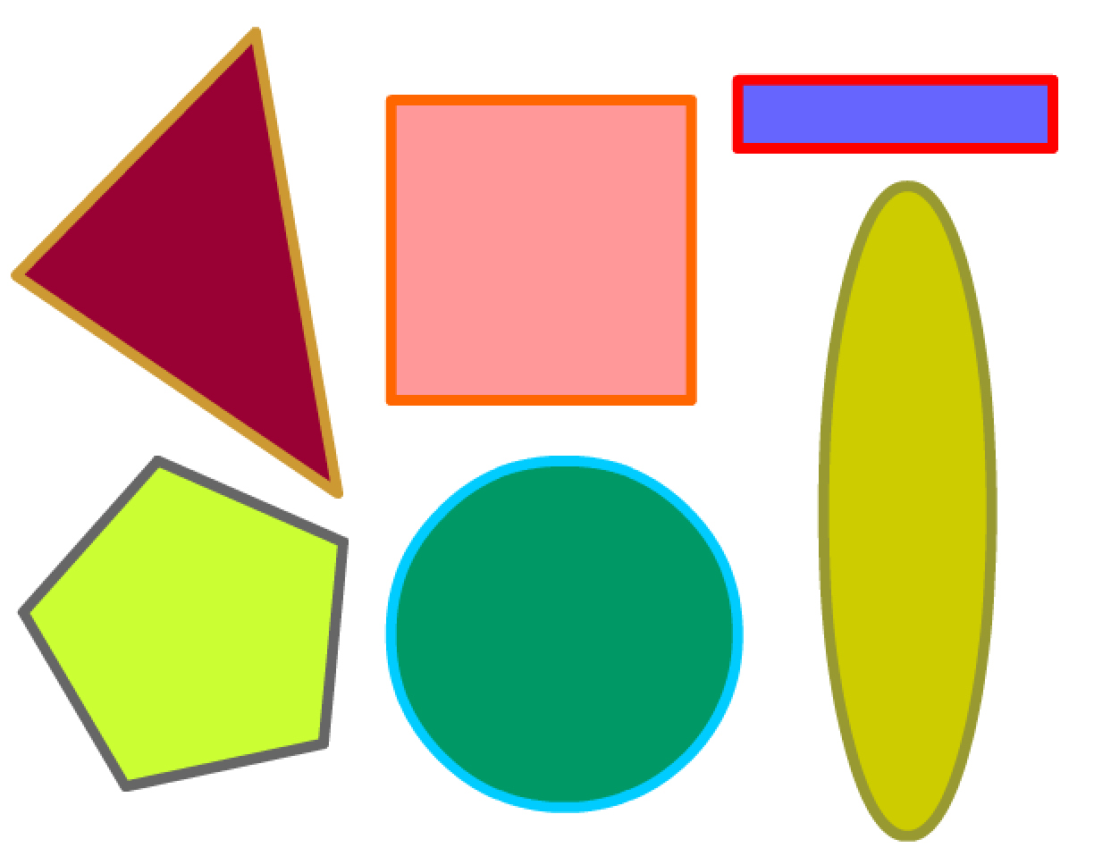
What are the common attributes of the following basic geometric shapes?

Slide 4
Review
public abstract class GeometricShape {
//Common attributes
private String strokeColor;
private String fillColor;
private int xPosition;
private int yPosition;

Slide 5
Describe common functionality of the following basic geometric shapes.

Slide 6
Review
public abstract class GeometricShape {
…
//Functionality
public abstract double getArea();
public abstract double getPerimeter();

Slide 7
Review
An abstract method cannot be
contained in a non-abstract class.
It is possible to define an abstract class that does not contain any abstract methods.

Slide 8
Review
Abstract classes define the common attributes of a general class.
You cannot create instances of abstract classes using the new operator.
----Error---
GeometricShape gs = new GeometricShape();

Slide 9
Review
A subclass can be abstract even if
its superclass is concrete.

Slide 10
Interface Class

Slide 11
What is an interface?
Interfaces are useful in Java in that they allow inheritance from one or more parent classes.
An interface looks much like a class.
An interface is a description of what a class does, but NOT how it is done.

Slide 12
interface methods and data members
An interface contains methods, all of which are implicitly public and abstract.
An interface contains data members, all of which are implicitly public, static, and final.
Interfaces, like abstract classes and methods, provide templates of behavior that other classes are expected to implement.

Slide 13
Using an interface
When creating a class that uses an interface, the keyword implements must be used.
When a class implements from an interface class, the child class must implement its own version of each method.

Slide 14
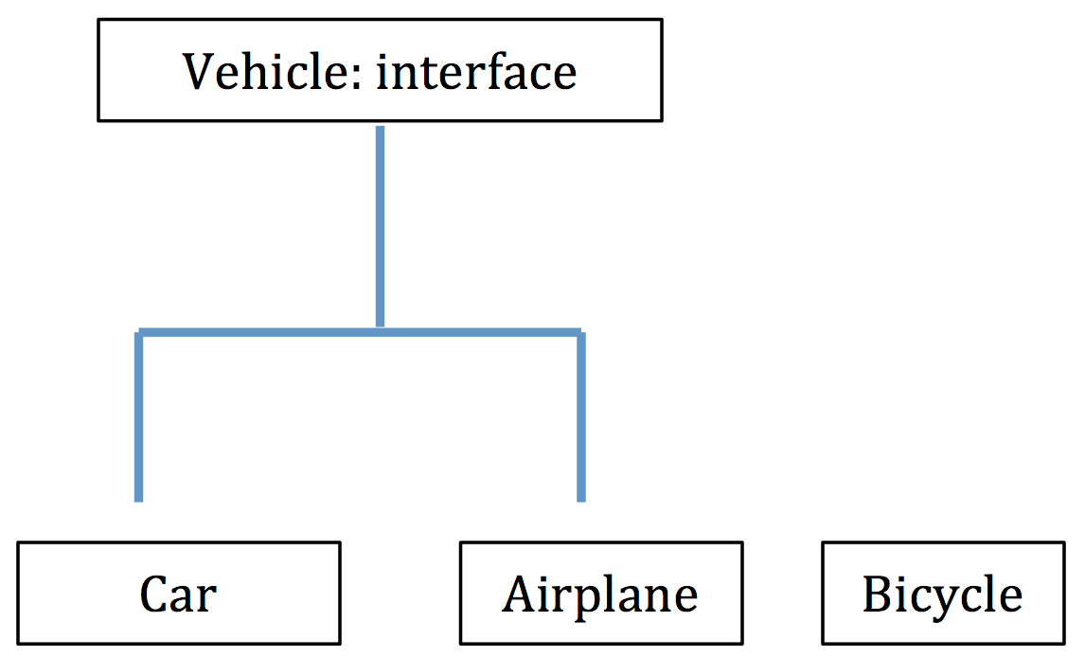
Interface Example
Assume that Vehicle is an interface.
Car and Airplane are both implemented as Vehicles.
Bicycle is not implemented as a Vehicle.

Slide 15
public interface Vehicle {
//DATA MEMBERS ARE IMPLICITLY PUBLIC AND FINAL
// -----------------------------------------------------------------------
int REVERSE = -1;
//METHODS ARE IMPLICITLY PUBLIC AND ABSTRACT
// -----------------------------------------------------------------------
String start();
String stop();
void changeSpeed(int newSpeed);
}

Slide 16
public class Car implements Vehicle{
private int speed;
public Car(){
speed = 0;
}
public int getSpeed(){
return speed;
}
// Vehicle INTERFACE METHODS MUST BE IMPLEMENTED
//__________________________________________________
public String start() {
return "Car is started and is in motion";
}
public String stop() {
return "Car has come to a halt.";
}
public void changeSpeed(int newSpeed) {
this.speed = newSpeed;
}
}

Slide 17
Question 2: What output is produced by the code below?
public class MyMain {
public static void main(String[] args) {
Car carA = new Car();
System.out.println(carA.start());
carA.changeSpeed(Vehicle.REVERSE);
System.out.println(carA.stop());
}
}

Slide 18
Answer 2
Car is started and is in motion
Car has come to a halt.

Slide 19
Question 3: Which of the following statements are invalid?
public static void main(String[] args) {
Vehicle myCar1 = new Car();
Car myCar2 = new Vehicle();
Car myCar3 = new Car();
}
}

Slide 20
Answer 3
Answer:
Car myCar2 = new Vehicle();
The declaration of myCar1 indicates that there is an 'is a ' relationship between the implementing classes and the interface.
The declaration of myCar3 is a Car instance.

Slide 21
Consider the Bicycle Class
public class Bicycle {
private int speed;
public Bicycle(){
speed = 0;
}
public int getSpeed(){
return speed;
}
public String start() {
return "Car is started and is in motion";
}
public String stop() {
return "Car has come to a halt.";
}
public void changeSpeed(int newSpeed) {
this.speed = newSpeed;
}
}
Bicycle is NOT implemented as a Vehicle.

Slide 22
Question 4: What output is produced by the code below?
public class MyMain {
public static void main(String[] args) {
boolean isVehicle;
Car carB = new Car();
isVehicle = carB instanceof Vehicle;
if (isVehicle)
System.out.println("carB is an instanceof Vehicle");
else
System.out.println("carB is not an instanceof Vehicle");
Bicycle bike = new Bicycle();
isVehicle = bike instanceof Vehicle;
if (isVehicle)
System.out.println("bike is an instanceof Vehicle");
else
System.out.println("bike is not an instanceof Vehicle");
}
}

Slide 23
Answer 4
carB is an instanceof Vehicle
bike is not an instanceof Vehicle
instanceOf indicates if there is an “is a” relationship between classes and the Vehicle interface.

Slide 24
What is the difference between a class and an interface?
A class can be instantiated.
An interface cannot be instantiated.
An interface contains a set of abstract methods for which a class provides the implementation.

