Slide 1
Class Inheritance
Concept of Inheritance
Java keywords
Practice extending a base class of a subclass

Slide 2
Inheritance
An important OOP mechanism.
Implies a parent child relationship.
Enables one class to acquire data attributes and functionality of another class.
Specifically, use inheritance to pass along setters, getters and other methods and data members of an existing class.

Slide 3

Example with John
John is a Loan Shark
He is often threatened with bodily harm.
He doesn’t have money to pay for a 24/7 bodyguard.
Decides to get a dog for protection.

Slide 4
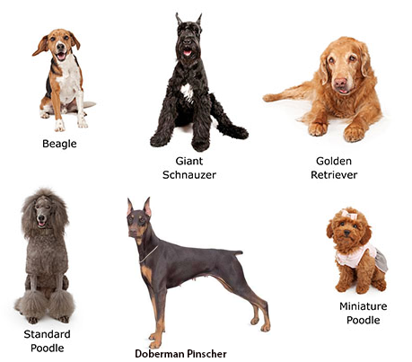
Dog Options for John

Slide 5

Why did John choose a
Doberman Pinscher?
Intelligent
Vigilant
Alert
Fearless
Aggressive
Loyal
Obedient

Slide 6
Real-world inheritance
          Attributes
          Traits
          Behaviors
… All passed down through a
lineage of generations

Slide 7
OOP inheritance
OOP provides a mechanism that
enables one class to acquire all
aspects of another class

Slide 8
Flexibility of Inheritance?
Programmers can create a subclass class by simply indicating the ways in which it differs from a super class that has already been developed and tested.

Slide 9
Inherited Traits
        Acquired
        or
        Overridden

Slide 10

Example
We expect to see shared traits in all Doberman Pinschers.
Individual Doberman Pinschers have different personal characteristics.
We dependably count on many inherited attributes and behaviors.

Slide 11
OOP Inheritance
We use inheritance to pass along functionality and attributes of an existing class.
We can use override to identify different traits and functionality.

Slide 12
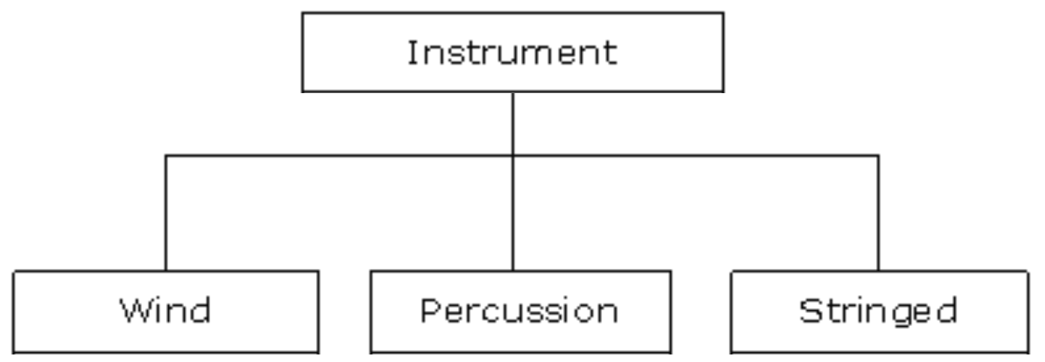
Inheritance Relationship
Instrument is a super class, a general class.
Wind, Percussion and Stringed are sub classes of Instrument. A sub class is-a specific type of super class.
  Example: Percussion is-a(n) Instrument.

Slide 13
What does a subclass inherit?
A sub class automatically inherits the data
fields and methods of the super class.

Slide 14
Subclass
A subclass can declare additional methods or change the implementation of inherited methods.
When you supply a new implementation for an inherited method, you automatically override the super class method.

Slide 15
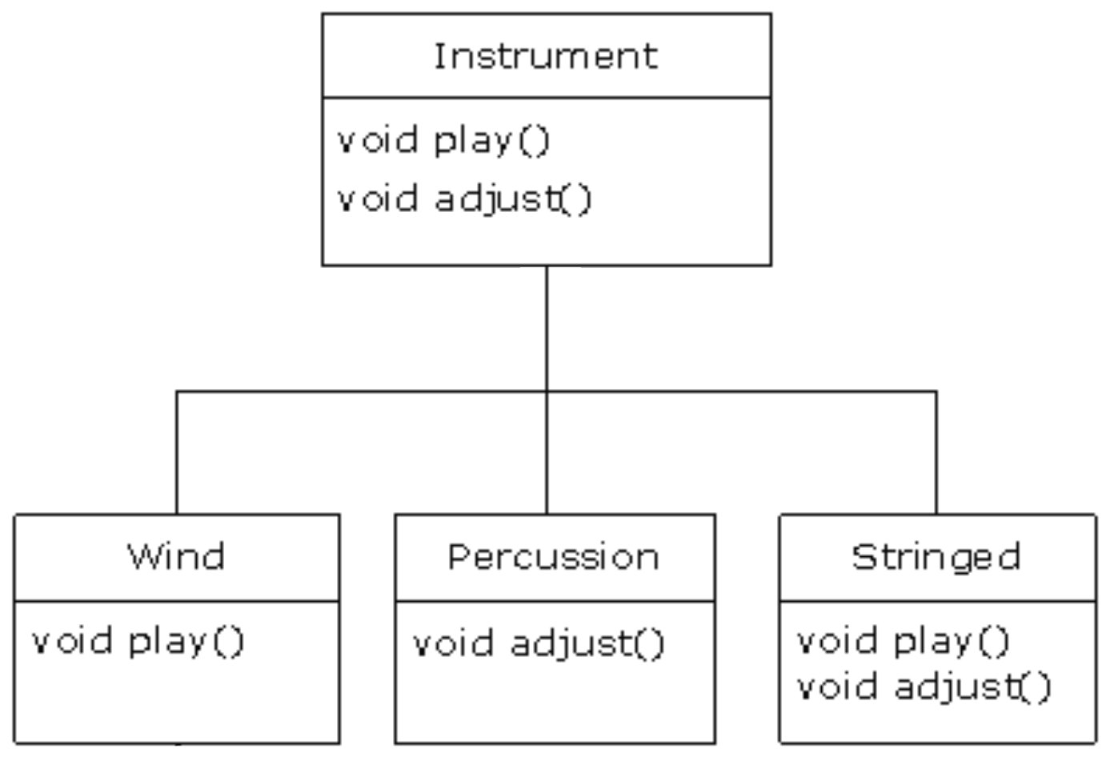
Polymorphism allows us to create a new implementation for an inherited method.
Example:
Instrument is the base class.
Wind has its own implementation of play().
Percussion has its own implementation of adjust().
Stringed has its own implementation of play() and adjust().

Slide 16
Java Keywords for Inheritance
extends
Use extends to create a subclass.
When a class B extends class A, B automatically inherits all variables and methods defined in class A.
super
Use super to access methods from the superclass (base class).
Used inside a subclass method to call a method defined in the superclass.
Only public methods can be called by the super keyword.
super is also used by class constructors to invoke constructors of its parent class.

Slide 17
Access Modifiers
There are 3 types of access modifiers:
private members are accessible only within a class.
protected members can be accessed only by the subclasses.
public members have the widest scope among all other modifiers. They are accessible everywhere.

Slide 18
Practice using the Quiz App
Two kinds of questions:
  Fill-in-blank (a generic question)
  Multiple Choice
  What is the base class (super class)?
  What is the sub class?

Slide 19
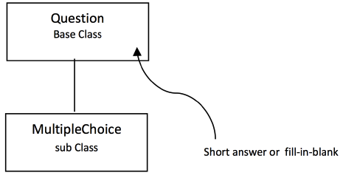
Question class and subclass

Slide 20
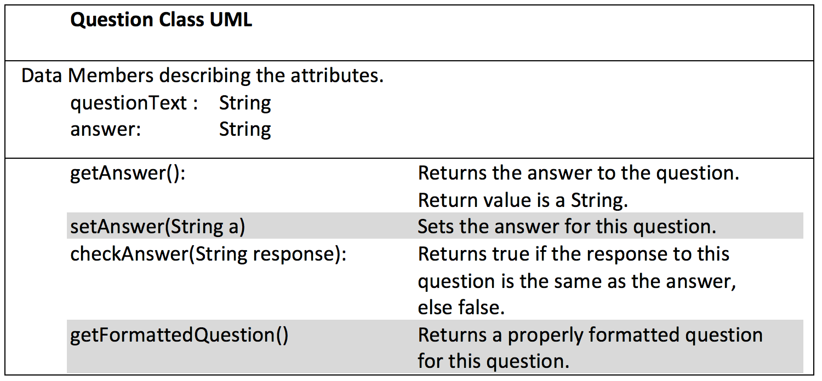

Slide 21

Multiple Choice Example 1
Question: What year was Java born?
      (a) 2004
      (b) 1995
      (c) 1991
      (d) 1989
  Answer: 1991
  NOTE: There are four choices.

Slide 22

Multiple Choice Example 2
Question: How many hamburgers per cow?
      (a) 4500
      (b) 25
      (c) 4
  NOTE: There are three choices.

Slide 23
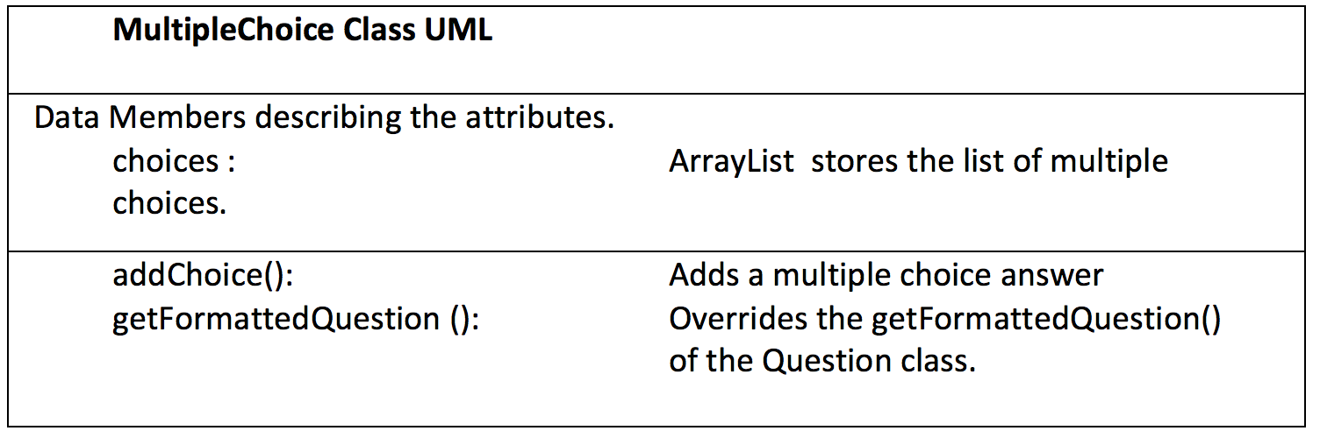

Slide 24
Quiz App classes
Question base class
MultipleChoice class extends Question
QuizEngine class
QuizMain class

Slide 25
public class Question {
// Data Members
private String question;
private String answer;
public Question(String q, String a) {
question = q;
answer = a;
}
// Setters and Getters
public String getAnswer() {
return answer;
}
public void setAnswer(String a) {
answer = a;
}
public String getQuestion() {
return question;
}
public void setQuestion(String q) {
question = q;
}
// Extra Functionality
public boolean checkAnswer(String response) {
return answer.toLowerCase().equals(response.toLowerCase());
}
}

Slide 26
public class QuizEngine {
private ArrayList<Question> questionList;
private int correctAnswers;
public QuizEngine() {
questionList = new ArrayList<Question>();
correctAnswers = 0;
}
public void addQuestion(Question q){
questionList.add(q);
}
public void shuffleQuestions(){
Collections.shuffle(questionList);
}
public void start(){
correctAnswers = 0;
Scanner in = new Scanner(System.in);
for (int i = 0; i < questionList.size(); i++){
System.out.println("Question " + (i+1)+ ": " + questionList.get(i).getQuestion());
System.out.print("Answer: ");
String response = in.nextLine();
if (questionList.get(i).checkAnswer(response)){
System.out.println("Correct");
correctAnswers++;
}
else{
System.out.println("Incorrect");
}
}
}
public void getResults(){
System.out.println("Score: " + (int)((double)correctAnswers/questionList.size()*100) + "%");
}
}

Slide 27
public class QuizMain {
public static void main(String[] args) {
// TASK 1: INSTANTIATE TWO QUESTIONS, ONE FOR EACH TYPE.
// TYPE: GENERIC QUESTION
Question q1 = new Question("Who invented Java?", "James Gosling");
// TYPE: MULTIPLE CHOICE QUESTION
MultipleChoice q2 = new MultipleChoice("Year was Java born?","");
q2.addChoice("1994", false);
q2.addChoice("1993", false);
q2.addChoice("1992", false);
q2.addChoice("1991", true);
// TASK 2: INSTANTIATE A QUIZ ENGINE AND POPULATE IT WITH QUESTIONS
QuizEngine quizEngine = new QuizEngine();
quizEngine.addQuestion(q1);
quizEngine.addQuestion(q2);
//TASK 3: SHUFFLE THE QUESTIONS AND START THE QUIZ
quizEngine.shuffleQuestions();
quizEngine.start();
quizEngine.getResults();
}
}

Slide 28
Further Practice
Use inheritance to add a True and False question to the Quiz App.
True and False questions are Multiple Choice questions, with a restriction of two choices.

